Slide 1
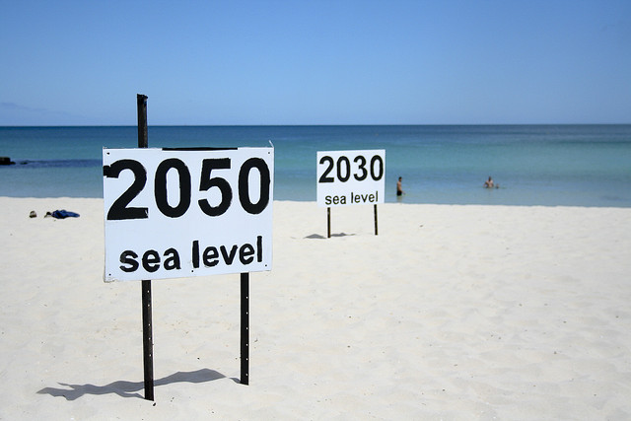
“Low-Regret” Adaptation Measures – Hard- and soft-coastal protection systems (Review)
1ST INTERN. WORKSHOP ON CLIMATE AND SOCIETAL CHANGE IN COASTAL AREAS IN INDONESIA AND SOUTH EAST ASIA
FEB. 19-22, 2014 – Jakarta, Rep. Indonesia
Prof. Torsten SCHLURMANN
Franzius-Institute for Hydraulic, Estuarine and Coastal Engineering Leibniz Universität Hannover
www.fi.uni-hannover.de
schlurmann@fi.uni-hannover.de
Cottosloe Beach, Perth, Australia
Session IV: Coastal Management and Low-Regret Adaptation Measures

Slide 2
Table of content
Background and motivation
Rationale of “low-regret” adaptation strategies and measures
Hard-coastal protection systems: Typical examples and their evaluation
Perspectives on “low-regret” adaptation strategies
Principle “Working with Nature”
Summary and discussion

Slide 3
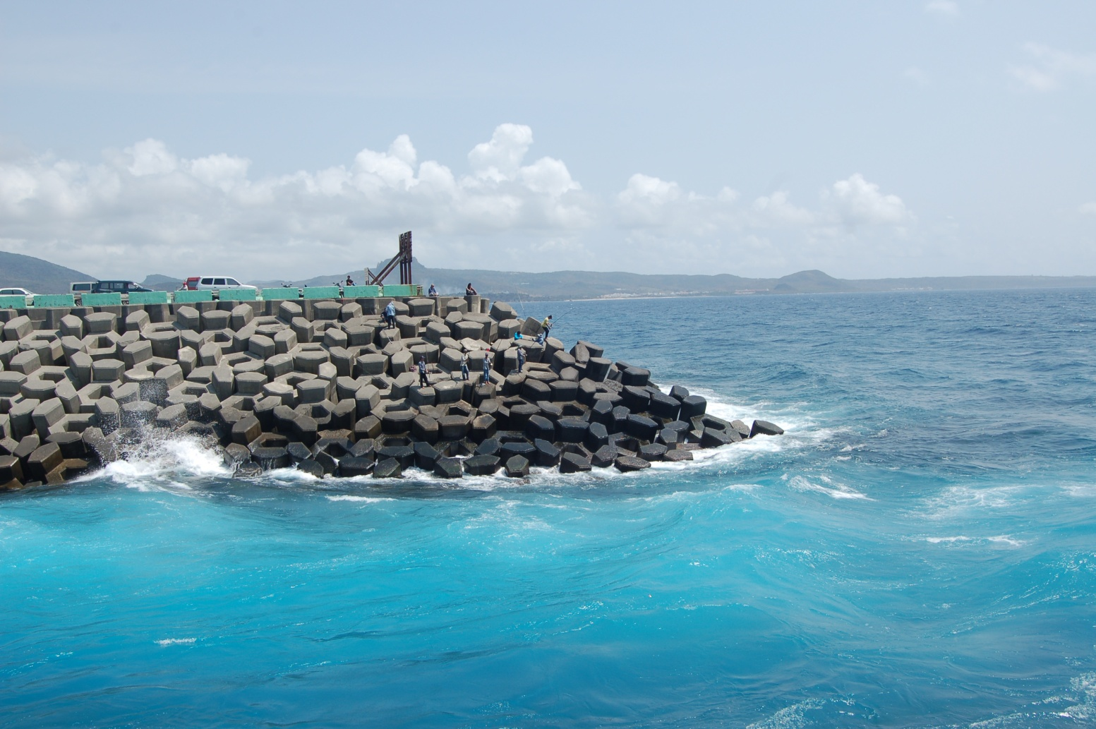
Background and motivation,
Rationale of “low-regret” adaptation
Breakwater Kenting, Taiwan, ROC
Taipower nuclear facility
© Schlurmann, 2010

Slide 4
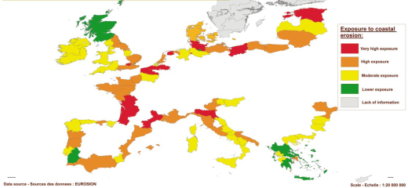
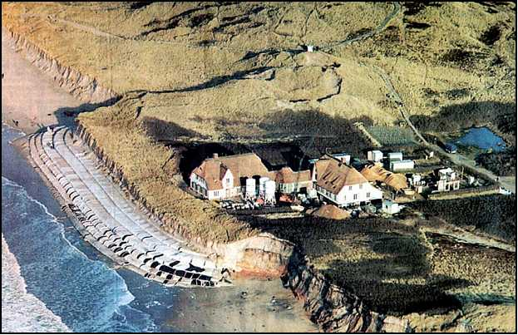
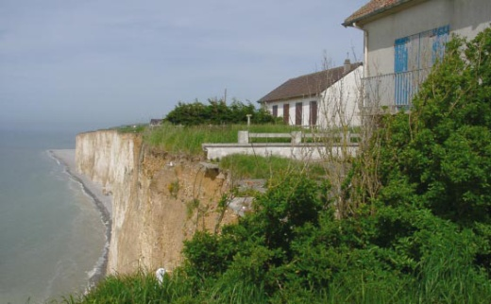
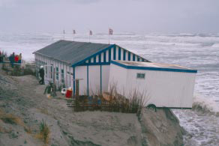
Background and motivation
More than 70 % of sandy coastlines worldwide in recession (Eurosion, 2004). Climate change will increase this general observation!
More than 20 % of European coasts are actively retreating (Eurosion, 2004) In Europe more than 70 million people with an economic asset of approx. 1,000 billion Euro live within 500 m from the coastline
Coastal ecosystems generate almost 40% of the services of all ecosystems of our planet (Costanza et al., 1997)
AR4 (IPCC, 2007) estimate the cost of coastal erosion in Europe will average to about 5.4 billion Euro per year
SREX (2011) promotes to establish diverse portfolio of options, e.g. “low regrets” adaptation measures to prepare for adverse environment impacts from future climates

Slide 5
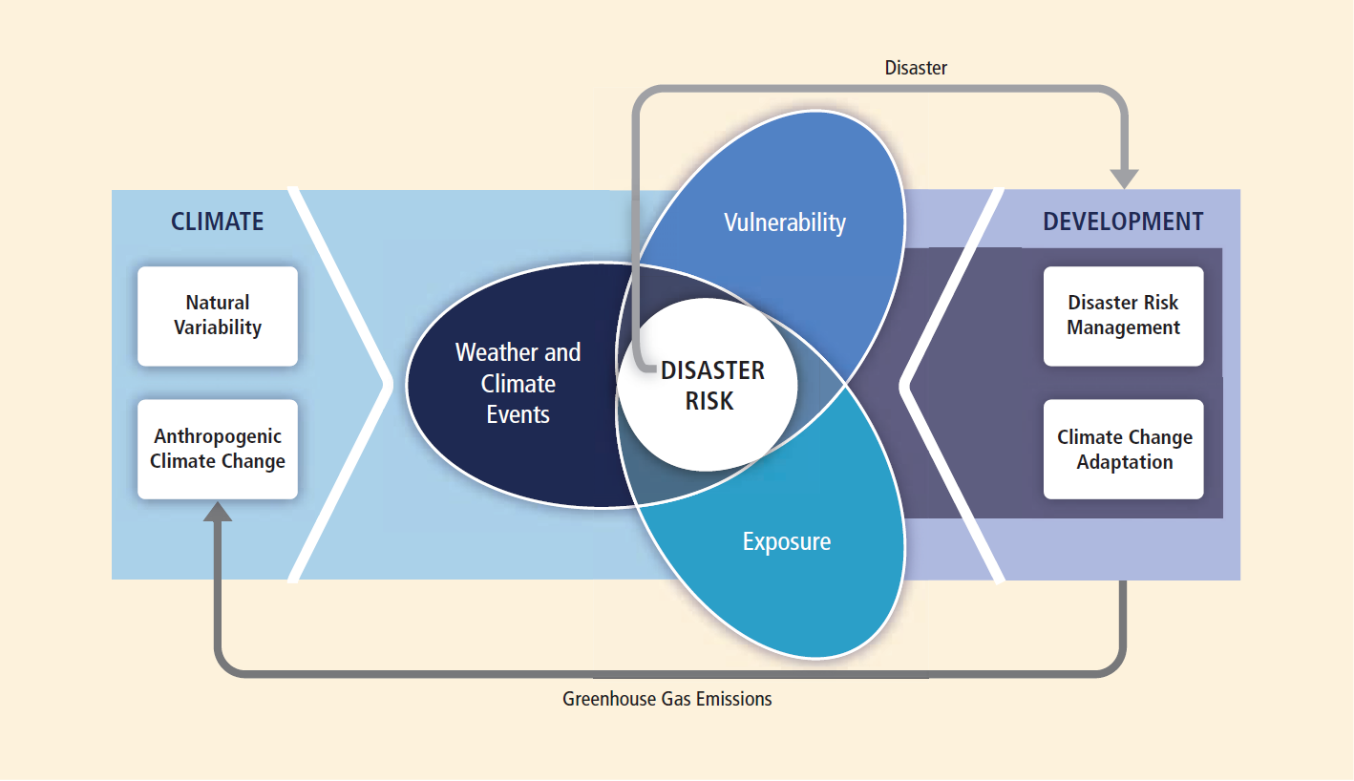
Background and motivation
Core methodological concept of SREX and possible transfer to Workshop
Source: Managing the Risks of Extreme Events and Disasters to Advance Climate Change Adaptation
(SREX, 2011)
Notes:
Ansiedelung des FIs im Bereich Climate Change Adaption

Slide 6
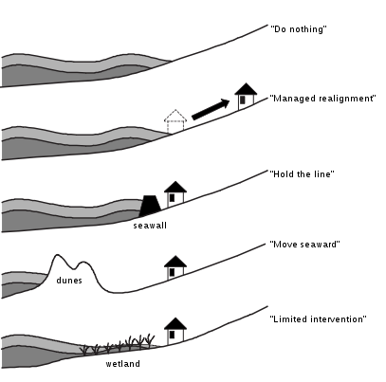
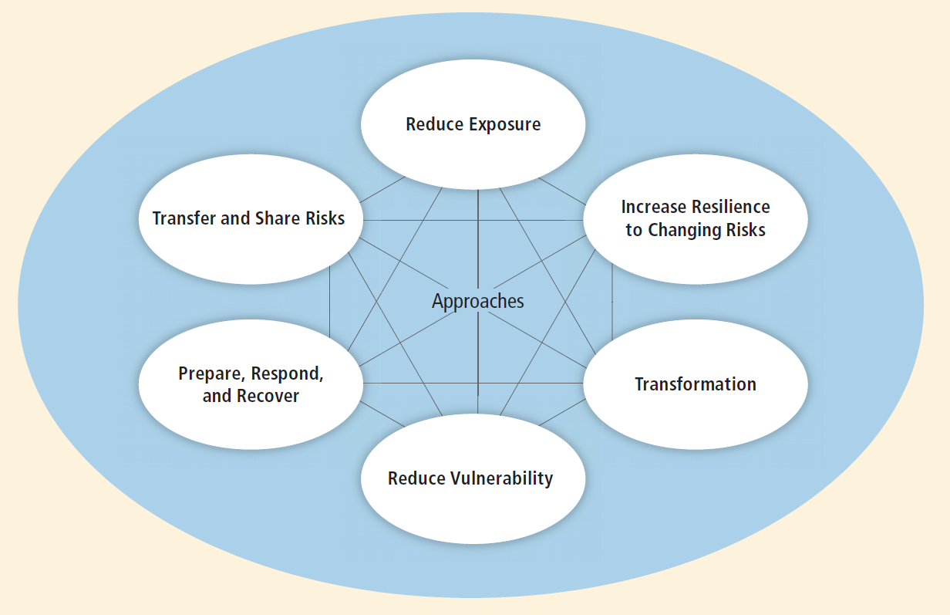
Background and motivation
Adaptation and Disaster Risk Management Approaches – SREX
versus
Generic Policy Options in Coastal Management
Source: Managing the Risks of Extreme Events and Disasters to Advance Climate Change Adaptation
(SREX, 2011)
Source: Probst, 2004
Notes:
Beschäftigung mit den Bereichen Reduzierung des Gefahrenpotentials und der Verwundbarkeit
Gestrichelt: Bereich „recover“ z.B. Wiederherstellung von Mangrovenwäldern

Slide 7
Rationale of “low-regret” adaptation strategies and measures
Coasts and estuaries are increasingly exposed to varying extreme weather and climate events
Likely impacts from gradual processes, i.e. sea-level rise, coastal erosion, etc., and likewise from extreme single events, i.e. storms and storm surges, etc. in particular in Rep. Indonesia with 250 Mn. inhabitants, 17.500 Islands and 35.000 km coastline, while tentatively affecting
Changing storms and storm surge regimes (altered severity and/or frequency)
Temperature increases and (local) precipitation changes
Changes in runoff and sediment transport from inland and near coast
Increased salinization (groundwater and soil)
But, cause-effect relationships between processes or likeliness of cascading effects are not yet effectively considered in costal adaptation frameworks
And, lack of means and concepts to combine variables and integrating sectoral models over different spatio- and temporal scales and processes within an integrated coastal risk analysis and adaptation framework

Slide 8
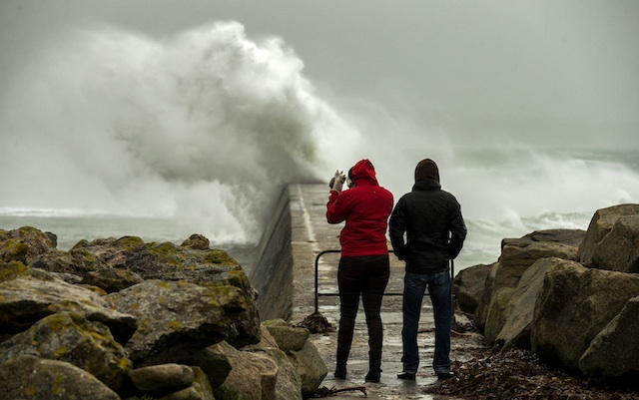
Hard-coastal protection systems: Typical examples and their evaluation
West Brittany, France
23 December 2013
© EPA/Ian Langsdon

Slide 9
Hard-coastal protection systems: Typical examples and their evaluation (1)
Traditional engineering-type hard-coastal protection systems encompass approaches to protect coastal areas from coastal hazards, e.g.
In coastal waters (shallow water environments)
On the shoreline
On Site
Source: UWAS, 2013

Slide 10
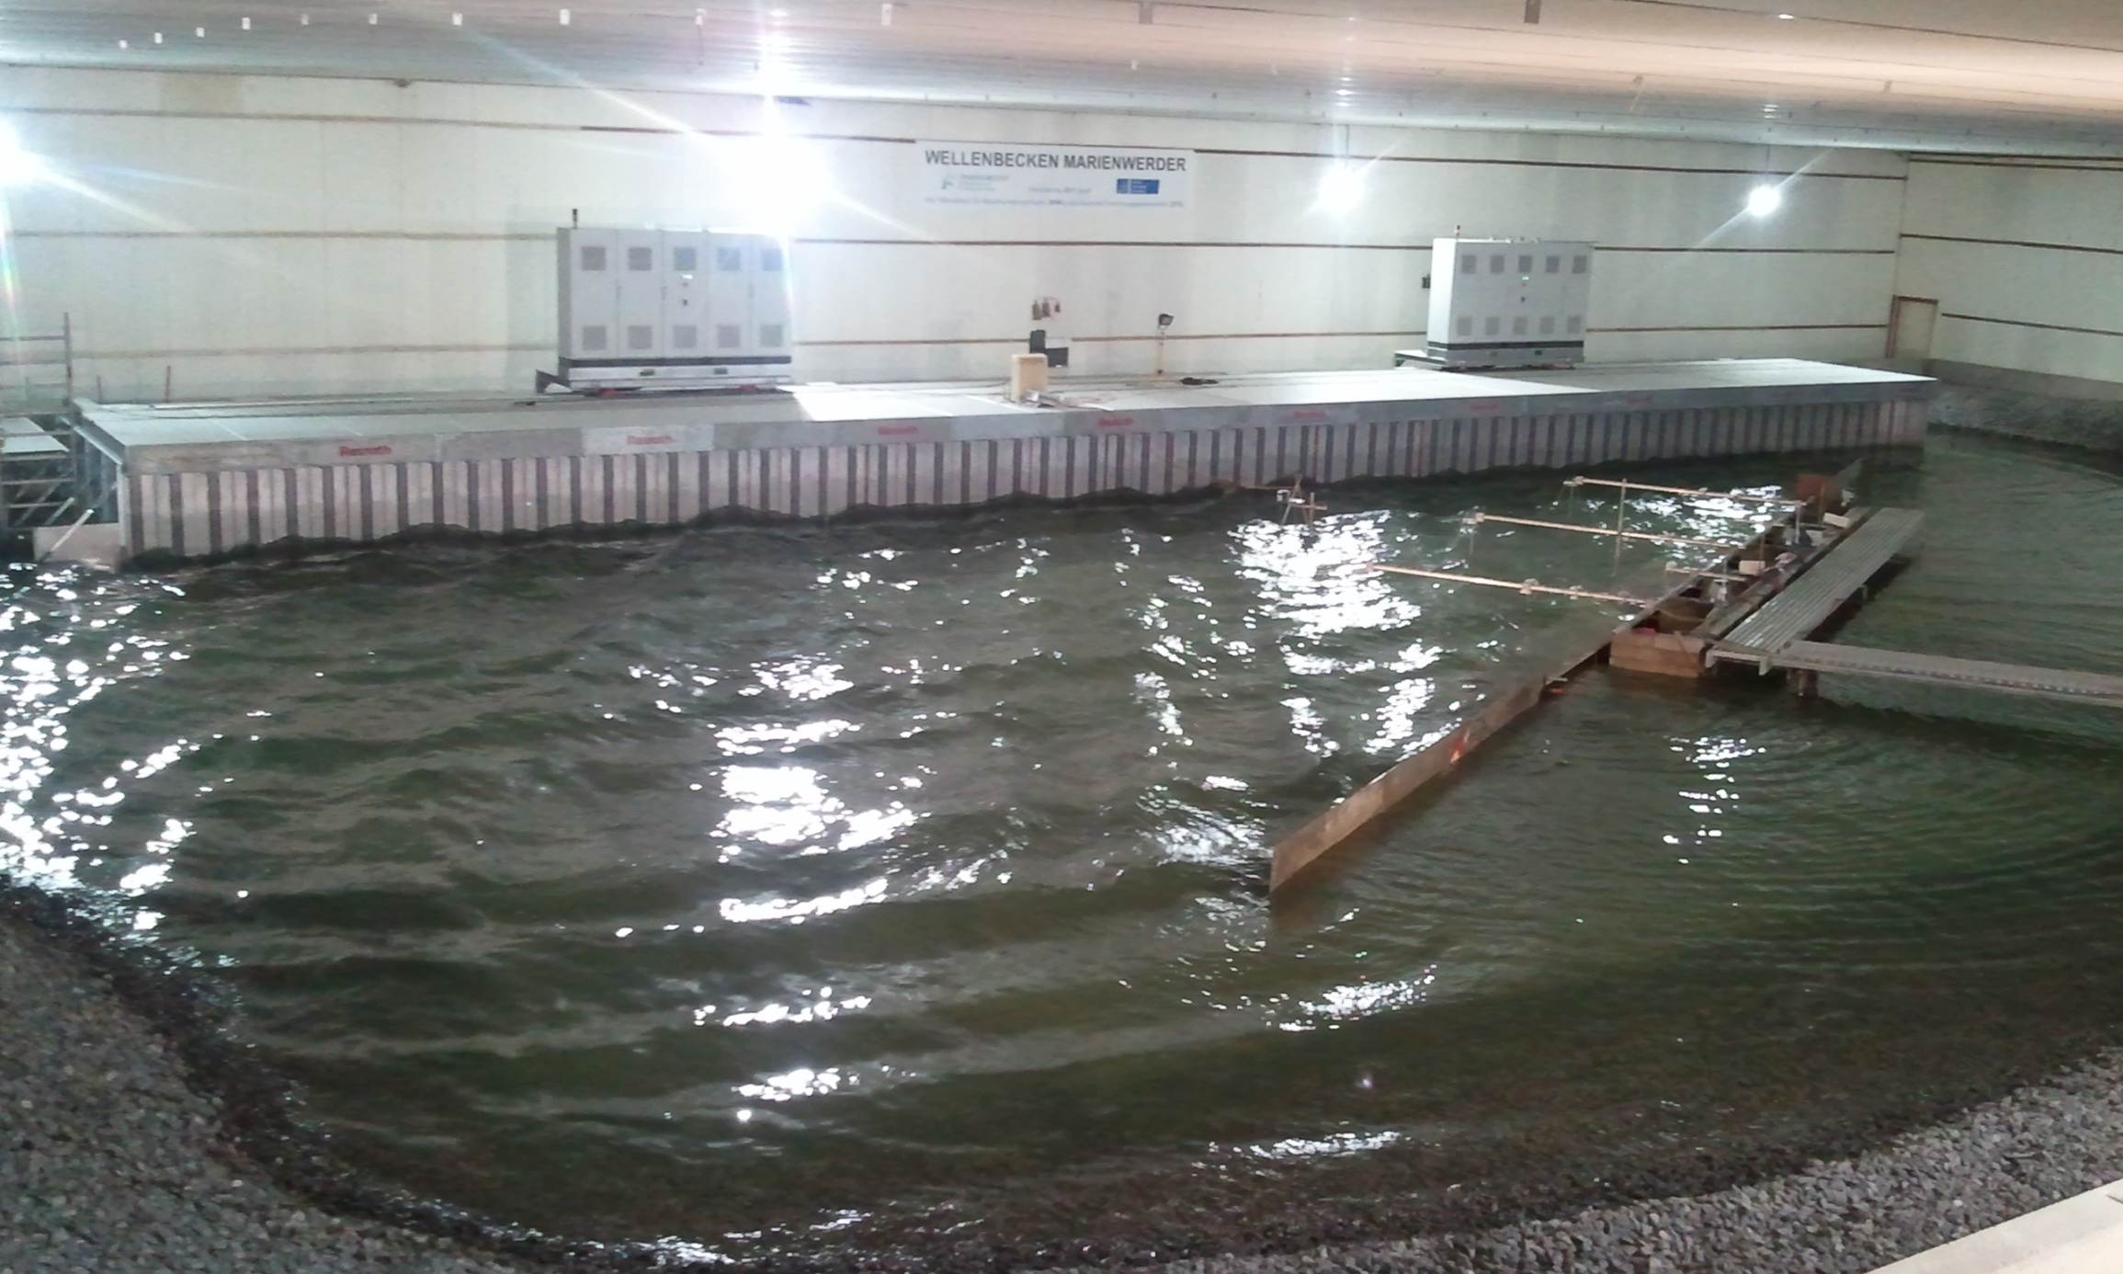
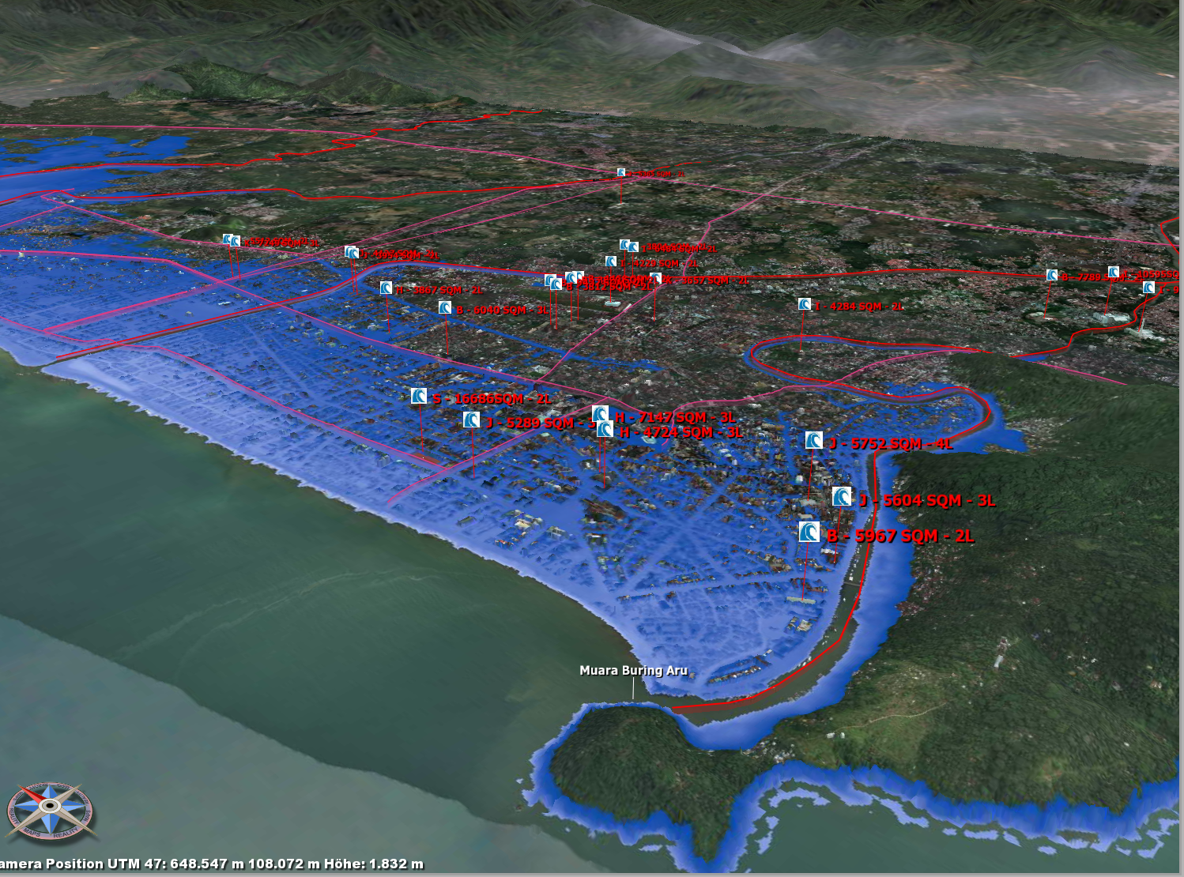
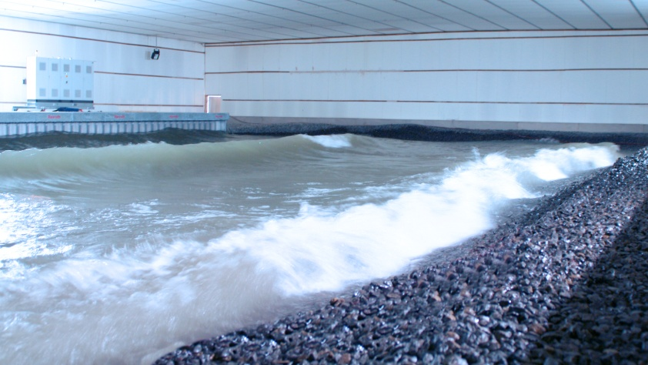
Hard-coastal protection systems: Typical examples and their evaluation (2)
Traditional engineering-type hard-coastal protection systems encompass approaches to protect coastal areas from coastal hazards and are typically pre-studied in physical and hydronumerical models to analyse prototype designs
Kerpen & Schlurmann, 2013
Kongko & Schlurmann, 2010

Slide 11
Hard-coastal protection systems: Typical examples and their evaluation (3)
Engineering-type hard-coastal protection systems encompass traditional approaches to protect coastal areas from coastal hazards, e.g.
Each is site-specific, proves system-relevance and addresses a certain degree of implementation necessity. Typical hard-coastal protection systems can moreover be described and evaluated regarding following aspects:
Coastal hazards addressed (i.e. effectiveness, reliability)?
Applicability and durability?
Financial burdens in dimensions of construction, maintenance?
Ecological side-effects and (ir)reversible impacts?
Co-benefits and level of public acceptance?
But, how are typical “soft-coastal” protection systems designed?
Are these constructional attempts of “low- or even of no-regret”, yet?
And if so, how could these novel measures be designed and assessed/monitored in regard of the above listed common queries?

Slide 12
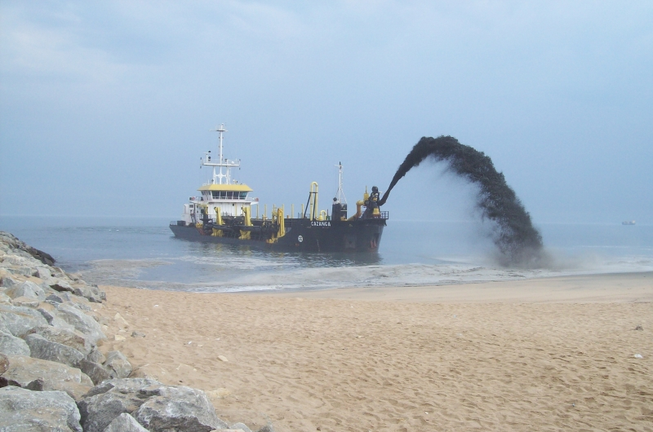
Perspectives on “low-regret” adaptation strategies
Lobito Beach, Angola
© DRAIMAR

Slide 13
Perspectives on “low-regret” adaptation strategies (1)
(Historically) Coastal adaptation strategies to hazards have been relatively well developed building on the disciplines of Coastal Engineering and Economics (Nicholls et al, 2007) ⇨ But too often “large-regrets”
Yet, engineering approaches and ecosystem preservation are in opposition as coastal habitats are destroyed, coastal erosion elsewhere aggravated or natural migration of shores is prevented
Recently, increased attention being paid to managing the risks of extreme events (e.g. SREX, 2011) by combining DRR with CCA
“Engineered” coastal adaptation strategies gradually supplemented by soft-protection measures, e.g. beach or foreshore nourishments, revised land management as well as flood insurance programmes (Cheong, 2011)
Yet, tendency observed that ecosystem protection and restoration are increasingly recognized as legitimate novel coastal protection systems to provide or even enhance function and structure of ecosystems services
Even non-classic policy solutions such as coastal setback lines, managed realignments, building codes and coastal zoning have emerged as possible forces to combat coastal hazards linked with climate change (Cheong, 2011)

Slide 14
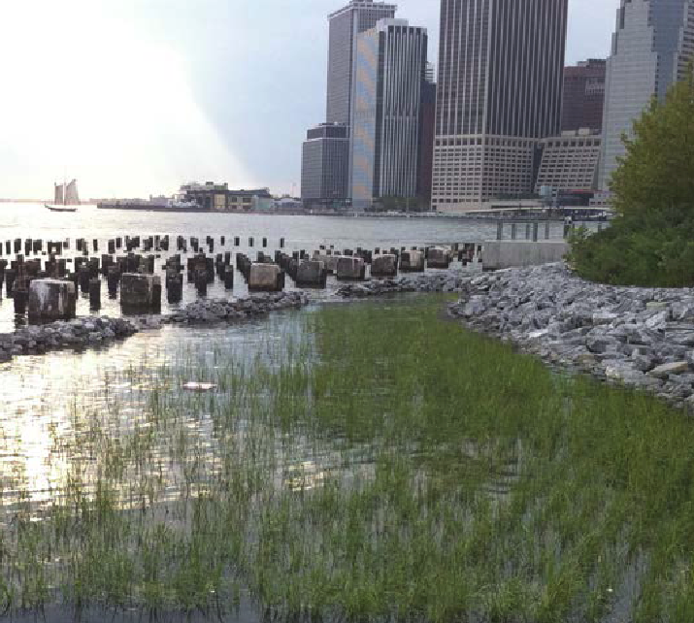
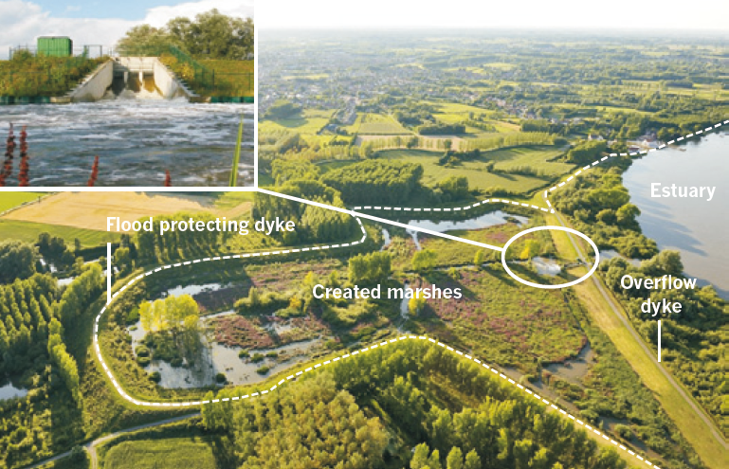
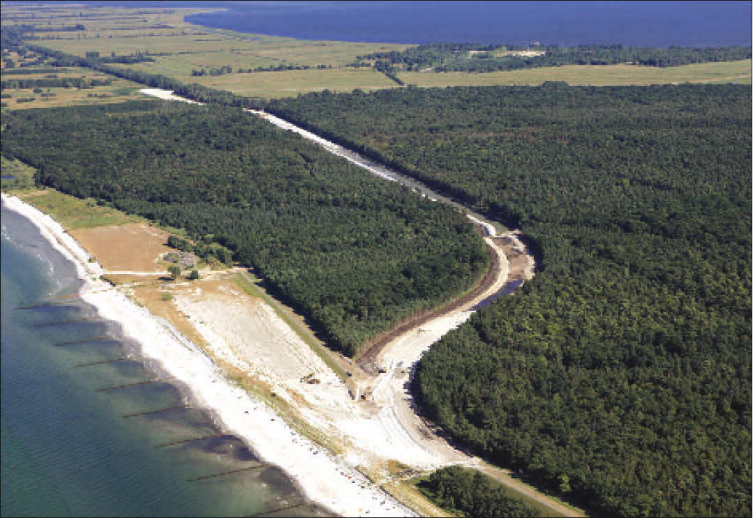
Perspectives on “low-regret” adaptation strategies (2)
Ecological
urban waterfront
development
Mega-Nourishment
Ecosystem-based flood defence
Scheldt estuary, Belgium,
Restoration of wetlands (managed realignment)
Brooklyn Bridge Park (UWAS, 2013)
taken from Temmermann et al., 2013
Island Darß, Baltic Sea Coast (StäLU, 2009)

Slide 15
Perspectives on “low-regret” adaptation strategies (3)
Effective coastal adaptation measures shift towards dynamic response to multiple stressors, which are often regarded as single, static systems!
“No- or low-regret” options generate net social benefits with no or low regrets irrespective of the future outcomes of climatic changes (Worldbank, 2012)
Thus, practical measures call for robust, resilient and cost-effective approaches to prepare coastal authorities for uncertain coastal environment in the future. >> Better than “regret-risking” options << (Cheong et al., 2013)
Coastal adaptation measures and practices, especially in the dimension of “low-regret” approaches, facing single or combinations of strategies mostly remain uncertain in its effectiveness in dynamic coastal environments
Yet, general principles and technical “low-regret” measures exist and key benefits are believed to be proved (i.e. myth of mangrove forests), but only few have been examined comprehensively in regard of efficiency, reliability, durability or ecological side-effects. Lack of long-term pilot studies.
Prior to any development of any principle or methodological approach on “low-regret” adaptation strategies, however, complementarities and compatibilities muss be assessed!

Slide 16
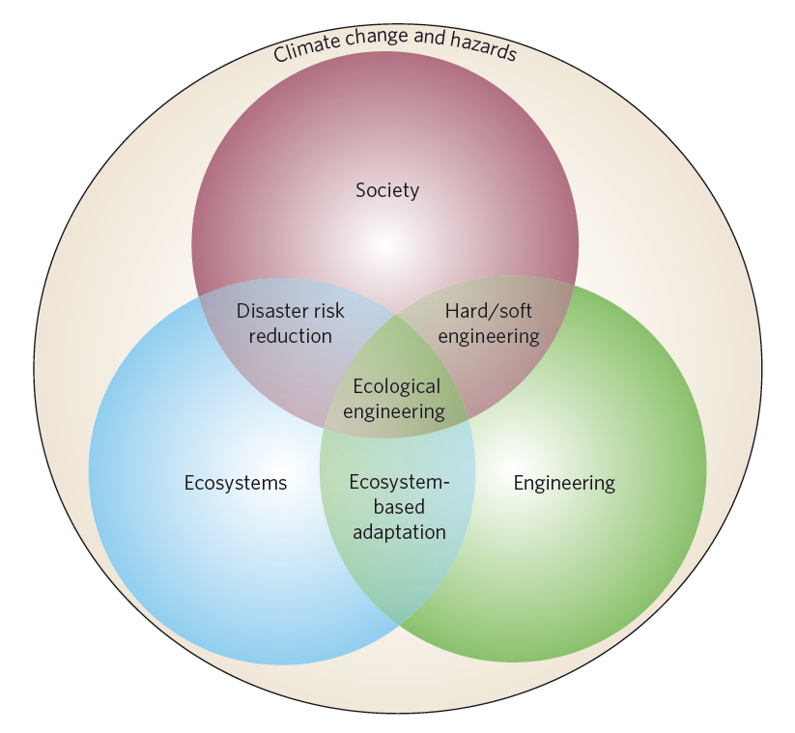
Perspectives on “low-regret” adaptation strategies (4)
Combining strategies for coastal adaptation describing the interactions of society, ecosystems and engineering in response to changing climate and coastal hazards, and delineates the overlapping areas that provide opportunities for combined adaptation strategies.
But is the principle of Ecological Engineering a candidate for “low-regret” adaptation measures or strategies?
Source: Coastal adaptation with ecological engineering
(Cheong et al., 2013)

Slide 17
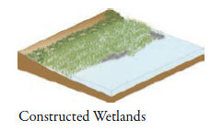
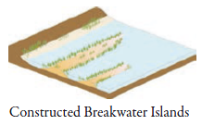
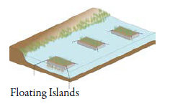
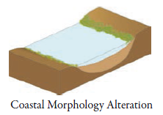
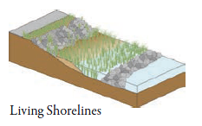
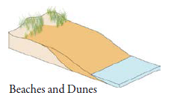
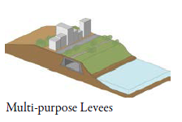
Perspectives on “low-regret” adaptation strategies (5)
Novel engineering-type soft-coastal protection systems encompass innovative approaches to protect coastal areas from coastal hazards, e.g.
In coastal waters (shallow water environments)
On the shoreline
Upland
Source: UWAS, 2013

Slide 18
Perspectives on “low-regret” adaptation strategies (5)
„Low-regret“ measures could also follow the Ecosystem Approach to Management (EEA, 1999) approach following a paradigm shift
“Working with Nature”
covering a transitional process from building in towards building with nature in correlation with findings from Millennium Ecosystem Assessment (2005) considering society as integral part of the ecosystem
PIANC, 2011, promotes the co-called WwN as a proactive, integrated philosophy by means of:
Achieving project objectives in an ecosystem context rather than assessing the detrimental consequences of a predefined project design
Identifying win-win solutions rather than simply minimizing environmental deteriorations or ecological irreversible damages
Three examples in the following:
Beach and foreshore nourishment (Germany, Netherlands)
Bamboo breakwaters (Vietnam)
Sustainment/Reforestation of Mangroves (various countries)

Slide 19
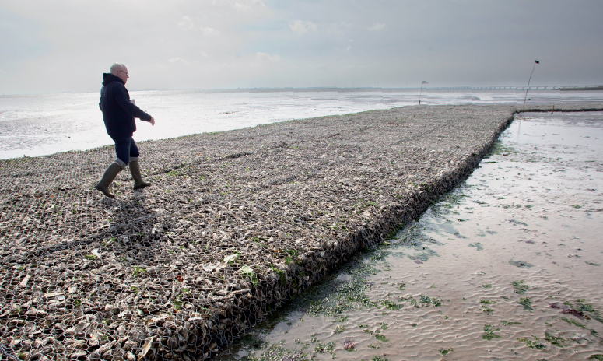
Principle „Working with Nature“
Oyster reef in the Eastern Scheldt estuary (The Netherlands) dissipate wave energy and trap sediment
© Ecoshape, 2014

Slide 20
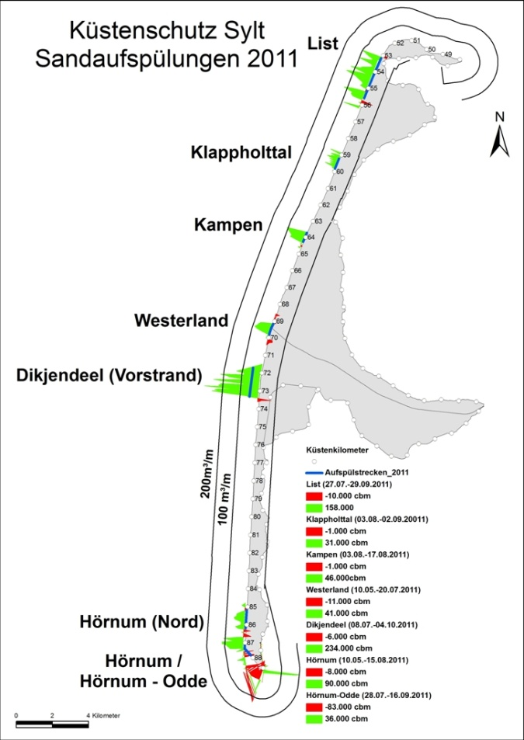
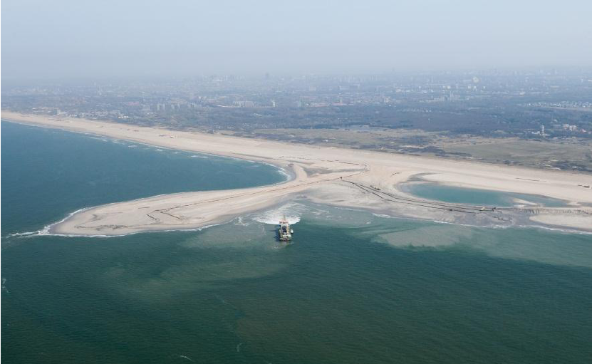
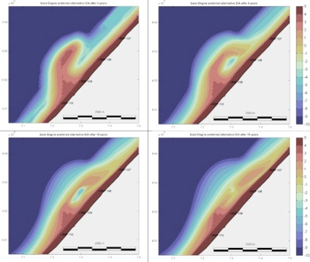
Principle „Working with Nature“
Beach and foreshore nourishments to artificially sustain coastal environments and enable soft (i.e. low-regret) measures for coastal protection
Pilot project to test the efficiency of local mega-nourishments as a counter measure for an anticipated enhanced coastal recession (Stive et al., 2013)
„Sand Engine“ (~21,5 Mio. m³)
in the Netherlands

Slide 21
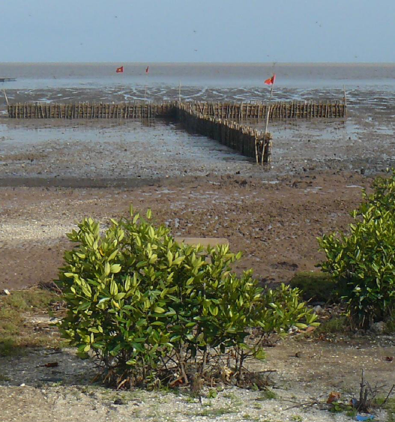
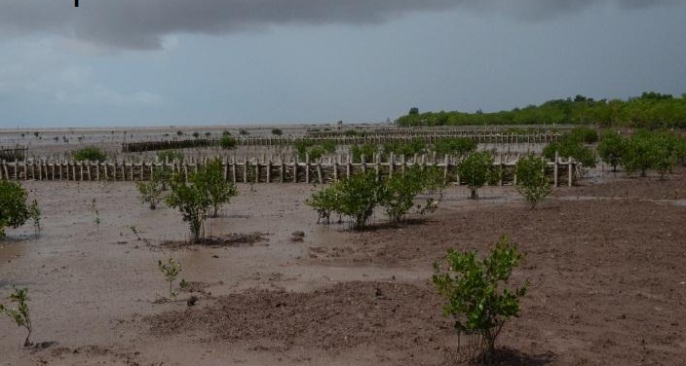
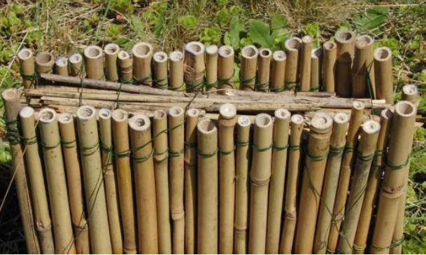
Principle „Working with Nature“
Bamboo Breakwaters as coastal stabilzation measure (sediment accretion) by means of installation and maintenance of innovative, ecologically-friendly materials (bamboo) with participatory involvement of local communities
Soc Trang Province, Vietnam (GIZ, 2012)
(Schmitt et al, 2013)

Slide 22
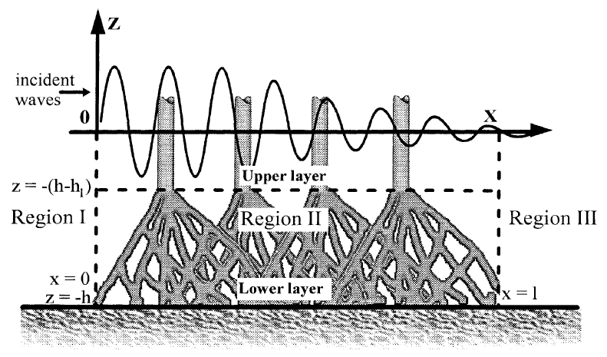
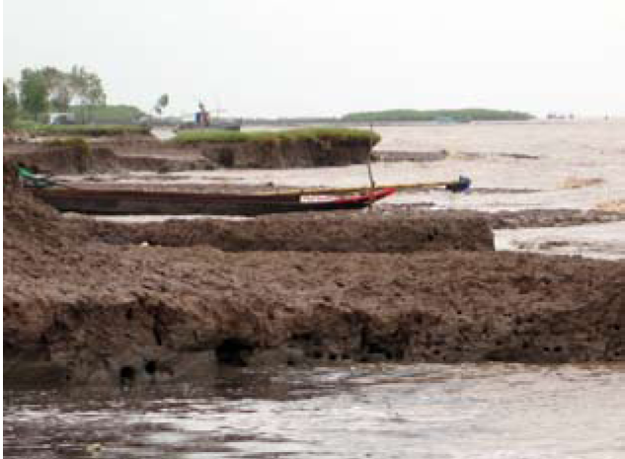
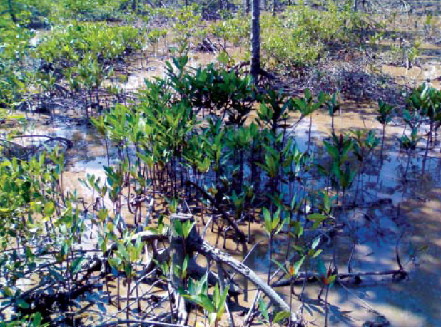
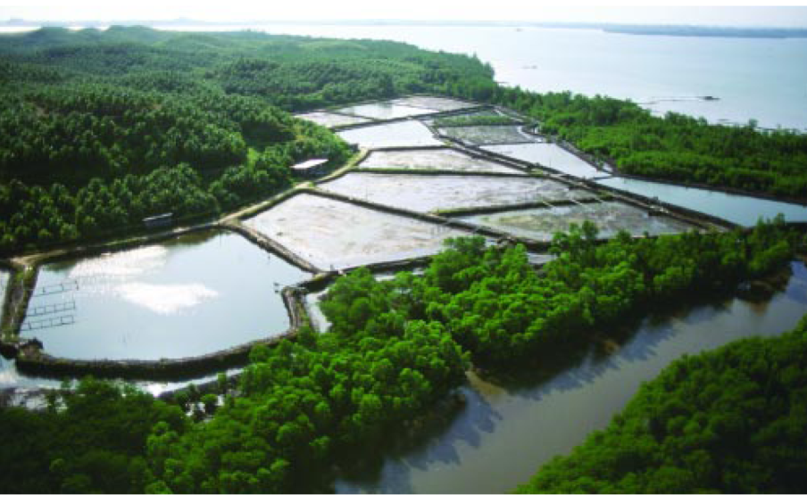
Principle „Working with Nature“
Sustainment and reforestatation of mangrove belts (green belts) to allow multi-functional services to coastal environments, i.e. protection, buffering, filtering and breading places
Source: GIZ, 2011
Coastal erosion due to lack of mangroves
Newly planted mangroves
Intact magroves forest
Source: Valiela, 2001

Slide 23
Summary and discussion
“Low-regret” adaptation measures are needed and are feasible in technological and ecological dimensions
Overarching principle is to (scientifically) assess complementarities and compatibilities
Need for definition of clear design and evaluation criteria, monitoring and inspection guidelines and share experiences on how technical “low-regret” measures are effective and by what means demanded key benefits are proved
Strengthened efforts must be undertaken and can be achieved by means of
transdisciplinary coastal research
education of students, and,
training of operational capacities/authorities
Participatory involvement of local communities
to establish sustainable, multi-functional and adaptive coastal protection solutions to infrastructural problems in environmentally sensitive areas and to endorse favorable side-effects in ecological dimensions, especially in regard of coastal habitats

Slide 24
References:
Atkins et al. (2011a): Management of the marine environment: Integrating ecosystem services and societal benefits with the DPSIR framework in a systems approach. Marine Pollution Bulletin, Vol. 62, pp. 215–226
Cheong, S.-M., Silliman, B., Wong, P.P., Van Wesenbeeck, B., Kim, C.-K., Guannel, G. (2013). Coastal adaptation with ecological engineering, Nature Climate Change, 3 (9), pp. 787-791
EEA (1999): Environmental Indicators: Typology and Overview. (Unpublished) Technical Report, No. 25. EEA, Copenhagen
EUROSION (2004). Living with coastal erosion in Europe: Sediment and Space for Sustainability, PART I - Major findings and Policy Recommendations of the EUROSION project. pp. 57
EcoShape (2012). Building with Nature philosophy (www.ecoshape.nl)
Hanson, H.; Brampton, A.; Capobianco, M.; Dette, H.H.; Hamm, L.; Laustrup, C.; Lechuga, A.; Spanhoff, R. (2002). Beach nourishment projects, practices, and objectives - A European overview. Coastal Engineering, 47 (2), pp. 81-111
Kerpen, N. and T. Schlurmann (2013). Scattering of the Mean Overtopping Discharge along a Crest at Dykes with Topped Vertical Wall, Proceedings of Coast, Marine Structures and Breakwaters Conference, ICE (in press)
Kongko, W., & Schlurmann, T. (2011). The Java Tsunami Model: Using highly-resolved data to model the past event and to estimate the future hazard. Coastal Engineering Proceedings, 1(32
IPCC (2012). Managing the Risks of Extreme Events and Disasters to Advance Climate Change Adaptation (SREX). A Special Report of Working Groups I and II of the Intergovernmental Panel on Climate Change (IPCC)
Stive, M. et al. (2013). A new alternative to saving our beaches from sea-level rise: The sand engine. Journal of Coastal Research, 29 (5), pp. 1001-1008
Schmitt, K. et al. (2013). Erosion protection through bamboo breakwaters: climate change adaptation in the Mekong Delta. Proc. Mekong Environmental Symposium, 5 – 7 March 2013, Ho Chi Minh City, Vietnam
Van Slobbe, E., de Vriend, H.J., Aarninkhof, S., Lulofs, K., de Vries, M., Dircke, P. (2013). Building with Nature: In search of resilient storm surge protection strategies, Natural Hazards, 65 (1), pp. 947-966
Förderkennzeichen: 01DP13005
www.ehs.unu.edu/article/read/twin-sea-1

Slide 25
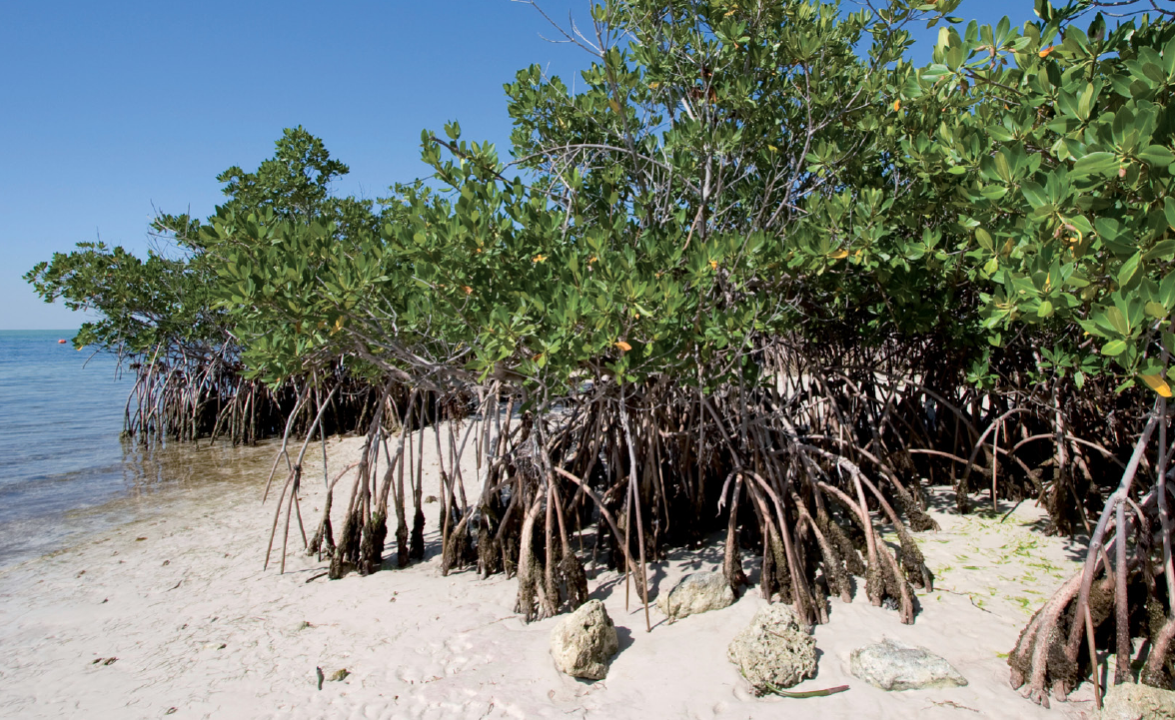
Thank you for your kind attention!
© Ecoshape, 2014
1ST INTERN. WORKSHOP ON CLIMATE AND SOCIETAL CHANGE IN COASTAL AREAS IN INDONESIA AND SOUTH EAST ASIA
FEB. 19-22, 2014 – Jakarta, Rep. Indonesia
Prof. Torsten Schlurmann
Franzius-Institute for Hydraulic, Estuarine and Coastal Engineering Leibniz Universität Hannover
schlurmann@fi.uni-hannover.de

