Slide 1
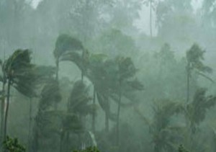
Dynamic Vulnerability Assessment and Adaptation Option (KRAPI) Experience from Tarakan, South Sumatra and Malang Raya

Slide 2
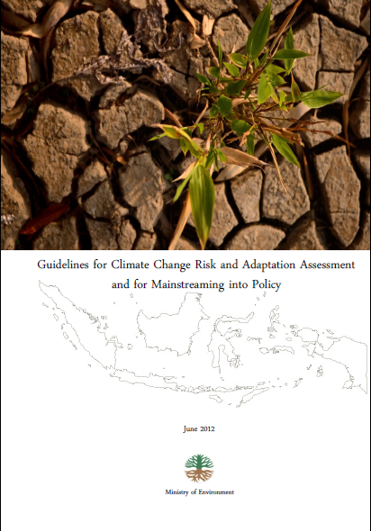
Background
Development Cooperation between GIZ, AusAID and Ministry of Environment on climate change and variability.
Learning from Lombok VA exercise, Guideline in Tarakan Island, South Sumatra Province and Malang Raya Region.
KRAPI was developed by Tilman Hertz, Djoko Santoso and Wilmar Salim. In 2012

Slide 3
KRAPI Objective:
To help provincial and district government in identify and assess the risk from climate change and variability in their area.
KRAPI develop a set of coherent approach and methods to examining risk and adaptation options, using meso level multi sector analysis.
This method consist of two parts: climate risk assessment and mainstreaming it into policy making.
KRAPI Approach:

Slide 4
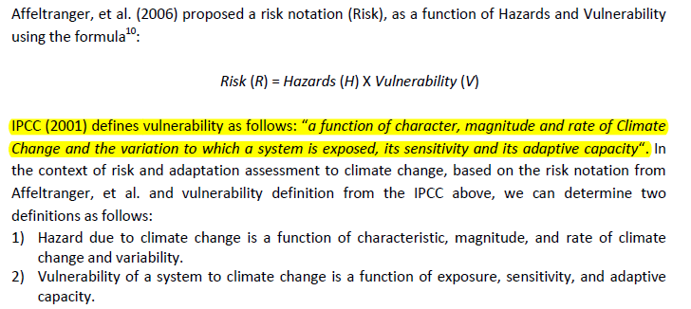
Risk, Hazard and Vulnerability Concept

Slide 5
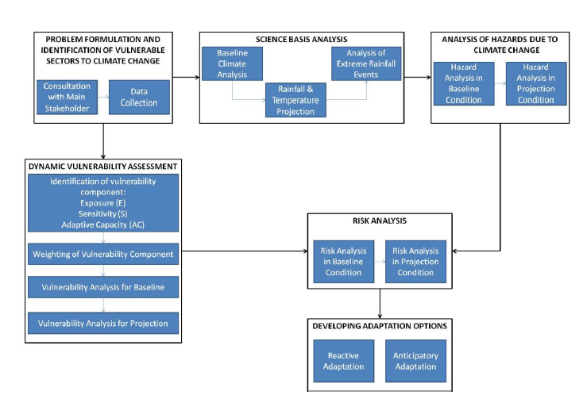
KRAPI Method
KLH - GIZ – AusAID 2012

Slide 6
Step 1. Problem formulation and identification of vulnerable sectors to climate change and variability.

Slide 7
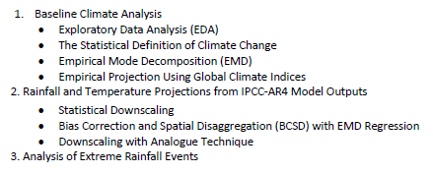
Step 2. Climate Science Bases Analysis

Slide 8
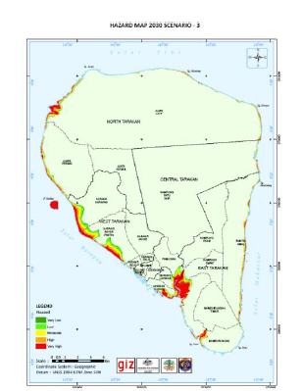
Step 3. Analysis of Hazards due to Climate Change
This study look a these hazards:
Decreasing agricultural production
Decreasing water availability
Flooding
Landslide
Coastal inundation and
Increasing disease event
Each hazard analysis used different
method or model.

Slide 9
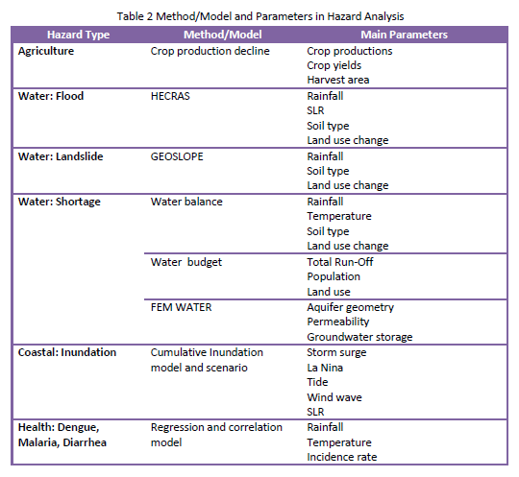

Slide 10
Potential Impact to Household
Ecosystem
Reduction of Environmental Service
Household
Livelihood
Reduce Productivity
Increase cost
New opportunity
Climate
Change
- Increase Vulnerability
- Lost and Damage

Slide 11
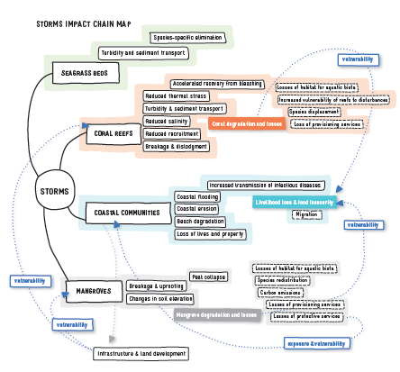
Climate Impact Chain Study*
* Climate Change
Impact Chain in
Tropical Coastal Area
GIZ-CIFOR 2013

Slide 12
Step 4: Dynamic Vulnerability Assessment
Vulnerability assessment was conducted for both baseline situation and future projection. In this study base line is 2008 and projection is 2030
Sample for vulnerability indicators:

Slide 13
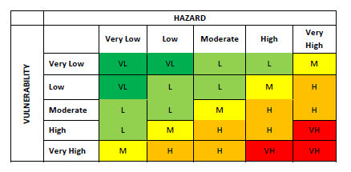
Step 5: Risk Analysis
The current risk is measured based on current hazard and vulnerability
Future risk is measured base on projected hazard using IPCC SRES scenario and projected vulnerability,

Slide 14
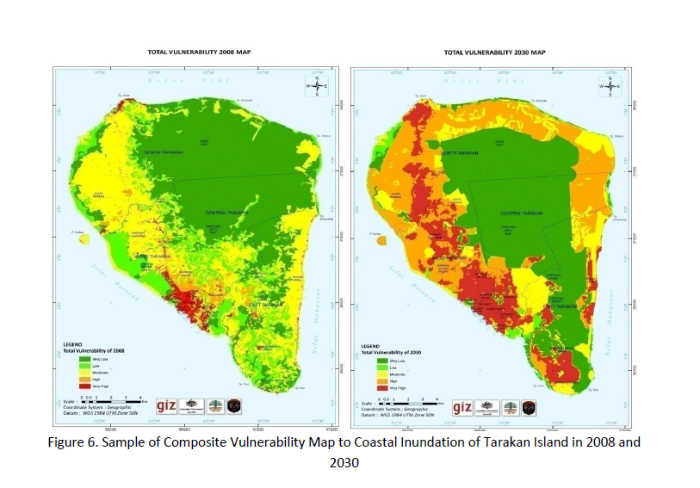
Sample of Climate Risk Analysis in Tarakan Island 2008 2030

Slide 15
Step 6: Developing Adaptation Options
Delineate Adaptation Zoning
Develop the right measures to reduce effects of climate change or exploit the positive ones by making appropriate adjustments.
Reactive adaptation for immediate actions and anticipatory adaptation for future or projected risk
Focused on reducing vulnerability
Adaptation zoning in
Tarakan island

Slide 16
KRAPI Method
KLH - GIZ – AusAID 2012

Slide 17
Mainstreaming Adaptation

Slide 18
Monitoring and Evaluation of Adaptation
Climate Parameter Monitoring
Exposure
Sensitivity
Climate Impact Monitoring
Potential Impact
Adaptive Capacity
Vulnerability
Vulnerability Assessment
Adaptation Actions
Monitoring outputs
Response
Results
Impact Evaluation
GIZ IMACC 2013

Slide 19
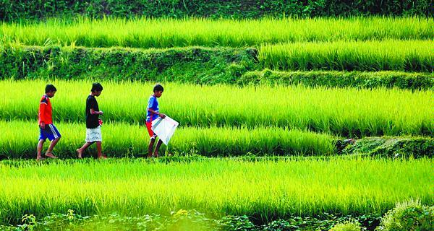
Terimakasih

