Slide 1
Coastal vulnerabilities – Australia and Oceania
John Handmer (RMIT University)
&
Johanna Mustelin (Griffith University)

Slide 2
Today
I will make some overview comments on Australia and for Oceania, specifically Vanuatu and the Solomon Islands.
Following the IPCC Special report on extremes (and custom in emergency management in Australia): Risk = exposure + vulnerability + hazard
I draw on many sources including a SSGM paper 2013/2 by Feeny et al.

Slide 3
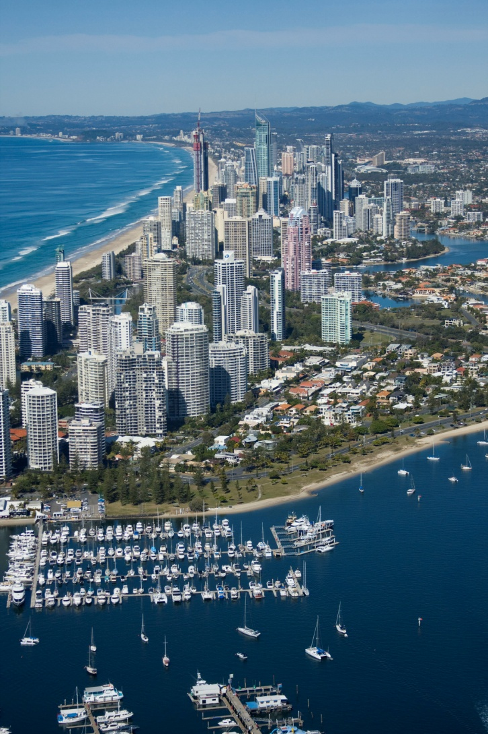

Slide 4
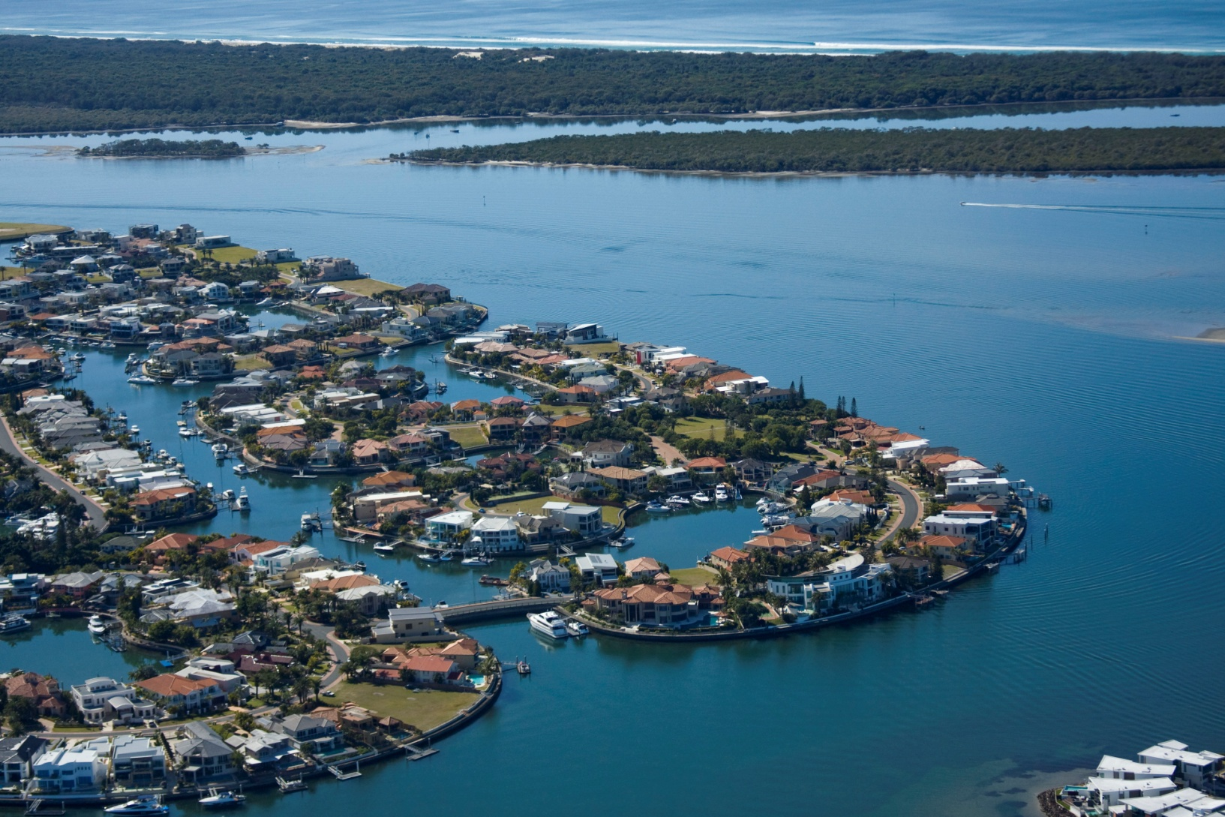

Slide 5
Exposure is increasing
Australia
Exposure to sea level rise and coastal hazards is high due to the large concentration of population on the coast (in Australia 86% of population lives on or close to the coast);
Strong migration trends towards the coast – “sea change” phenomenon;
The trend is also to the cyclone prone tropics;
Does insurance have a role?

Slide 6
Current activity
Needs to be seen in a strong pro-development/anti-climate change context
Politics - the Queensland government has dropped any restrictions on coastal development. The approach was to restrict new development in hazard zones, and include SLR scenarios to determine the risk and level of protective measures;
Courts - used to challenge planning decisions. Local governments often see themselves trapped:
can be taken to court by the developer/future owner because a) they allowed building in a vulnerable area and are liable for damages, and b) because they do not allow building in a vulnerable area.

Slide 7
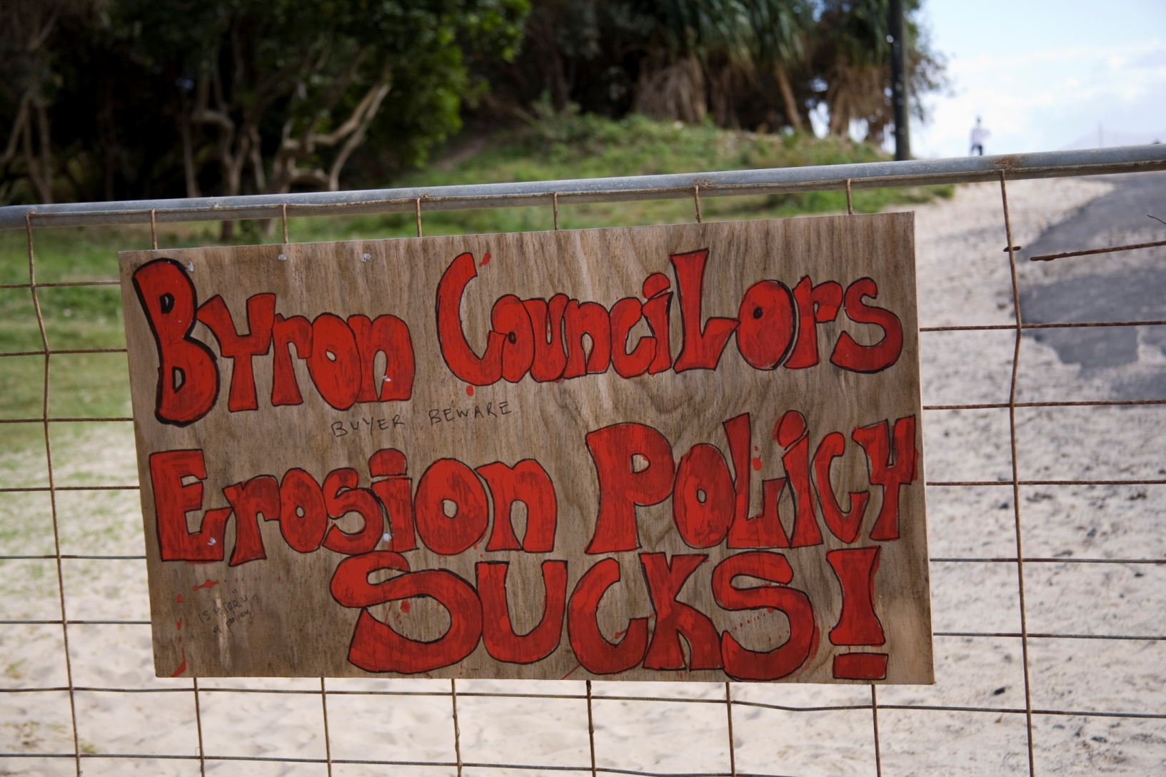
Where local action is taken – not all agree!

Slide 8
Exposure in Oceania
Vanuatu & Solomon Islands – mountainous countries with almost all valuable assets on the coastal strips. Countries ranked by the UNU at #1 and #4 in terms of exposure to natural hazards.
The trend is to increase the development of assets by the sea;
And some informal settlements are also expanding in the same exposed locations.
Atoll countries and regions (eg Kiribati, Ontong Java in SI, are at the highest end of exposure.

Slide 9
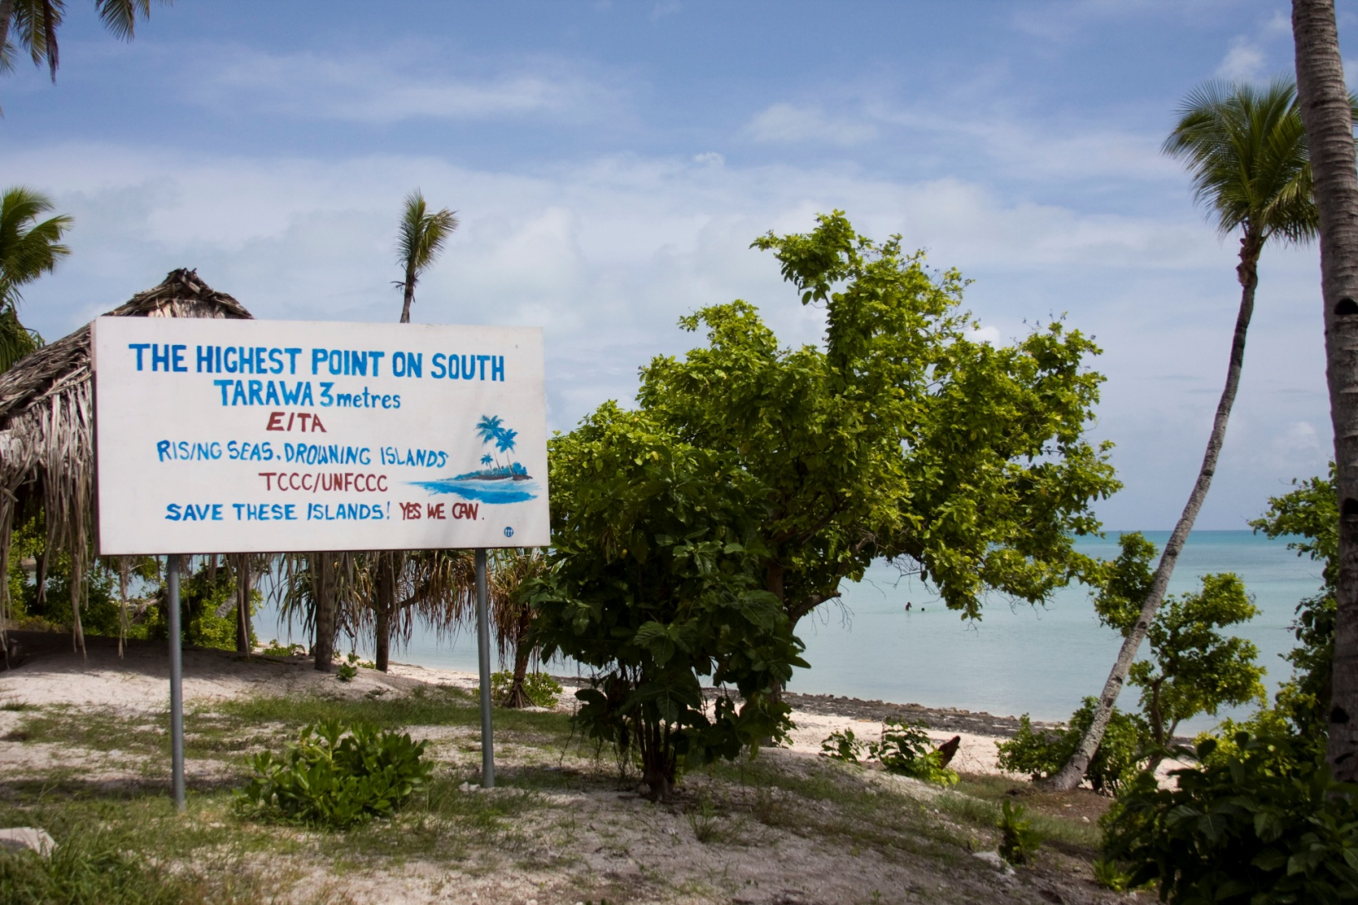
Highest point – 3m

Slide 10
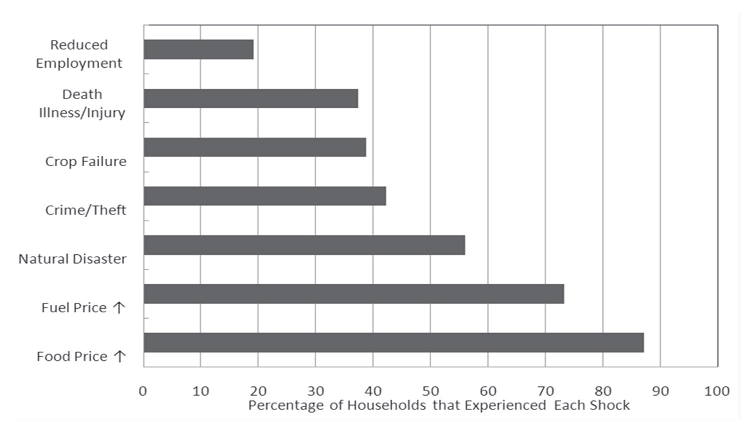
Importance of natural disasters?
Feeny et al 2013. Household vulnerability…Solomon Islands & Vanuatu. SSGM Discussion paper 2013/2

Slide 11
Vulnerability & resilience
Dominated by the informal sector & subsistence.
Livelihoods are fundamental in Oceania - food security and access to health and education are challenges. The majority operate at the edge of paid employment.
Access to land (for food gardens) and infrastructure.*
Having access to remittances seen as the single key factor. (Related to having a relo in paid employment).*
Traditional resilience mechanisms might be decreasing, esp in urban areas (the “wantok” system).
Note that the main impact appears to fall on women who are responsible for food.*
* Feeny et al 2013. SSGM, ANU. Discussion paper 2013/2.
Notes:
*The key points here come from Feeny et al 2013. SSGM, ANU. Discussion paper 2013/2.

Slide 12
Adaptation - in Australia:
Lots of plans and strategies. Some local and state activity and supportive court cases;
Lot (?) of activity by commerce and individuals;
More leadership by government is needed.
Debate about, and need for research on, the role of the state (eg PC); on the effectiveness and implementation; on the economics of disasters and adaptation; and on insurance.

Slide 13
Vanuatu & Solomon Islands
States have limited power and resources – but could show more leadership and deal with people’s priorities: eg support small scale commerce, reduce tensions and violence and crime.*
Multiple donors & their unique requirements, endless plans, strategies, and small scale pilots, are a source of frustration. and importantly, institutional change. The merging of DRR and CCA is occurring across the PICs providing capacity.
Providing access to work in Australia & New Zealand would increase opportunities for remittances – and resilience;
Education (school) for the development of resilience*
Land issues complicate the option of moving;
The role of the local Chinese run commercial sector?
The future role of the “kastom” system?
Notes:
“Feeny et al 2013. SSGM, ANU. Discussion paper 2013/2.

Slide 15
