Slide 1
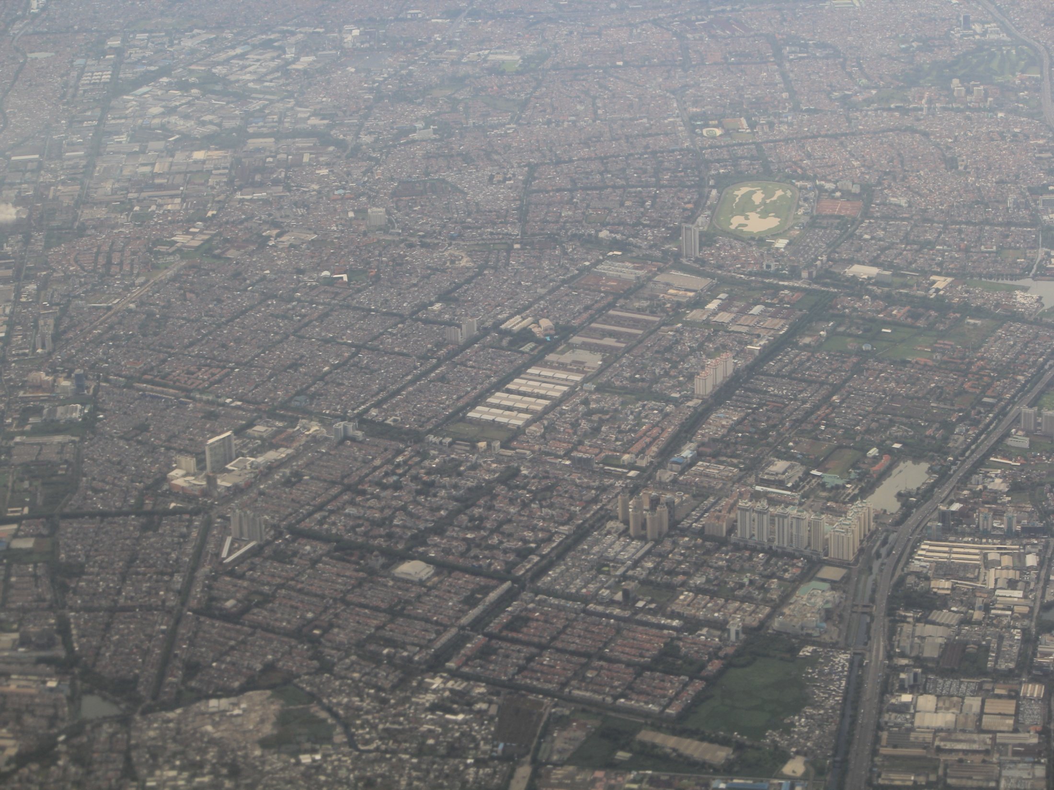
Urbanization and Proposed Adaptive Development Strategies in Megacities : The Greater Jakarta
Robert Delinom
Robert Delinom
ICIAR – LIPI

Slide 2
Regionally, Jakarta area is occupied by lowland area that has five main landforms (Rimbaman and Suparan, 1999) that consists of:
Volcanic and alluvial landforms, that are found in southern part of the basin,
Marine origin landforms, which are occupied the northern area adjacent to the coastline,
Beach ridge landforms, which are discovered along the coast with east-west direction,
Swamp and mangrove area landforms, which are encountered in the coastal fringe,
Paleo-channels, which run perpendicular to the coastline.

Slide 3
JAKARTA GEOLOGICAL CHARACTERISTIC
Genetically, formed in fluviatile, fluvio-marine, fluvio-volcanic or shallow marine environment
As an area with volcanic chain in the hinterland area, it is mostly formed by fluviatile and fluvio-volcanic sediment
Some aquifers found as a lens in beach ridge
Tertiary Formation act as the Basin Basement

Slide 4

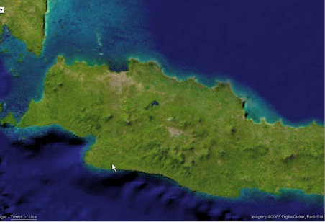
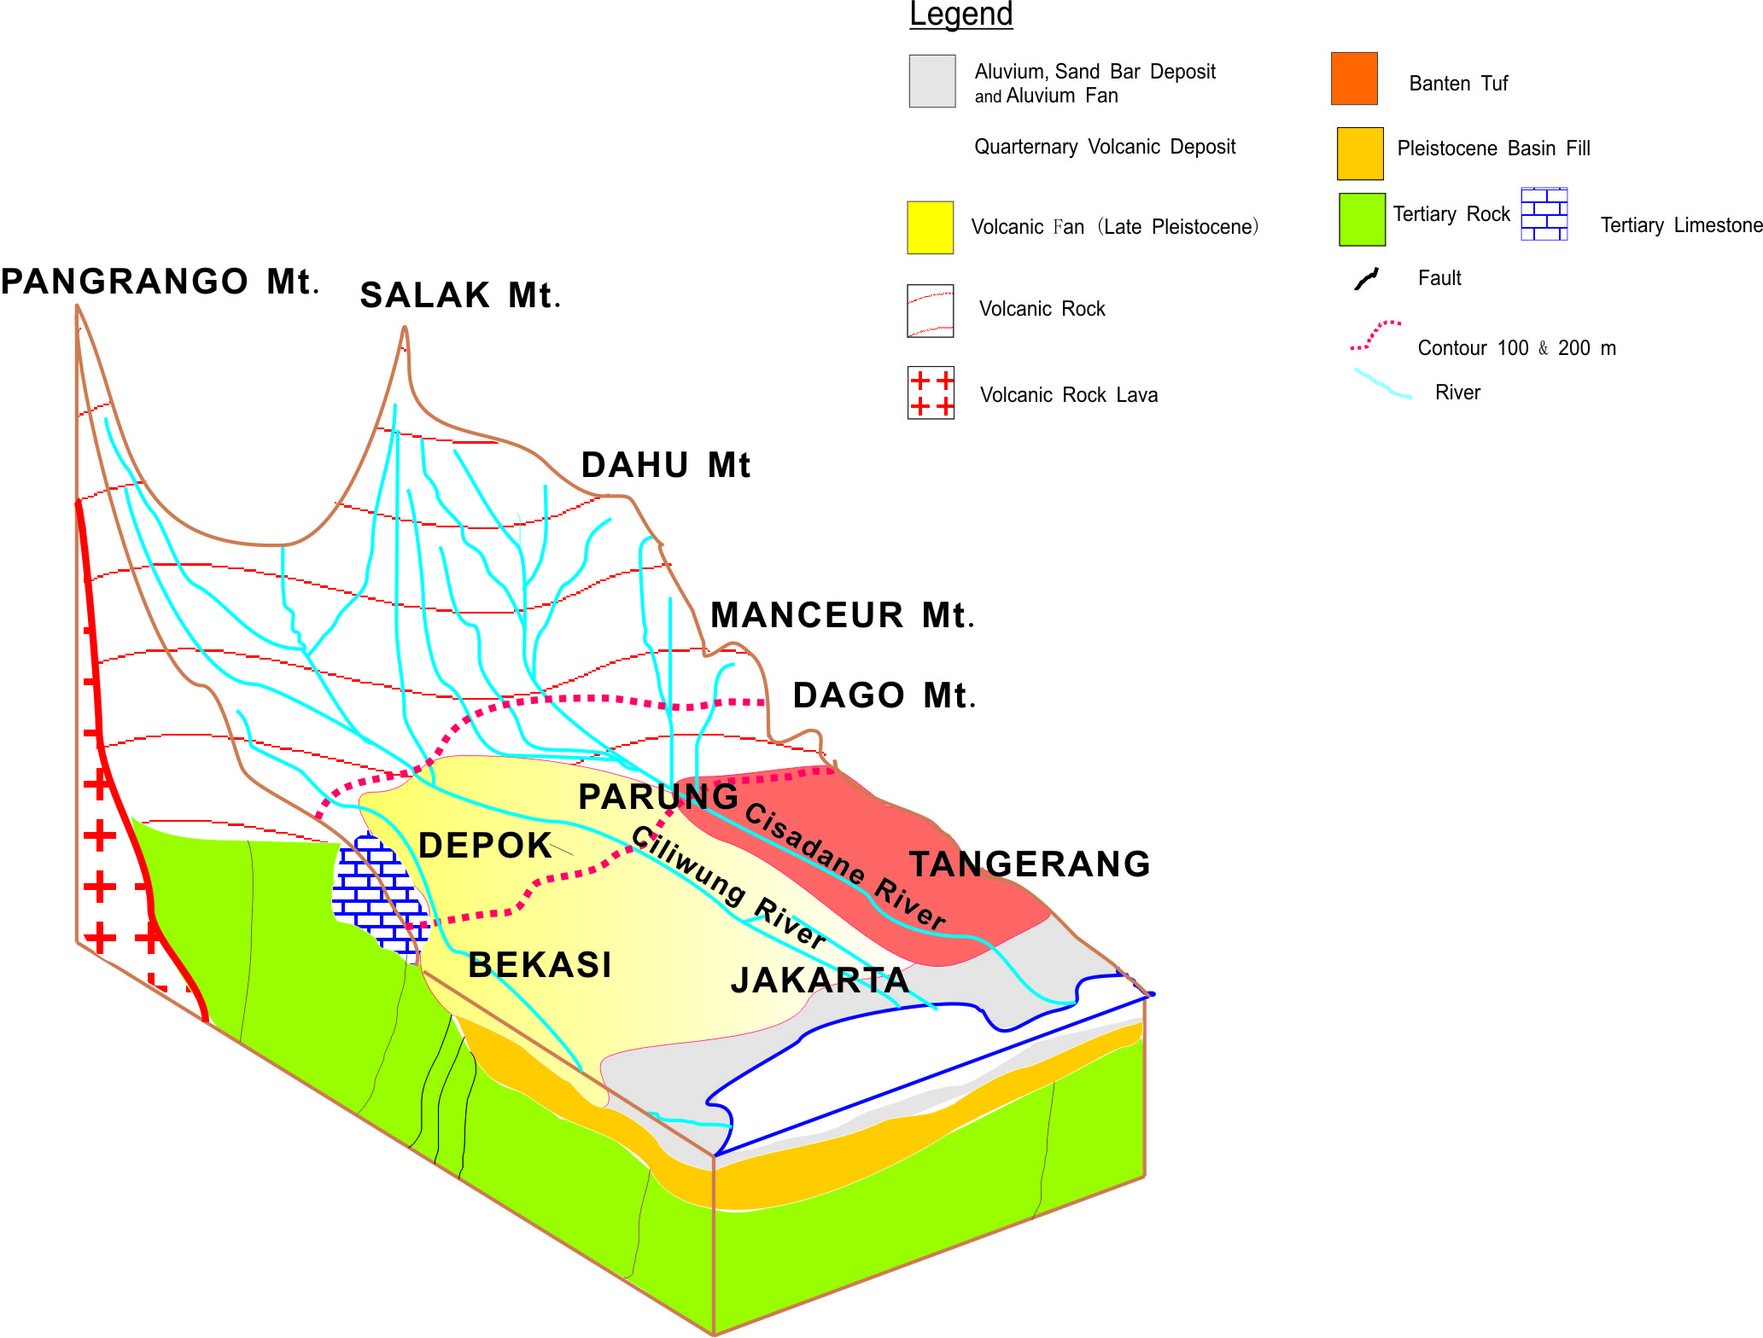
Geological Setting
Simplified Model
S
(Modified from Iwaco & Ministry Of Public Work, Indonesia ; 1994)
(Not to scale)
N

Slide 5
Greater Jakarta Present Condition
Around 10 millions inhabitant live in Jakarta Area. (During office hours around 12 millions)‏
Urbanization to this city unstoppable
Land Caring Capacity Decreasing
Subsidence occurred
Water resources use is increasing year by year.

Slide 6
Population Growth of DKI Jakarta
[Lo and Yeung, 1995; BPS Jakarta, 2007]
Year | Population ('000) | Year | Population ('000)
1948 | ≈ 2,000 | 2002 | 8,379
1961 | 2,973 | 2003 | 8,603
1971 | 4,579 | 2004 | 8,725
1980 | 6,503 | 2005 | 8,864
1990 | 8,259 | 2006 | 8,961

Slide 7
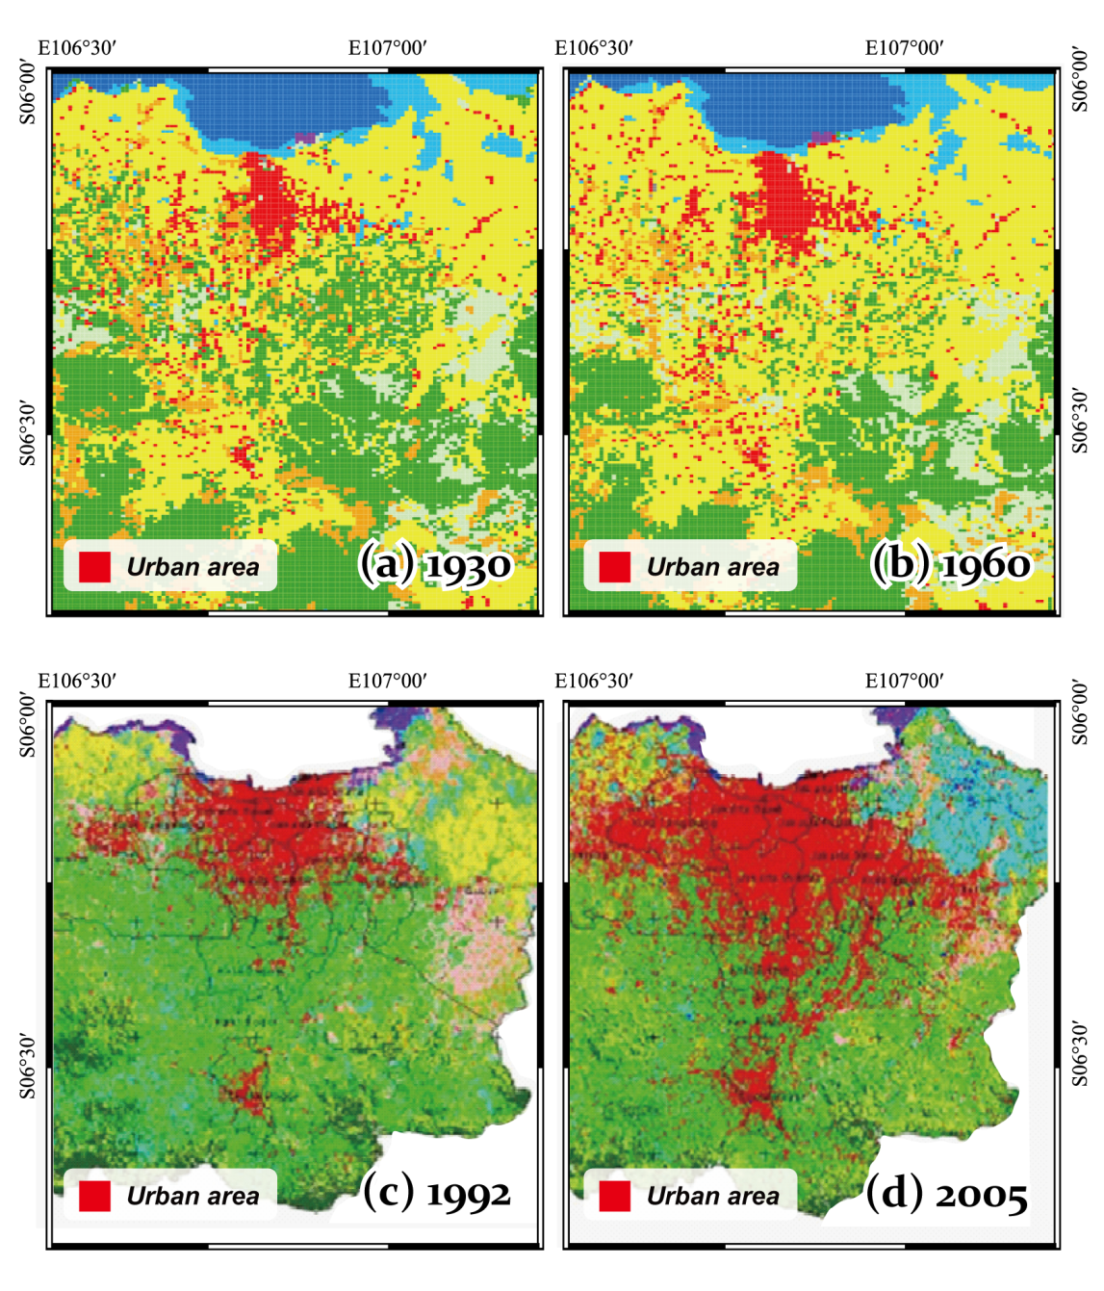
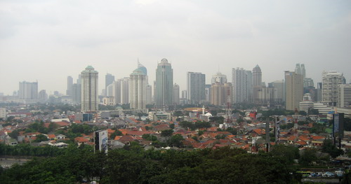
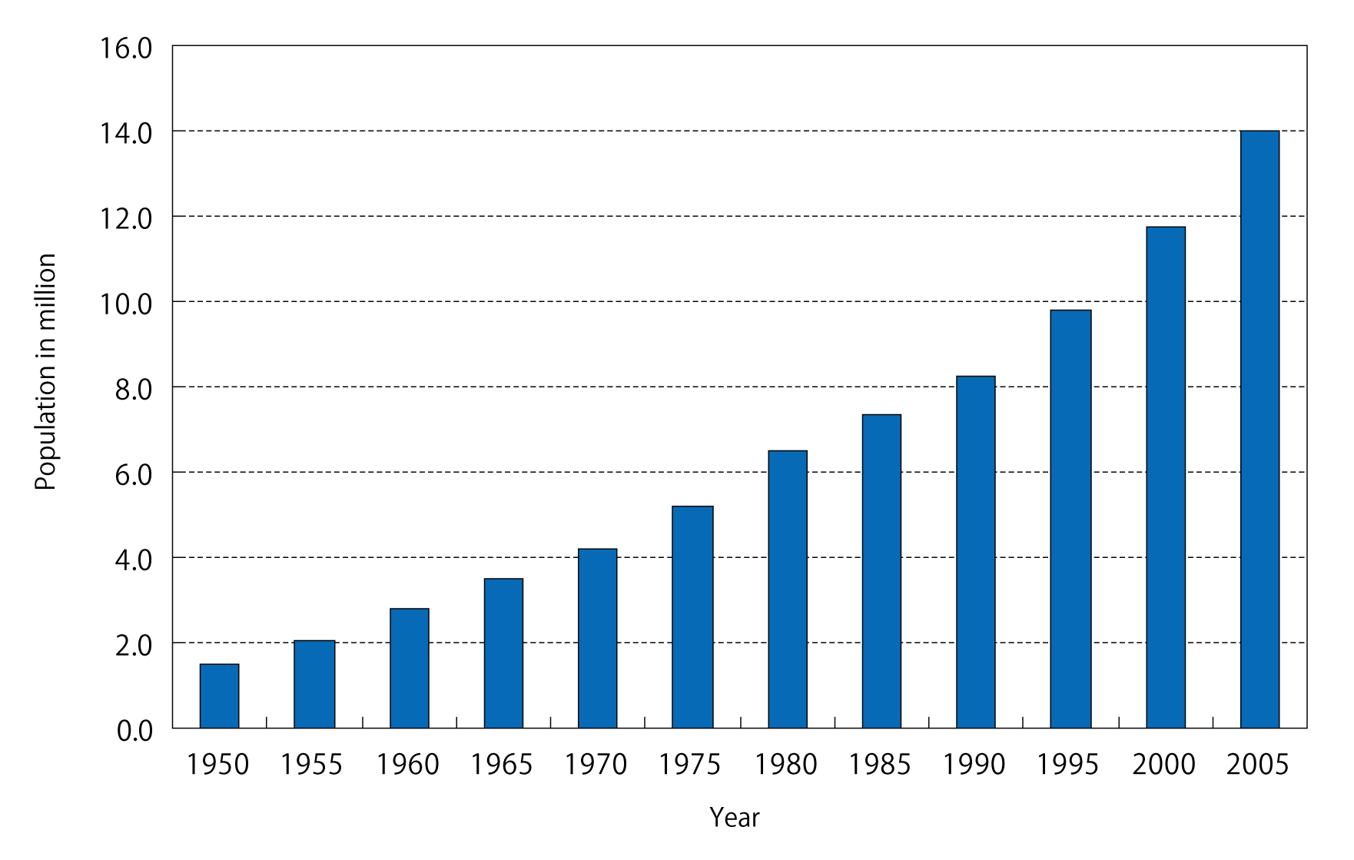
Jakarta
urbanization
Population
Land use

Slide 8
Greater Jakarta Population Density (people/km²)‏
South Jakarta : 11.676
East Jakarta : 11.157
Central Jakarta : 18.746
West Jakarta : 12.426
North Jakarta : 8.267
Seribu Islands : 1.616
Total Population : 7.456.931 people
Average Density : 11.272 people/km².
(Sources: BPS Prop. DKI Jakarta, 2003).

Slide 9
Land Subsidence in Jakarta
subsidence due to groundwater extraction (including de-watering)
subsidence induced by the load of constructions
(i.e. settlement of high compressibility soil),
subsidence caused by natural consolidation
of alluvium soil, and
tectonic subsidence.

Slide 10
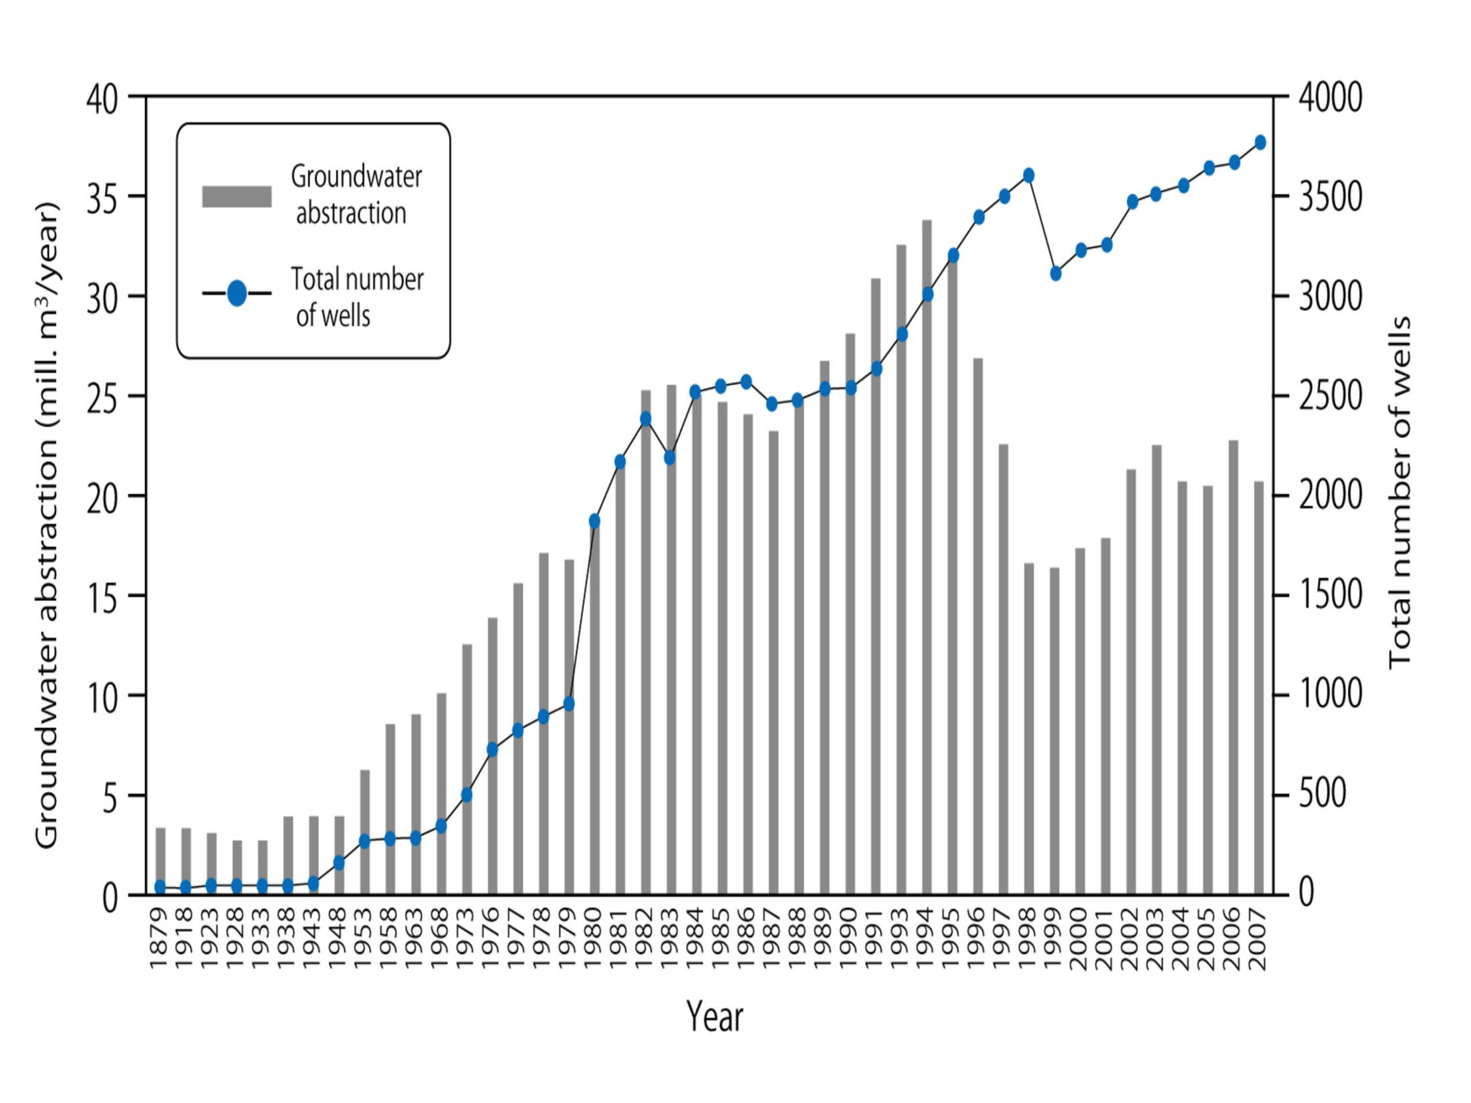

Slide 11
Step1
Step2
Step3
Step4
Step5
Tokyo
Osaka
Taipei
Bangkok
Jakarta
Groundwater demand for the city water (cheep, easy access, stable, clean)
Step1
GW disaster followed by urban expansion
(land subsidance, salinization, oxygen deficit air accident, etc）
Induced recharge
（shallow aquifer, river & sea water）
Step2
Infrastructure of surface water supply
and National groundwater act
（public water of private property ?）
Enforcement of GW regulation
（groundwater disaster→regulation）
Step3
Recovery of regulated area⇔
Maximun potential recharge⇔Hydro-meteorological setting of the city
Step4
New GW disaster caused by abrupt recovery
（Floating problem of subsurface station）
Sustainable GW management
considering potential recharge rate
Step5

Slide 12
The decision maker paradigm :
“Out of sight out of mind”
There is always no consideration to groundwater

Slide 13
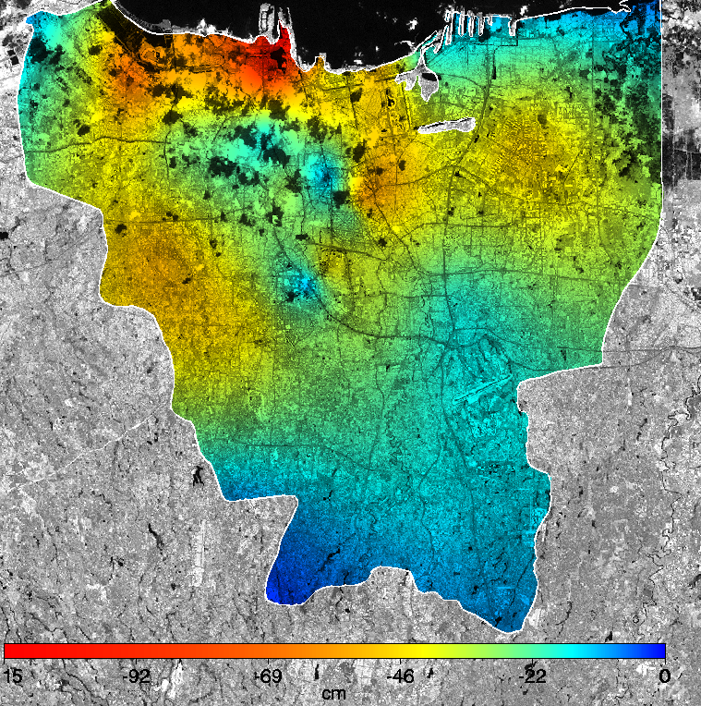
LAND SUBSIDENCE ZONATION IN JAKARTA (2002 – 2010)
Land Subsidence Locations in Jakarta :
North Jakarta : Muara Baru, Pantai Mutiara, Pantai Indah Kapuk, dan Ancol ;
West Jakarta Barat : Cengkareng Barat ;
East Jakarta : Kelapa Gading
116 cm
65 cm
47 cm
15 cm
11 cm
Hasanuddin Z. Abidin, 2010

Slide 14
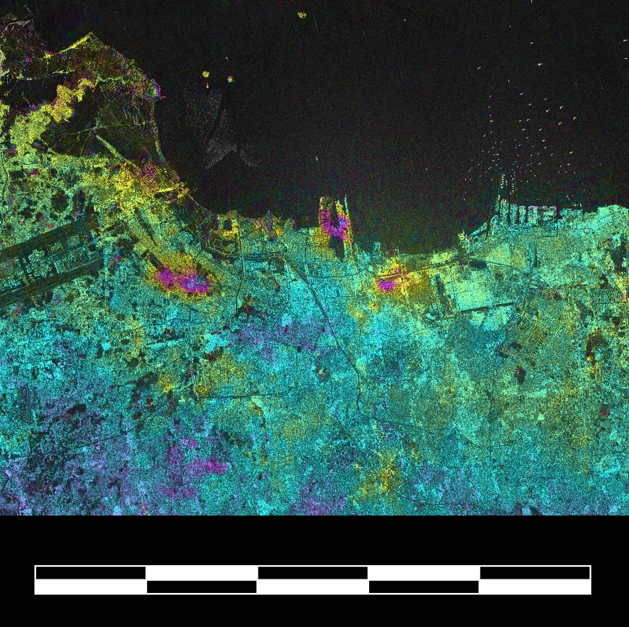

Land
Subsidence
from InSAR
June 2006
to February 2007
(8 months)
Cooperation with
ERSDAC Japan
Pantai Mutiara Estate
(Reclamation land)
CONES OF SUBSIDENCE
Deguchi, 2007
0 30km

Slide 15
IMPACTS OF LAND SUBSIDENCE
The wider expansion of (coastal) flooding areas.
Cracking of buildings and infrastructure.
Lowering the quality of living environment and life (e.g. health and sanitation condition) in the affected areas.
Increasing the maintenance costs for the affected
buildings and infrastructure.

Slide 16
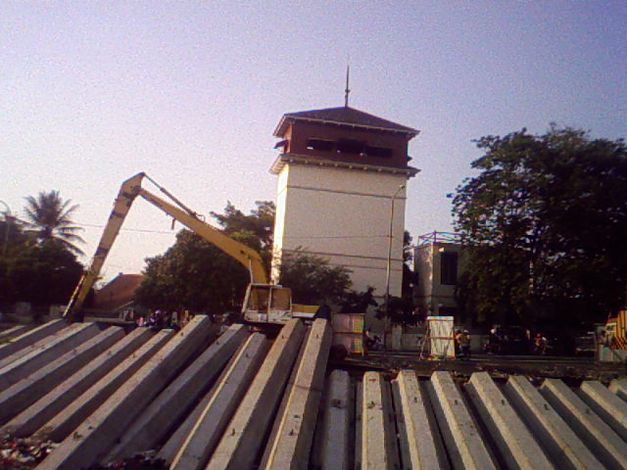
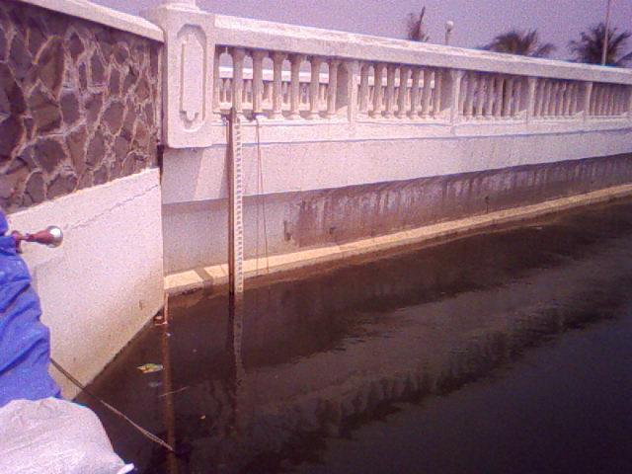
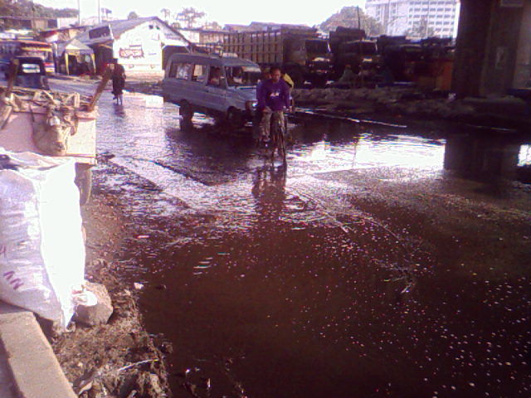
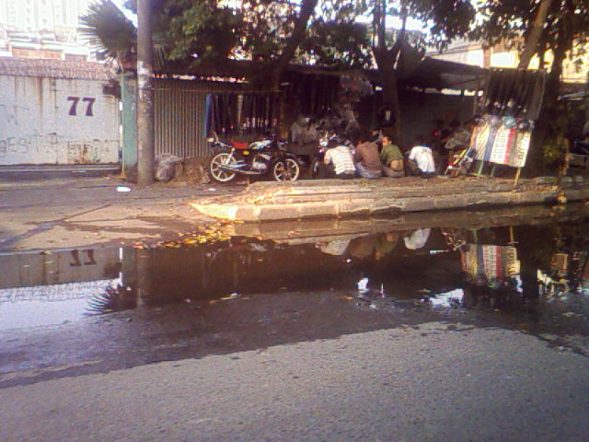
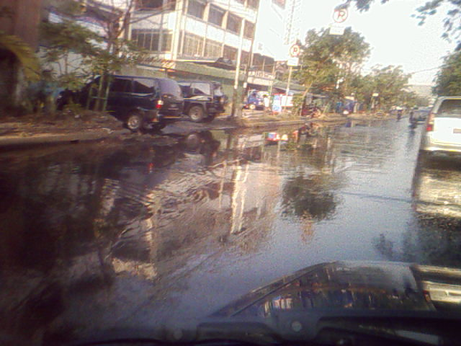
Impacts of Subsidence in Jakarta
Bangunan miring (Tongkol)
Struktur jembatan turun (mutiara)
Genangan Rob (Tongkol)
Genangan Rob (Gunung sahari)
Genangan Rob (Gunung sahari)
Hasanuddin Z. Abidin
KK Geodesi ITB 2010

Slide 17
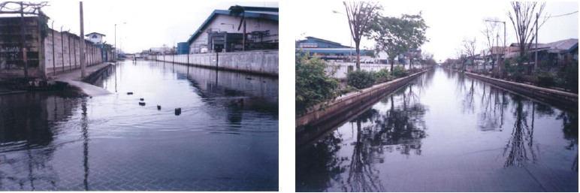
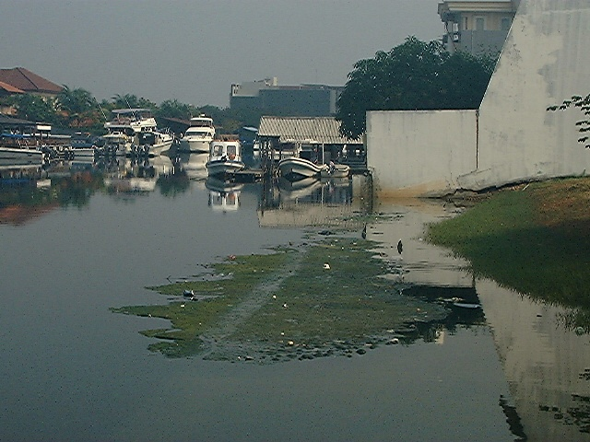
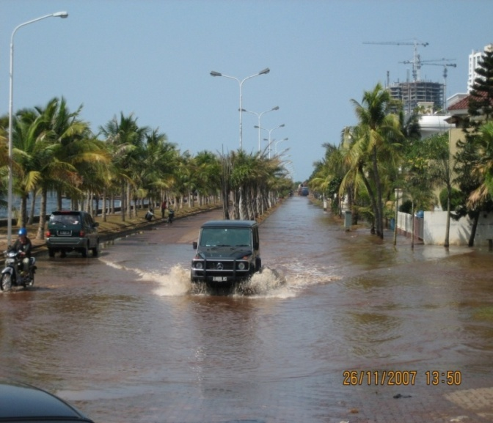
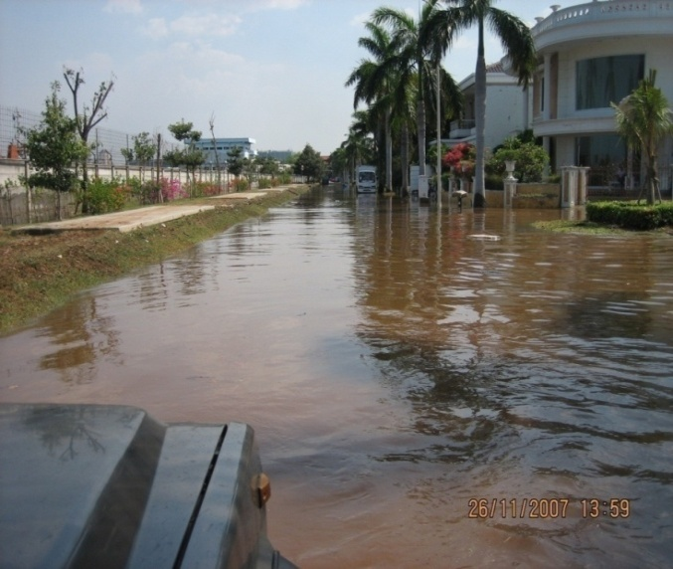
Impacts of Coastal Subsidence in Jakarta

Slide 18
Sea Level Rise in Coastal Areas of Jakarta
Tide
Gauge
Satellite
Altimetry
Hasanuddin Z. Abidin, 2009

Slide 19
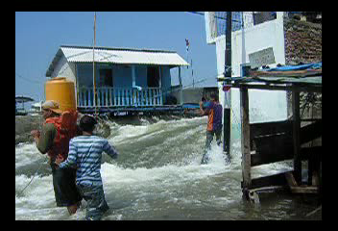

Slide 20
Possible Inundation Areas
in Coastal Areas of Jakarta
 | CONSERVATIVE SCENARIO | PESIMISTIC SCENARIO
Land subsidence rate | 2.5 cm/year | 10 cm/year
Sea level rise rate | 0.2 cm/year | 1 cm/year
Hasanuddin Z. Abidin, 2009

Slide 21
AIR TEMPERATURE AT JAKARTA
Annual gradient
Hansen and Lebendeff, 1987 ; Huang et.all, 2000 :
Global warming : 0.5 – 0.7 ⁰C/100 year
1.36 ⁰ C
2005
Indonesia Ministry of Environment & NOAA, BMG, 2007

Slide 22
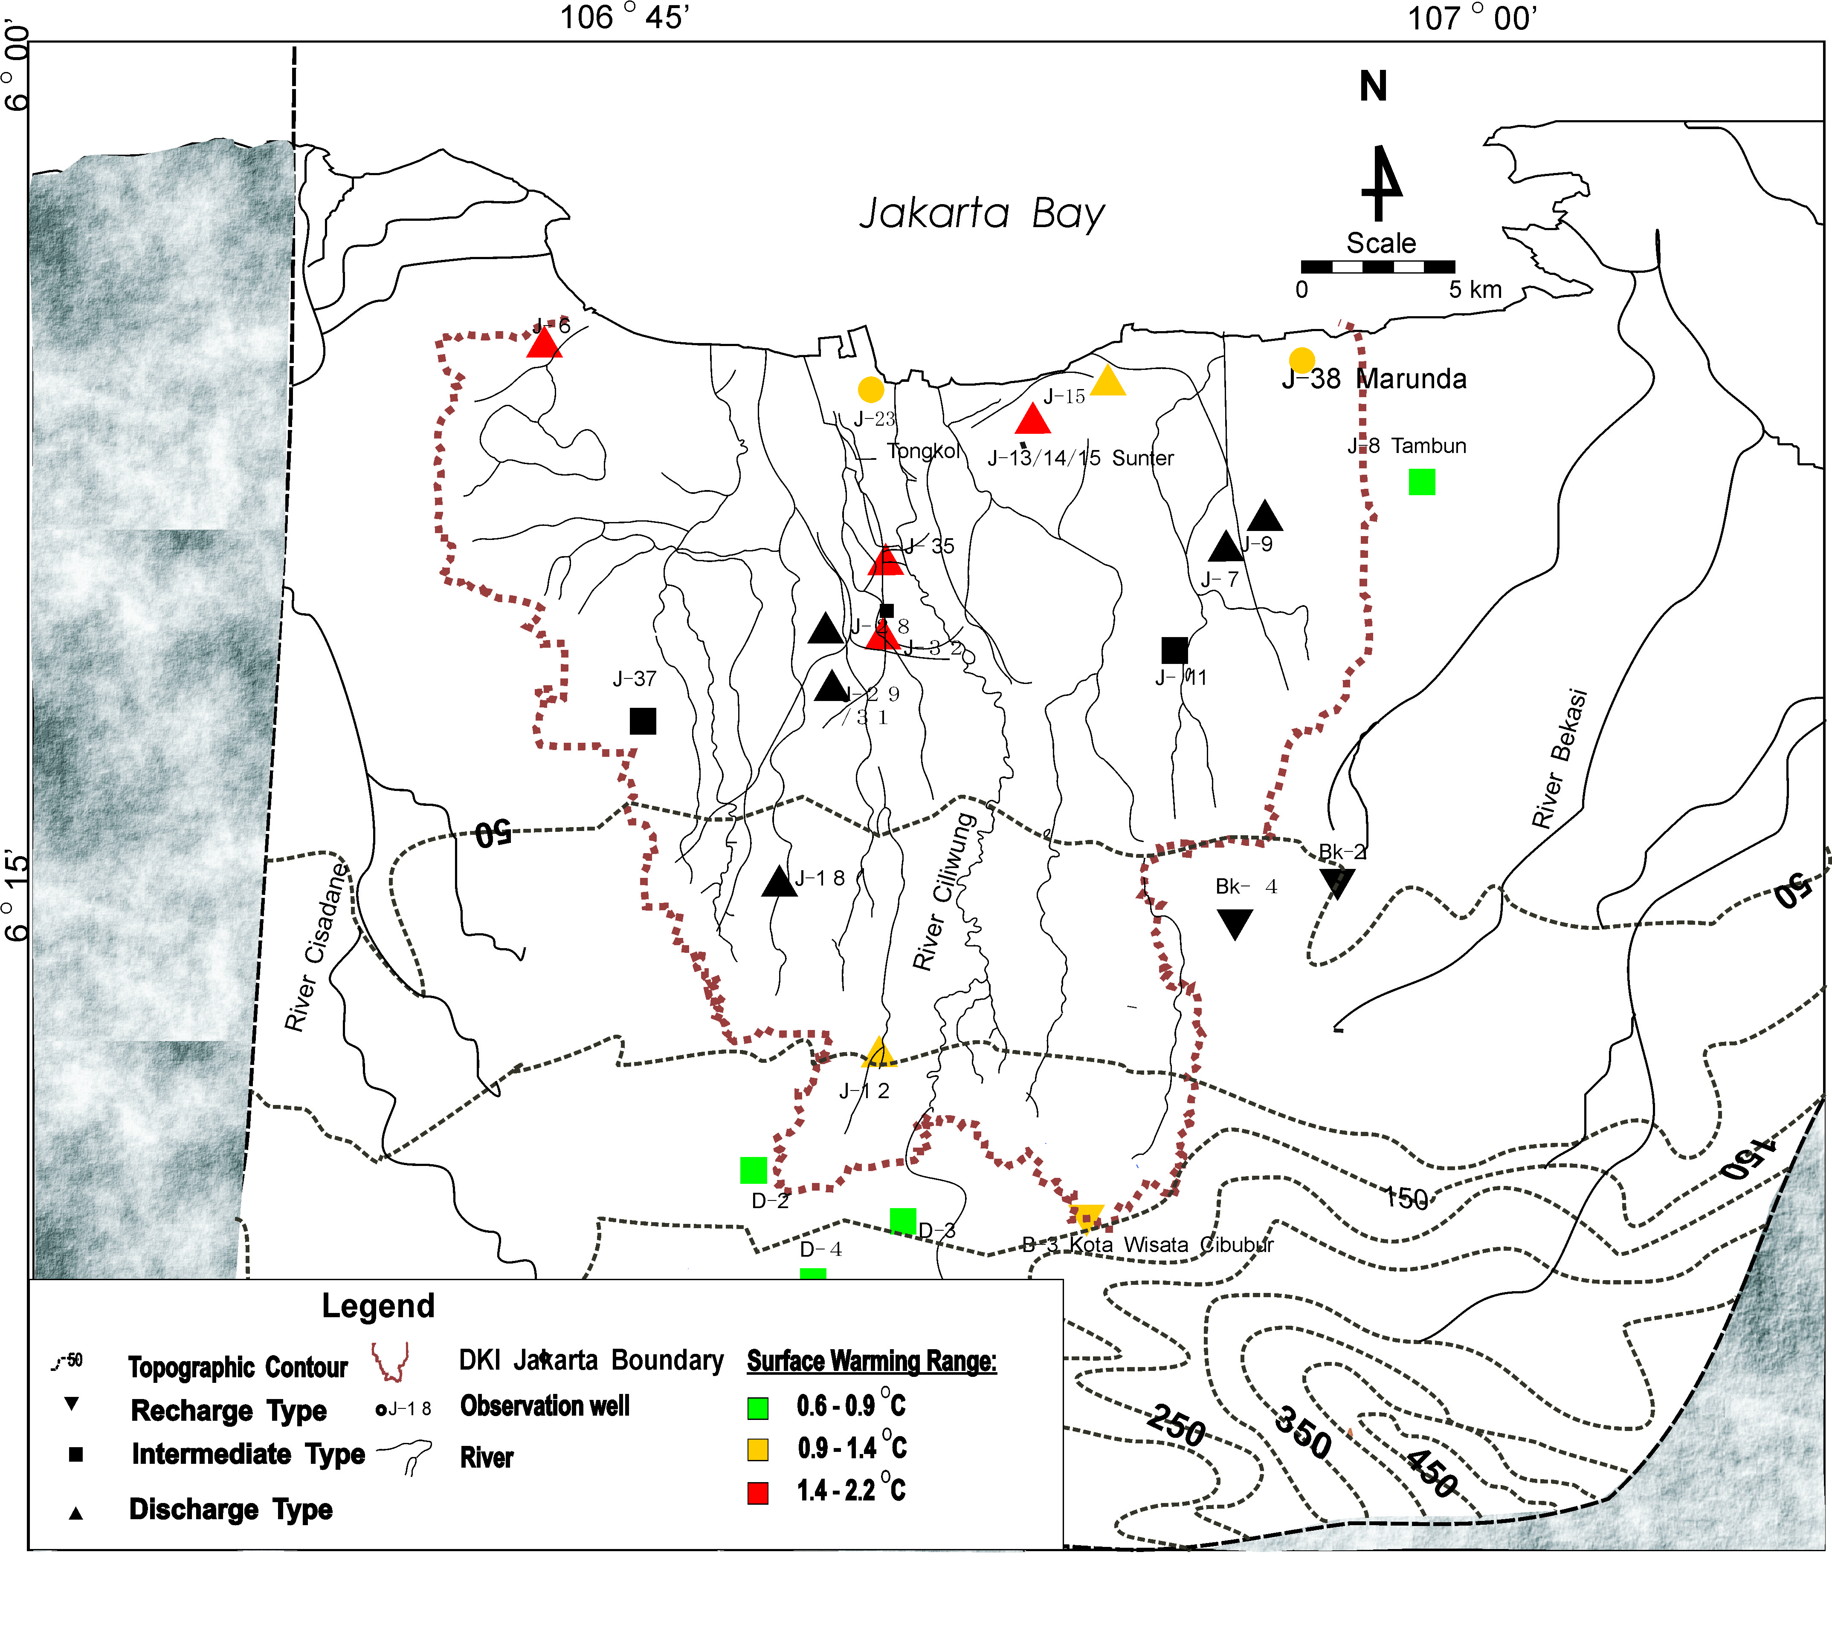
Distribution Surface Temperature Warming in Jakarta Groundwater Basin
MAXIMUM HIGH DENSITY EFFECT OF HEAT ISLAND /URBANIZATION EFFECT

Slide 23
Some parameters should be concern :
Jakarta needs more space for living area
Retention Dam
Good, wide, and deep water way
Decrease the air pollution and green environment
An Adaptive Urban Oasis should be created

Slide 24
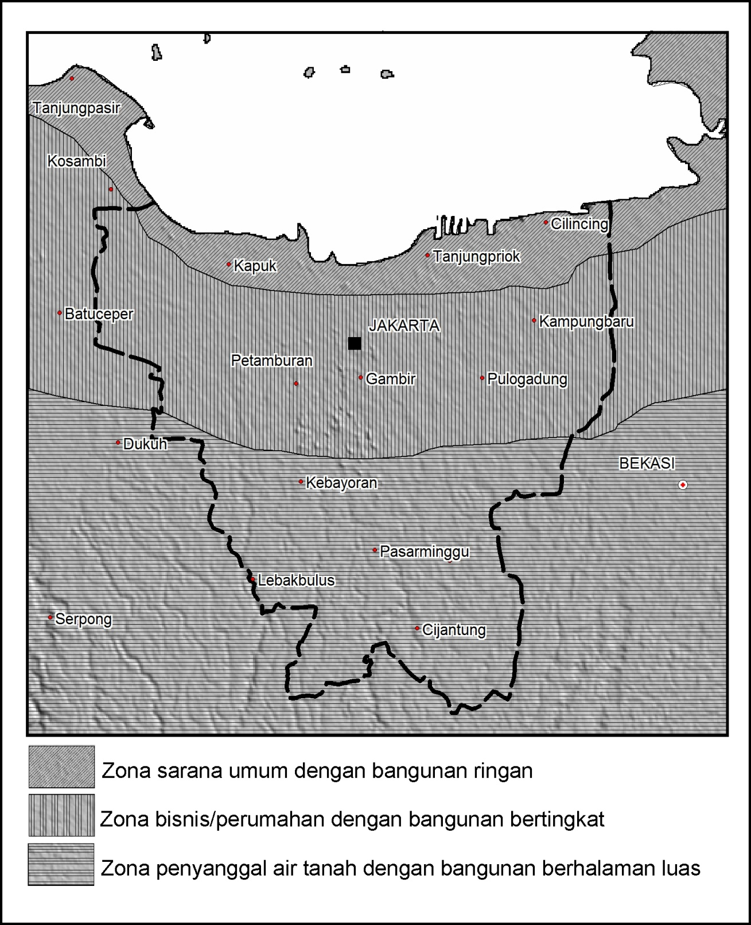

Slide 25
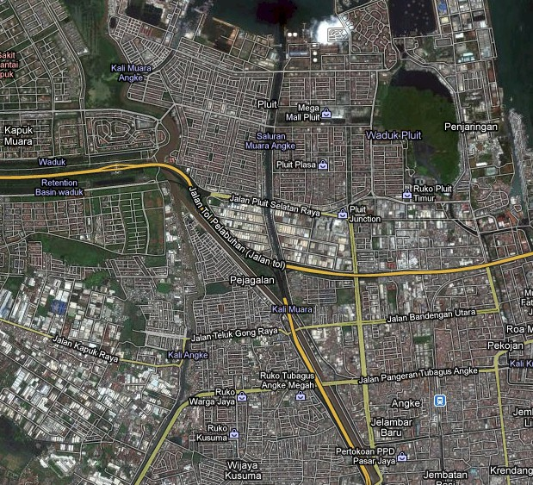

Slide 26
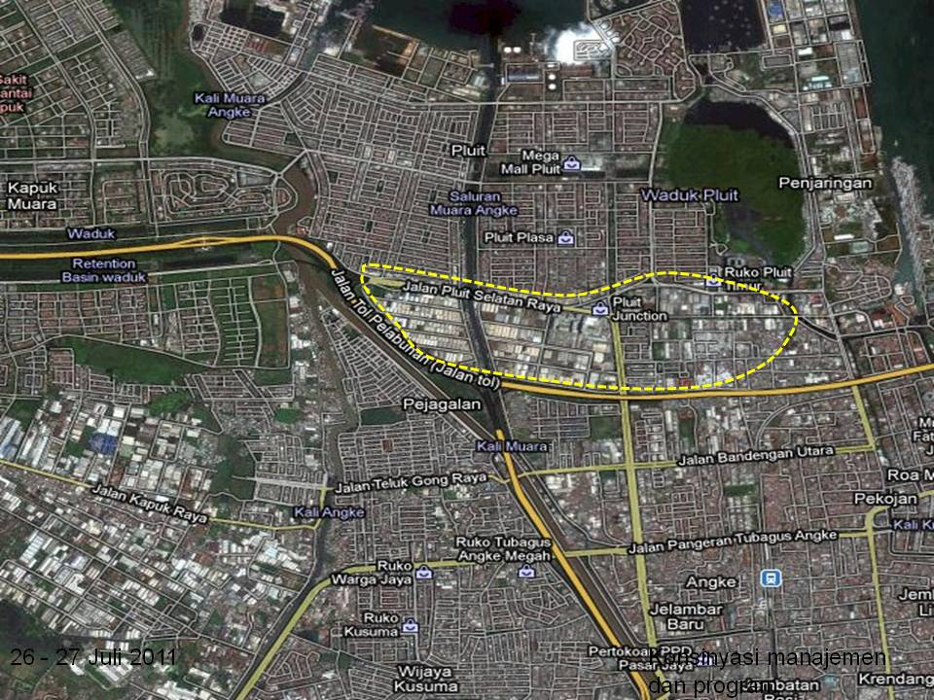

Slide 27
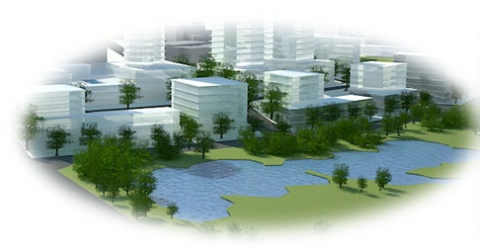

Slide 28
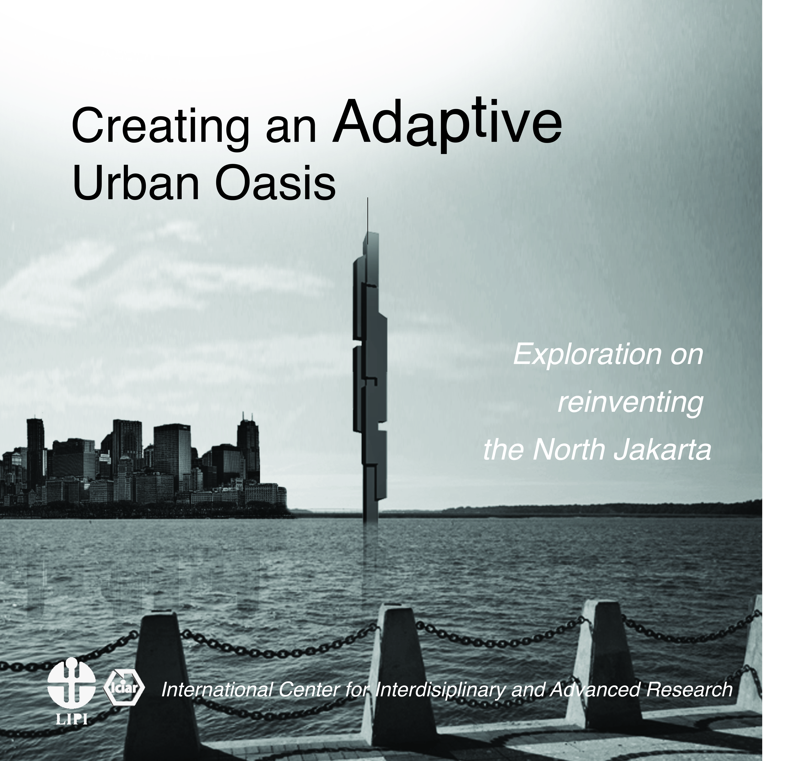

Slide 29
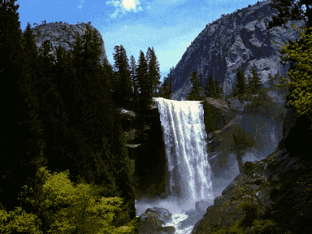
Thank you

