Slide 1
DEVELOPMENT PLANS IN THE COASTAL AREAS AND IMPACTS OF CLIMATE CHANGE
Directorate of Marine and Fisheries
National Development Planning Agency

Slide 2
CLIMATE CHANGE IN NATIONAL DEVELOPMENT PLANNING

Slide 3
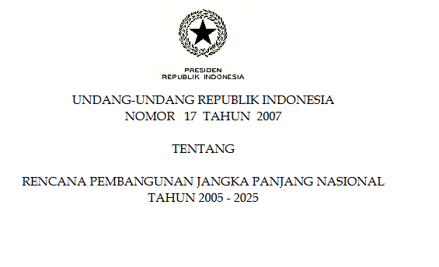
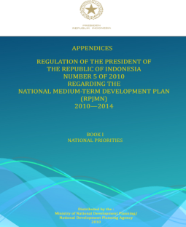
NATIONAL DEVELOPMENT PLANNING
Long Term National Development Plan (RPJPN) 2005-2025
Medium Term National Development Plan (RPJMN)
Annual Government Workplan (RKP)

Slide 4
LONG TERM NATIONAL DEVELOPMENT PLAN (RPJPN) 2005-2025
Vision :
Indonesia that is self-reliant, advanced, just, and prosperous
Eight National Development Missions :
Mission 6
Realizing an Indonesia that is balanced and sustainable → maintain the balance among the utilization, sustainability, availability, and uses of the natural resources and environment
Mission 7
Realizing an Indonesia as an archipelago nation that is self­reliant, advanced, strong, and that is based on the national
interest → focus on the development of marine aspects

Slide 5
MEDIUM TERM NATIONAL DEVELOPMENT PLAN (RPJMN)
Mainstremaing Sustainable Development
Environment, social, and economic aspects
Climate Change as a cross sectoral issue, with priority sectors :
Mitigation: Forestry, Peatland, Energy, Transportation, Industry, waste management.
Adaptation: Agriculture, Marine and Fisheries, Infrastructure, Health
Supporting : data and information, institutional capacity building, research and development

Slide 6
Progress on Climate Change Strategy
Indonesia : National Responses to Climate Change (yellow book) in 2007-2009
Indonesia Climate Change Sectoral Roadmap (ICCSR) in 2010 → Adaptation and mitigation
Indonesia Climate Change Trust Fund (ICCTF) in 2010
National Action Plan on Reducing greenhouse gases Emission (RAN-GRK) - 2011
National Action Plan on Adaptation of Climate Change (RAN API ) - 2013

Slide 7
NATIONAL ACTION PLAN ON CLIMATE CHANGE ADAPTATION (RAN-API)
OBJECTIVE
To strengthen mitigation actions: National Action Plan for reduction of GHG Emission – Presidential Regulation No 61/2011
Guidance for sector/cross sector and local government in the adaptation programs/activities: Short term, mid term plan, long term plan
To sinergize and coordination for all sectors and local government in the adaptation program

Slide 8
RAN-API Targets Framework
Main Objective
SUSTAINABLE DEVELOPMENT AND ADAPTIVE TO CLIMATE CHANGE
ECOSYTEM RESILIENCE
Targets
SPECIAL AREAS RESILIENCE
STRENGTHENING SUPPORT SYSTEM
ECONOMICS RESILIENCE
LIVELIHOOD RESILIENCE
Knowledge Management, Planning and Financing,
Capacity Building, Monitoring and Evaluation

Slide 9
Adaptation Action Plan (RAN-API)
SECTOR
SUB-SECTOR
CLUSTER
ACTION PLAN
Food Security
7 clusters
Cluster 1: Adjustment of Food Production Systems
Minimize yield loss by reducing the area exposed / puso by floods
…….
Economy Resilience
Energy Independency
4 clusters
Health
4 clusters
Cluster 1: Identification and control factors
Mapping populations and areas vulnerable to climate change
…….
Social and Livelihood Resilience
Settlement
4 clusters
Infrastructure
4 clusters
Cluster 1: Repair / Improvement of Spatial Planning and Land Classification of Land
Identification and mapping vulnerability forests, marine ecosystems, watersheds, and biodiversity of the climate change
…….
Ecosytem Resilience
7 clusters
Cluster 1: Integrating spatial planning with adaptation efforts
Preparation of maps of vulnerability to climate change for urban areas
…….
Special Area Resilience
Urban Area
5 clusters
Coastal and Small Islands Area
5 clusters
Cluster 1: Capacity building for stakeholders in the climate change adaptation
Education, counseling, and training on the climate change adaptation
…….
Supporting System
5 clusters

Slide 10
Sub sector Coastal and Small Islands Area
Coastal and small areas management to climate change
Capacity enhancement for coastal communities
Management of coastal ecosystems and environment for climate change adaptation
Applying structural and non structural adaptation actions in vulnerable coastal and small islands areas
Integration of climate change adaptation actions into national/regional coastal management plans
Improvement of supporting system for climate change adaptation in coastal and small islands

Slide 11
Climate Change Impacts
Global Warming
Increase in Sea Level
Impact on marine and fisheries
Impact on Agriculture
Change in weather, climate, and intensity rainfall pattern
Impact: Health and the availability of water - energy
Impact on natural disaster
IMPACT AND WHO IS VULNERABLE?

Slide 12
The effect of climate change on Coastal Areas
Changes in land surface temperature → spread of insect population
Changes in rainfall → spread of insect (mosquito) population and diseases, water scarcity
Changes in sea surface temperature → coral bleaching, changes in fish migration
Sea level rise → changes in coastline, expansion of sea water intrusion
Extreme climate →droughts, storm
Extreme weather → erosion, abrasion

Slide 13
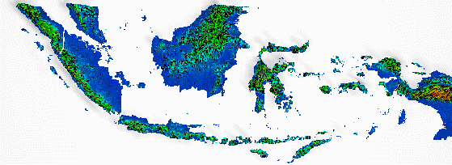
The Forcasting of Sea-Level Rise in Indonesia
Year | Coastal area losses (km²) | Sea-level rise (m)
2010 | 7408 | 0.4
2050 | 30120 | 0.56
2100 | 90260 | 1.1
Source: Susandi et.al, 2008

Slide 14
Concept Loss and Damage
Rapid onset
Slow onset

Slide 15
Rapid Onset
Extreme climate
flooding
thunderstorm
storm surge

Slide 16
Slow onset
The increase in temperature
Increased sea surface
Ocean acidification
Salinization
Land degradation and forest
Loss of biodiversity

Slide 17
Ocean Role on Climate Change
one of the main drivers of climate and weather machine in Indonesia.
one of the major habitats of tropical marine biodiversity in the world as well as sources of food are very important.

Slide 18
Cope with Loss and Damage
Management and Risk Prevention
Insurance
Rehabilitation and Compensation

Slide 19
Follow Up
Socialization and facilitation to the regional government for the preparation of regional climate change adaptation and mitigation strategies
Mainstreaming RAN GRK and RAN-API to the National Mid Term Development Plan (RPJMN) 2015-2019
Monitoring and evaluation of RAN GRK and RAN API implementation

Slide 20
THANK YOU
Direktorat Kelautan dan Perikanan-Bappenas
Jl. Taman Suropati No. 2 Jakarta 10310
Telp/Fax: 021-3107960
Email: kelautan@support.bappenas.go.id

