Slide 1
INTERNATIONAL CENTERS FOR INTERDISCIPLINARY AND ADVANCED RESEARCH INDONESIAN INSTITUTE OF SCIENCES (LIPI-ICIAR)
Diaz D. Santika
W/S on Climate and Societal Change in Coastal Areas of
Indonesia and South East Asia
19-21 February 2014, Grand Sahid Jaya Hotel, Jakarta

Slide 2
International Centers for Interdisciplinary and Advanced Research
ICIAR
Background
E. HRD
ISSUES
F. ICIAR
Challenges
ICIAR
Background
B. ICIAR
Values
C. Instituti-
onalization
D. ICIAR
Programs
LIPI organizes 22 Research Centers and 23 Technical Implementation Units with scientific domain ranging from
Social Sciences & Humanity to Natural & Life Sciences, and
Engineering Sciences.
LIPI is preparing to widen and deepen its all research
activities and programs including its recent strategic
initiatives such as ICIAR. Through ICIAR and other research
initiatives, LIPI is continuing to foster creativity of its
researchers in order to produce new advances in
scientific knowledge, discovery and innovation.

Slide 3
International Centers for Interdisciplinary and Advanced Research
ICIAR
Background
B. ICIAR
Values
C. Instituti-
onalization
D. ICIAR
Programs
E. HRD
ISSUES
F. ICIAR
Challenges
LIPI - ICIAR
Universities
Research Centers
Core Features:
Interdisciplinary and Advanced Research
Research with Training and Education Components

Slide 4
THE VALUES OF ICIAR TO LIPI
ICIAR
Background
C. ICIAR
Values
C. Instituti-
onalization
D. ICIAR
Programs
E. HRD
ISSUES
F. ICIAR
Challenges
Supports for research capacity building of LIPI’s young scientists, in degree and non-degree training programs.
Facilitates developing new interdisciplinary research teams
Helps to maximize LIPI’s contribution in solving real world problems in order to enhance LIPI’s reputation within the country
Strengthens LIPI’s position as a regional/national leader in this merging area.

Slide 5
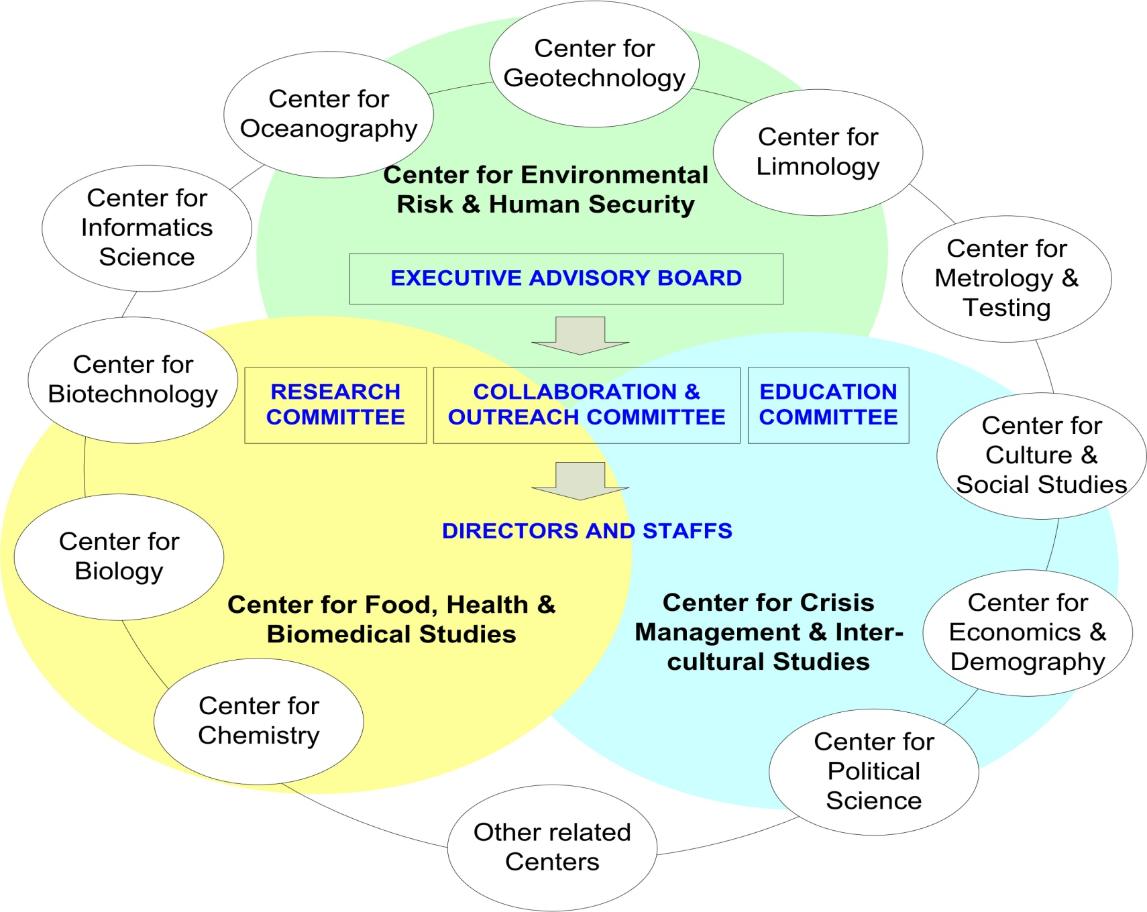
A. ICIAR
Background
B. ICIAR
Values
C. Instituti-
onalization
D. ICIAR
Programs
E. HRD
ISSUES
F. ICIAR
Challenges
ICIAR FITS WELL WITHIN LIPI’s INFRASTRUCTURES

Slide 6
ICIAR
Background
B. ICIAR
Values
C. Instituti-
onalization
D. ICIAR
Programs
E. HRD
ISSUES
F. ICIAR
Challenges
ICIAR FITS WELL WITHIN LIPI’s INFRASTRUCTURES
RESEARCH PROGRAMS, COOPERATIONS, WORKSHOP & SEMINARS
Research Programs
Bio-Geodynamic and Sustainable Environment
Conflict and Crisis Management and Inter-Cultural Studies
Green Advanced Materials
Food, Health, and Biomedical Studies
Coastal Community Resilience
Climate Change and Disaster Risk Management
Research Capacity Building :
Degree and Non-Degree Training Programs
LIPI’s Leadership Development Programs
Short Courses, Summer Schools
Problem Based Action Learning Projects

Slide 7
ICIAR
Background
B. ICIAR
Values
C. Instituti-
onalization
D. ICIAR
Programs
E. HRD
ISSUES
F. ICIAR
Challenges
ICIAR FITS WELL WITHIN LIPI’s INFRASTRUCTURES
COASTAL COMMUNITY RESILIENCE
Objectives
Provide basic need and fair opportunities for livelihoods
Reduction of vulnerabilities of coastal communities
Preservation and conservation of critical ecosystems (coral reef, sea grass bed, etc)
Prepare important data and information for coastal land use planning
Develop sustainable management model for coastal resources (biotic and abiotic)
Goals
Creating sustainable livelihoods and
Reducing the poverty level of coastal communities
Creating sustainable and integrated coastal management systems

Slide 8
ICIAR
Background
B. ICIAR
Values
C. Instituti-
onalization
D. ICIAR
Programs
E. HRD
ISSUES
F. ICIAR
Challenges
ICIAR FITS WELL WITHIN LIPI’s INFRASTRUCTURES
COASTAL COMMUNITY RESILIENCE
Program Priorities
Ensuring fresh and save water availability
Safety from man-made and natural hazards
Optimizing use of coastal lands
Enforce economic growth based on non-rural employment
Sustainable and equitable natural resources management
Environmental conservation
Empowerment through knowledge management
Creating an enabling institutional environment

Slide 9
ICIAR
Background
B. ICIAR
Values
C. Instituti-
onalization
D. ICIAR
Programs
E. HRD
ISSUES
F. ICIAR
Challenges
DEGREE & NON-DEGREE PROGRAMS OF RISET-PRO SCHOLARSHIPS
No | DESCRIPTION | 2013 | 2014 | 2015 | 2016 | 2017 | 2018 | TOTAL
 | Degree Program
1 | PhD (S3) (LN) | 30 | 70 | 70 | 53 |  |  | 223
2 | Master (S2) (LN) | 5 | 11 | 12 | 11 | 11 |  | 50
 | Number of Scholar | 35 | 81 | 82 | 64 | 11 |  | 273
 | % | 12.82 | 29.67 | 30.04 | 23.44 | 4.03 |  | 100%
 | Non-Degree Programs
3 | Tailor made (LN) | 25 | 40 | 40 | 40 | 40 | 40 | 225
4 | Tailor made (DN) | 25 | 25 | 25 | 25 | 25 | 25 | 150
5 | Off the shelf (LN) | 25 | 25 | 25 | 25 | 25 | 25 | 150
6 | Off the shelf (DN) | 25 | 25 | 25 | 25 | 25 | 25 | 150
7 | Work Placement (LN) | 10 | 14 | 14 | 15 | 15 | 15 | 83
8 | Work Placement (DN) | 10 | 14 | 14 | 15 | 15 | 15 | 83
9 | Visiting scholar | 10 | 16 | 16 | 16 | 16 | 16 | 90
 | Number of Scholar | 130 | 159 | 159 | 161 | 161 | 161 | 931
 | % | 13.97 | 17.08 | 17.08 | 17.29 | 17.29 | 17.29 | 100%
 | Total Number of Scholar | 165 | 240 | 241 | 225 | 172 | 161 | 1204
 | % | 13.71 | 19.93 | 20.02 | 18.68 | 14.29 | 13.37 | 100%

Slide 10
ICIAR
Background
B. ICIAR
Values
C. Instituti-
onalization
D. ICIAR
Programs
E. HRD
ISSUES
F. ICIAR
Challenges
DEGREE PROGRAM OF RISET-PRO SCHOLARSHIPS
No. | LPNK | NUMBER OF QUOTA/YEAR |  |  |  |  |  |  |  |  |  |  |  | Total ∑
 |  | 2013 |  | 2014 |  | 2015 |  | 2016 |  | 2017 |  | ∑
 |  | S2 | S3 | S2 | S3 | S2 | S3 | S2 | S3 | S2 | S3 | S2 | S3
1 | BATAN | 1 | 6 | 1 | 16 | 2 | 15 | 1 | 11 | 1 | 0 | 6 | 48 | 54
2 | Bapeten | 0 | 2 | 1 | 2 | 1 | 2 | 1 | 1 | 1 | 0 | 4 | 7 | 11
3 | BPPT | 1 | 7 | 2 | 17 | 2 | 17 | 2 | 14 | 2 | 0 | 9 | 57 | 64
4 | BSN | 0 | 1 | 1 | 2 | 1 | 3 | 1 | 2 | 1 | 0 | 4 | 8 | 12
5 | LAPAN | 1 | 3 | 1 | 9 | 1 | 8 | 1 | 5 | 1 | 0 | 5 | 25 | 30
6 | LIPI | 1 | 7 | 2 | 18 | 2 | 18 | 2 | 15 | 1 | 0 | 8 | 58 | 66
7 | BIG | 0 | 2 | 1 | 1 | 1 | 2 | 1 | 1 | 2 | 0 | 5 | 6 | 11
8 | Ristek | 1 | 1 | 1 | 3 | 1 | 3 | 1 | 2 | 1 | 0 | 5 | 9 | 14
9 | 6-KE | 0 | 1 | 1 | 2 | 1 | 2 | 1 | 2 | 1 | 0 | 4 | 7 | 11
∑ |  | 5 | 30 | 11 | 70 | 12 | 70 | 11 | 53 | 11 | 0 | 50 | 223 | 273

Slide 11
ICIAR
Background
B. ICIAR
Values
C. Instituti-
onalization
D. ICIAR
Programs
E. HRD
ISSUES
F. ICIAR
Challenges
ICIAR FITS WELL WITHIN LIPI’s INFRASTRUCTURES
ICIAR MAJOR CHALLENGES
Solve difficult problems with short term expectations
Deliver examples of success so that the country and the
societies can see the benefits and capability of the
center
Develop a research platforms/themes and capabilities
that are unique and competitive at the national/
international research competitions

Slide 12
TERIMA KASIH

