Slide 1
Selected Case Study and Main Findings on Vulnerability And Risk Assessment in Rural Coastal of Indonesia
Herry Yogaswara
Research Center for Population
Indonesian Institute of Sciences
First International Workshop on
“Climate and Societal Change in Coastal Areas in Indonesia and Southeast Asia”
UNU-EHS and LIPI-ICIAR
Jakarta, 19-21 February 2014

Slide 2
Coastal Areas in Indonesia
Source : Suprajaka, Poniman and Hartono, 2005)
Coastal Lines 81,000 kms
(2008) : population under the poverty lines 34,96 millions and 63,47% inhabitant of coastal and rural
Rocky Coastal, Sand Coastal and Mud Coastal.

Slide 3
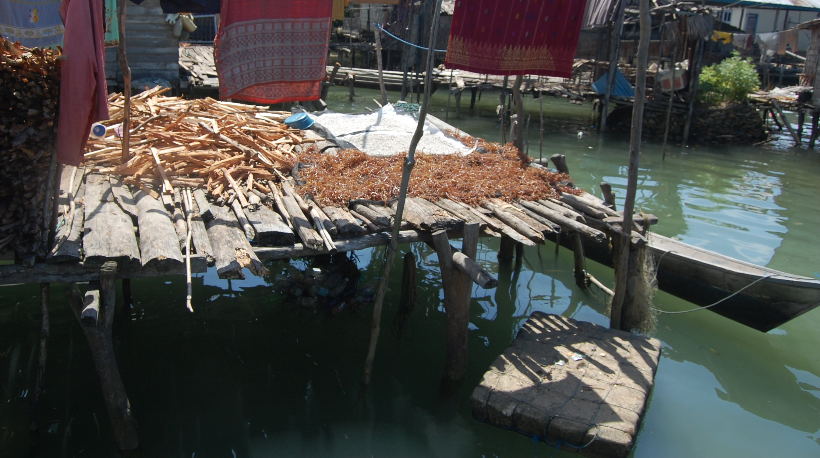
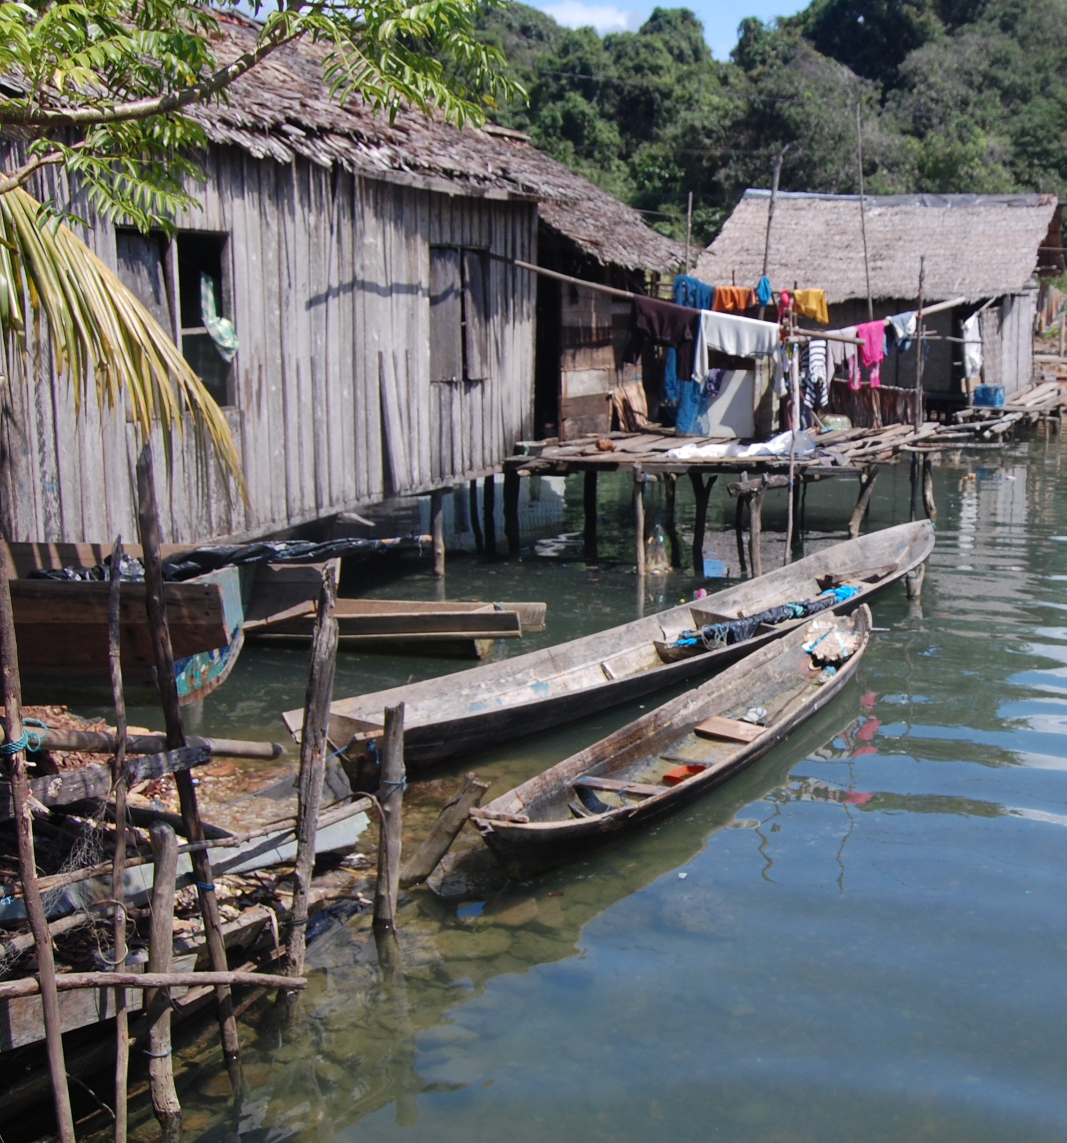
Rural Coastal Areas
Fishing Communities
Mixed Fishing Communities, Fish ponds and Food Crops
Urban Coastal Areas
Border Urban-Coastal Areas
Coastal Areas in Small Island (+remote small Island), examples of Bajau/Bajo/Sama/Orang Laut

Slide 4
Problems
7,8 millions peoples in rural coastal areas are poor (CBS, 2010)
High rate environmental degradation in coastal areas
Low of self sufficient and degraded of local culture
Low village infrastructure and environmental health problems → They are vulnerable people by access and socio-economic condition

Slide 5
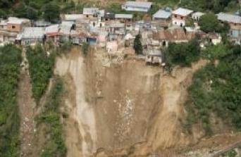
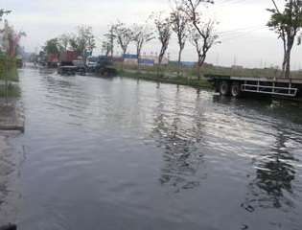
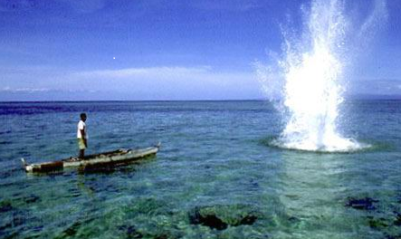
Natural Resources Degradation, Climate Change and Disaster
Environmental Degradation : Destruction of Coral Reef; Conversion of Mangroves Forest ; Conflict over Tenure ; Pollutions
Impact of Climate Change: Sea Level Rise, Coral Reef Bleaching, Diminished of Fish
Disaster : Earthquake, Tsunami, Landslide, Floods, Typhoon

Slide 6
Forced Migration
“Environmental Refugee” : No Pull Factor, but Push Factor, People should leave their homeland to safer area → flood, landslide, tsunami
Seasonal Migration → Coping mechanism from uncertainty of livelihood (Perception of pull and push factors)
DIDR → Development Induce, Displacement and Resettlement (Examples of Reclamation areas, waterfront city etc)

Slide 7
Risk and Risk Perception
Risk is defined by the probability of an unwanted event occurring and by the magnitude of its consequences, and risk perception refers to the views or attitudes that people have of risks.
Risk perception is usually studied, as reviewed in detail by Renn and Rohrmann (2000) (1) to establish risk as a subjective concept, not an objective entity, (2) to include technical/physical and social/psychological aspects in risk criteria, (3) to accept options of “the public” (i.e., lay people, not experts) as the matter of interest, and (4) to analyze the cognitive structure of risk judgments, usually using multivariate statistical procedures.
Cultural approach, risk is a social and cultural construction, not an objective entity to be measured independently of the context in which hazards occur”

Slide 8
Local Knowledge
Local knowledge is variously referred to as folk knowledge, traditional knowledge, indigenous knowledge, traditional environmental knowledge, indigenous traditional knowledge, indigenous agricultural knowledge, farmers’ knowledge, rural people’s knowledge, peasants’ knowledge, ethno-science, etc.
Based on experience, often tested over centuries of use, and entails many insights, perceptions and intuitions relating to local culture and the environment. It is both dynamic and complex, and is not confined to knowledge about uses and products but also about processes.

Slide 9
Cases : District of Demak, Central Java and Island of Bali

Slide 10
District of Demak
Demak is a district part of Central Java, the coastal area well known as pantai utara jawa (Northern Java’s Coast), the most important region area in Java Island, connecting between provinces in the island, Sumatera and Bali.
There are typologies of border rural-urban coastal communities, rural fishing communities and mixed livelihood between fishing and food crops
Cases two areas : (1) border urban-rural coastal communities with problems of tidal-flood, hamlet’s sinking and forced migration (2)

Slide 11
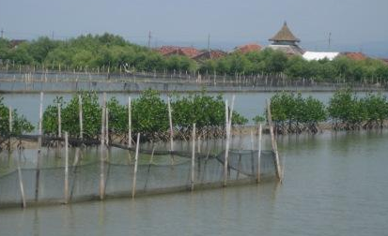
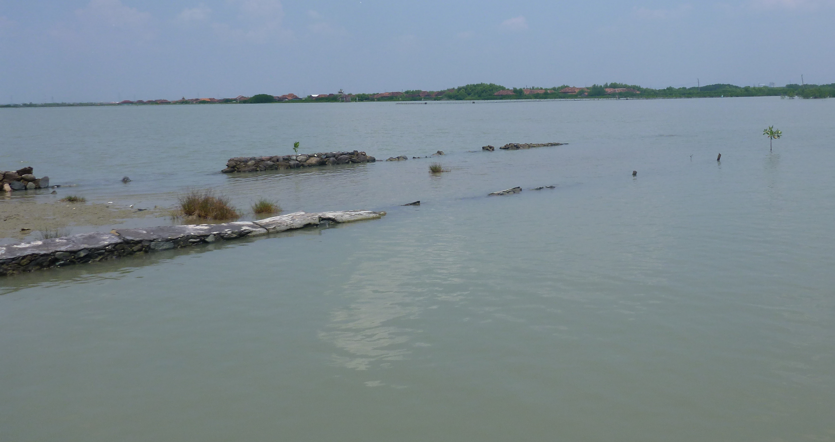
Tidal Flood (Banjir Rob) : Scientific Debate, Who care Community ?
Village of Bedono of sub-District of Sayung hase been experiencing tidal flood almost 20 years. Recently some hamlet has been sinking and could be settled anymore :
Sea level rise has no significant impact since only 7,5 mm per year (?)
Development of Marina and sea-port in Semarang City affectted to abration. In the last 10 years the coast line extend to 650 meter backward
Factories need deep water and affeceted to the . Kegiatan Pengambilan Air tanah oleh industri

Slide 12
How to Survive ?
Leave their hamlet move to other place nearby
Sell their land with low price (IDR 5000/m2)
Changing livelihood from fisher folk become petty trader, labor in factory, construction worker, and food stall
Civil Society Organization efforts to planted mangrove forest or reforestation
Hoping government do something with infrastructure to reduce flood

Slide 13
Moro Demak : Uncertain Season
Important sea-port for fishing boat in Central Java
Problems of tidal-flood and uncertain season
Affected mostly for small fisherman than big-scale fishing (size of boat and modes of fish cath)

Slide 14
Risk and Vulnerability
Peoples are more vulnerable while they have no capacity or low capacity to understand external factors affected to their community

Slide 15
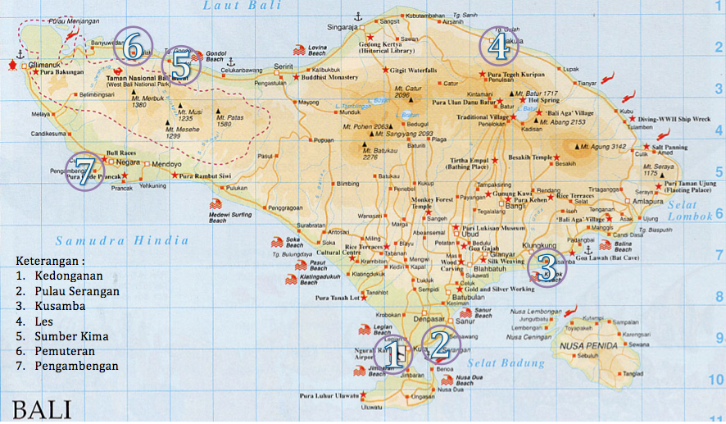
Why Bali ?
Report about impact of climate change related to weather anomaly, coral bleaching, impact of ENSO.
Loss of Sardinella sp (lemuru) in the particular season.
Uses of fish bomb and poison
Coral-mining and coast reclamation
Local Knowledge
Bali Action Plan 2007 contribute to world’s efforts on climate change, how it’s backyard ?

Slide 16
Rural Coastal Communities in Bali : Pengambengan
Located in sub-District of Negara, District of Jembrana. Approximately 125 kilometer from Denpasar
Fishing sea-port (5-10 GT dan 10 GT up). Fisherman are seasonal migrant from northern coast of East Java Province, such as Banyuwangi and Muncar.
Seasonal uncertainty and diminishing sardinella, while fisherman perception of “missing of fish”, but scientifically proven because of dynamic of sea-water, related with temperature in the Pacific ocean.
Coping mechanism of temporary migration to their homeland in East Java.

Slide 17
Kedonganan : Fishing and Tourism
Typologi border urban-rural coastal communities
Changing division of labor Balinese fisherman into tourism. Migrant from East Java replace their position
Uncertain of weather and season need to cope with livelihood strategy between fishing and tourism.
Issues of carrying capacity of tourism area
Discourse on sustainable tourism by local-elite

Slide 18
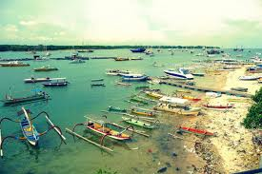
The Serangan Island : After the Reclamation
Reclamation of the area, diminishing local’s income.
Ecosystem degradation due to reclamation activities, especially for turtle habitat and mangroves
Coral mining and uses of Potassium by local
Alternative livelihood : tourism education and sea-grass.

Slide 19
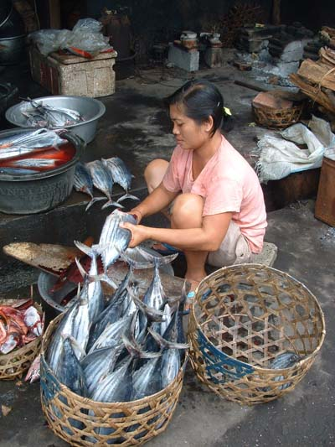
Kusamba : Home Industry based on Fish Product
Located in Klungkung District
Problems of uncertain of weather and season affected to their livelihood.
Balinese’s, ancestor from Bugis (South Sulawesi). Acculturation between Hinduism and Islam
Home industry processing of fish-steam (pindang)

Slide 20
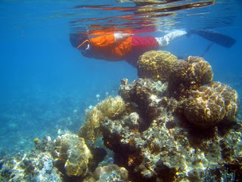
Village of Les : When Conservation and Arts Meet
Located in sub-district of Tejakula, District of Buleleng
Coral Reef degradation due to poisoning
Balinese with strong customary influence
Initiative from NGO and local to have program conservation of coral reef with artificial reef

Slide 21
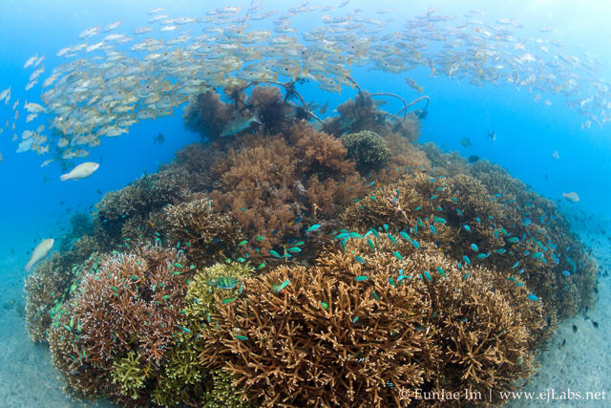
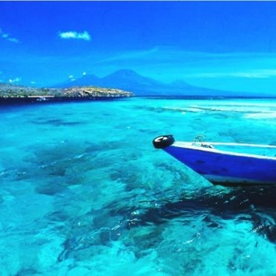
Pemuteran : Community Based Tourism
Community Based Tourism with creative industry
Artificial Reef (biorock)
Cooperation between Customary Village and Government

Slide 22
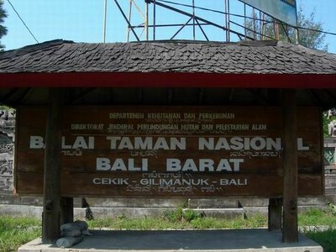
Sumber Kima : Conservation through Community Based
Migrants from Madures and Buginese
Problems of Coral Bleaching
Collaborative works facilitated by WWF

Slide 23
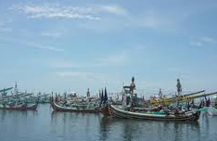
Learning from Bali : Coping Mechanism or Adaptive Strategy ?
Adjust time go fishing
Looking for new fish catchment area
Adjust fish species
Non Fishing Activities :
Tourism services → “Nelayan Tourist”
Construction Worker
Division of Labour Among Family Member.
Debts
Temporary go to homeland

Slide 24
Lesson to be Learned
Rural Coastal areas in Indonesia varies based on livelihood, geographical areas, type of communities, population structure, culture heterogeneity and outsider intervention. These are creating different risk perception, level of vulnerability and coping mechanism.
Important to understand “localities”. In one village, there are different peoples with different need. It is important to see problem in the micro-level and put attention to whom most vulnerable in the community.
Community has capacity to coping threat from outside; the role of outsider is facilitate enhance community it reach their goals.
There is no single factor threat rural coastal communities, attention to impact of climate change should equally consider environmental degradation through mismanagement of natural resources.

Slide 25
Further (Possibility) Research Agenda
Population Dense area of rural-coastal (including border areas) still important to be studies, but put more attention on qualitative measurement, including resilience of local organization and capacity of local knowledge to solve the problems
Rural-coastal areas in small island and remote coastal areas is also important to be studied, since they seem to be “unforgotten peoples” in regards of policy and disaster management
Local Knowledge is important to be studied, but it should be on the framing of dynamic of society, culture and policy. Local knowledge is local practices and hybrid knowledge, using in daily life and changing over the time

Slide 26
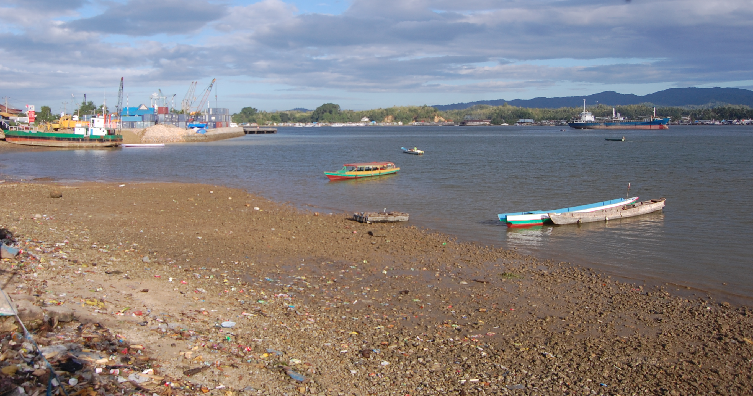
Thank You
Thank You

