Slide 1
COMMUNITY VULNERABILITY AND RISK
IN FACING CLIMATE AND ENVIRONMENTAL CHANGES IN JAKARTA
Deny Hidayati
PPK – LIPI
Jakarta
19 February 2014

Slide 2
OUTLINE
Background: Jakarta Prone Area
  Climate changes
  Environmental changes : development and man made process
Community Vulnerability Condition
How Vulnerable and Risky the Kamal Muara Community & its Livelihood in Jakarta Bay
Summary

Slide 3
JAKARTA PRONE AREA TO CLIMATE CHANGES
The most vulnerable in Southeast Asia (EEPSEA)
The third worst in Asian Mega Cities (WWF)
Increase temperature 1.42⁰C in July and 1.04⁰C in January every 100 year | Rainfall Change in Average Monthly rainfall Extreme weather Events | Sea Level Rise 5.7 mm/year in Jakarta 20Bay 0.8 meter 5 cm rise by 25 | Land Subsidence Average 5 cm per year Coastal areas : up 12 cm/year
Sources: ITB (2010, 2011) and World Bank (2011)

Slide 4
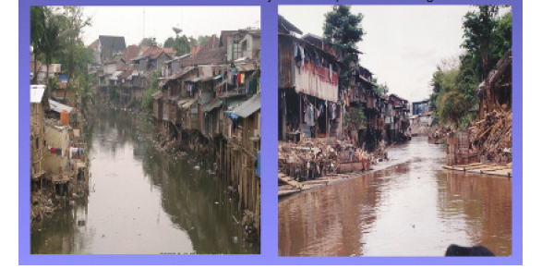
DEVELOPMENT - MAN MADE PROCESS
Extensive development in coastal areas Sea ports, coastal resorts, golf course, residential areas, condominium, malls, hotels, industries, commercials and office buildings & coastal reclamation
Excessive construction in Jakarta water catchment areas poor watershed management Poor drainage
Negligent behavior of urban people

Slide 5
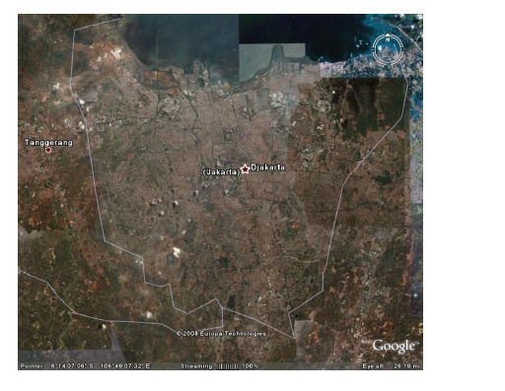
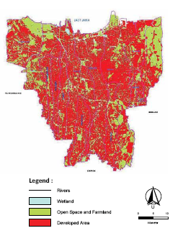
LAND USE CHANGE
THE BUILT-UP AREAS IN JAKARTA IN 2008
Cover : 90 % of the Region
Source: Abidin et all, 2010

Slide 6
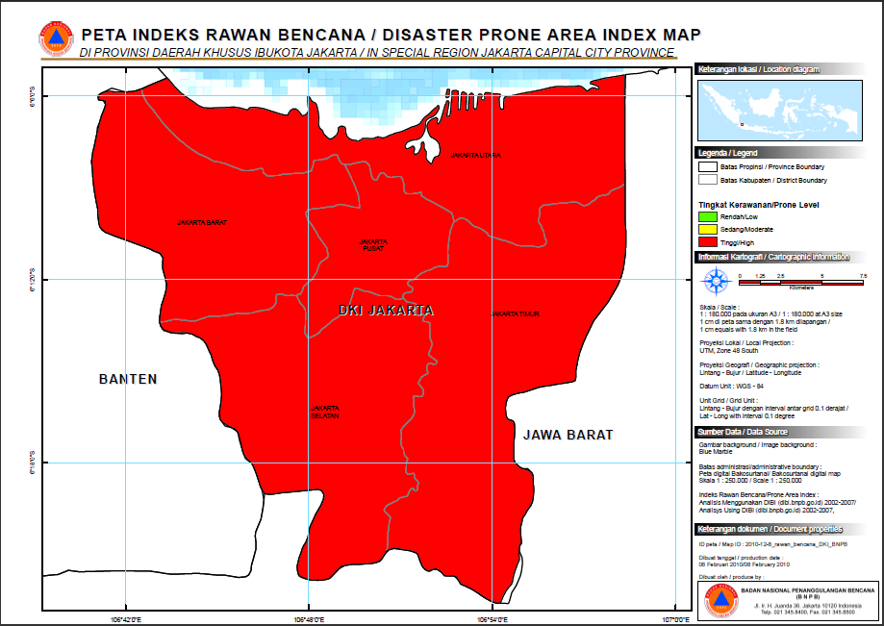
JAKARTA PRONE AREAS
Climate Change
  The top list : North, Central and West Jakarta
  The second top list : East Jakarta
  Source:(EEPSEA)& WWF
Source: BNPB, 2011
Flood (out of 174 list |  | Drought (out 0f 182 list) |  | Earthquake (out of 151 list)
2 | North Jakarta | 8 | North Jakarta | 80 | West Jakarta
3 | West Jakarta | 9 | East Jakarta | 95 | North Jakarta
 |  | 10 | Central Jakarta | 122 | East Jakarta
 |  | 11 | West Jakarta | 137 | South Jakarta
 |  | 37 | South Jakarta
Source: BNPB, 2010

Slide 7
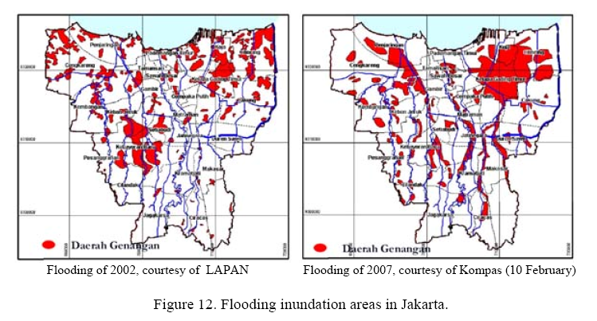
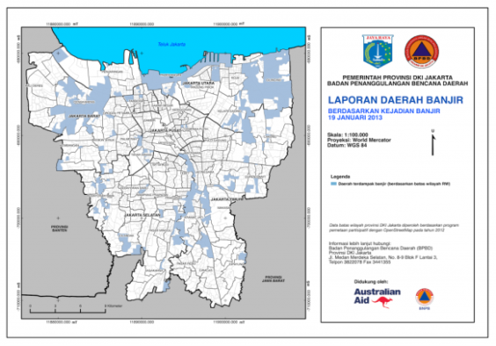
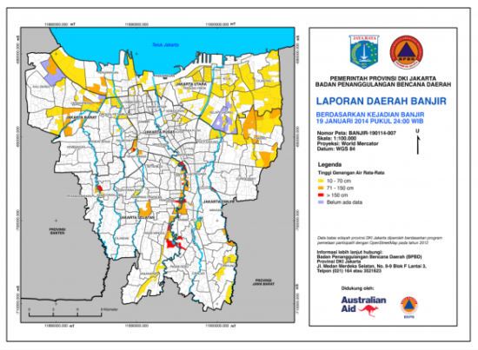
FLOODING
Source: Abidin et al, 2010
Flloding of 2013 Flooding of 2014
Source: BPBD DKI Jakarta, 2014

Slide 8
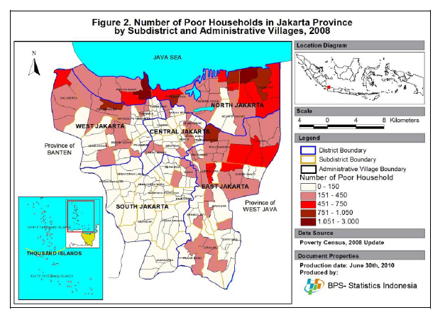
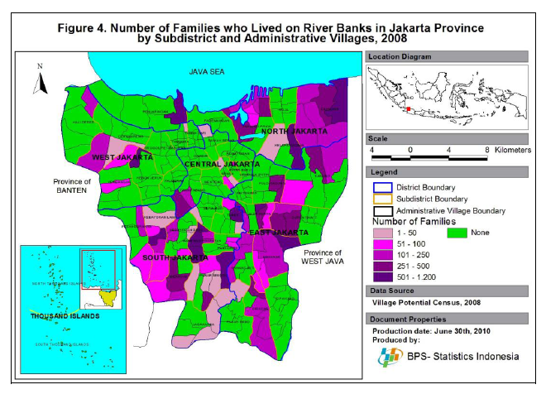
JAKARTA’S POOR
Living along water ways
and on the coast
Concentration of the poor
  North Jakarta
  East Jakarta
  West Jakarta
(Hasanuddin, 2008)
Number of families living on river banks in Jakarta

Slide 9
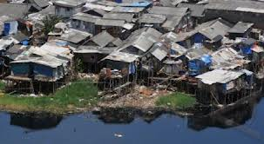
THE JAKARTA POOR COMMUNITIES
Settle in unregistered lands and slum areas
→ Unregistered Inhabitants
Informal settlements → pocket of poverty
Unskilled labor
Informal activities
Mostly working in informal jobs
Low income
Many in below poverty line
VULNERABLE
Physically
Economically
  Livelihood and employment in the
  same areas

Slide 10
COMMUNITY AWARENESS AND RESPONSE
TO FLOOD RELATED DISASTERS
Lack of Awareness
Lack choices of Response
The use of rivers/canals for disposal of their solid wastes
Reluctant or unable to leave their homes and assets
Settle in dense, but tenuously constructed housing
Low income
Lack provision of basic services (adequate housing, clean water, garbage collection)
Have less information
Fewer safety net

Slide 11
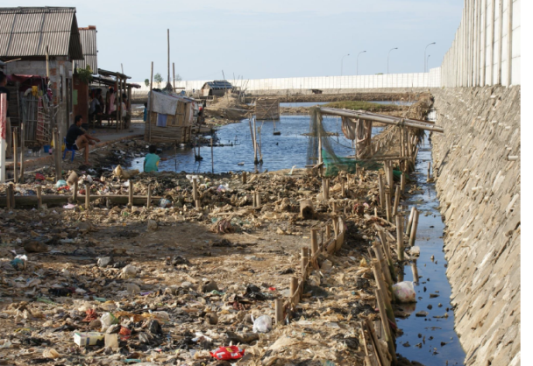
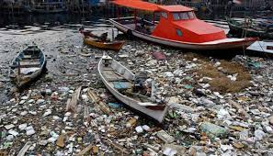
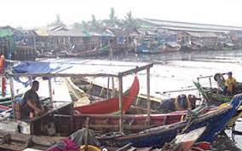
HOW VULNERABLE COMMUNITY
IN NORTH OF JAKARTA
The top list of the most vulnerable area of climate change
The second top list of Jakarta land subsidence
Degradation of ecosystem (mangrove destruction, sand and coral extraction, destructive and over fishing, water pollution)
The Jakarta bay as the mouth of waste (domestic and industrial activities) -transported through 13 rivers and canals
Slum with flood areas
Pocket of poverty

Slide 12
LESSONS FROM KAMAL MUARA HAMLET,
PENJARINGAN SUB-DISTRICT, JAKARTA BAY
Living on the coast & waterways
Rob Flooding
Flooding
Unmanaged water pollution
Coastal reclamation
Pocket of poverty
Lack of basic service delivery
Livelihood
at Risk
Fishing at risk
Lack & expensive fresh & clean water
High risk for illness

Slide 13
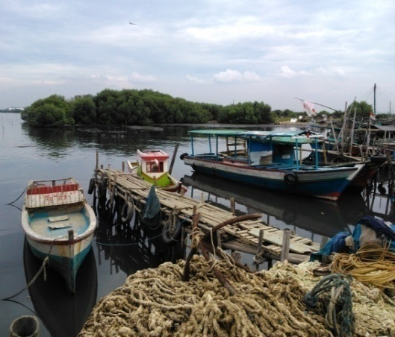
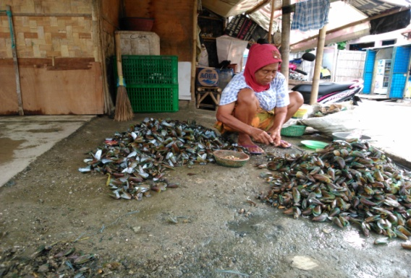
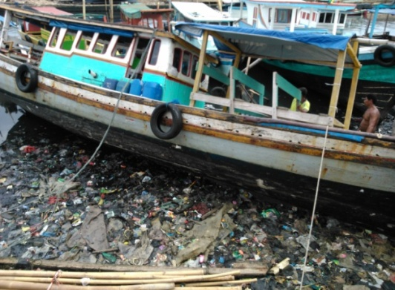
FISHING AT RISK,
KAMAL MUARA, JAKARTA BAY
Significant decrease in green oyster cultivation units/area
Substantial decrease in fishing areas and activities
Water pollution/contamination
Mangrove & environmental degradation

Slide 14
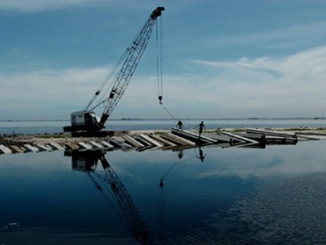
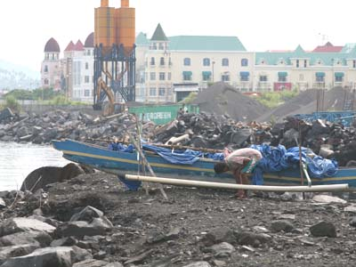
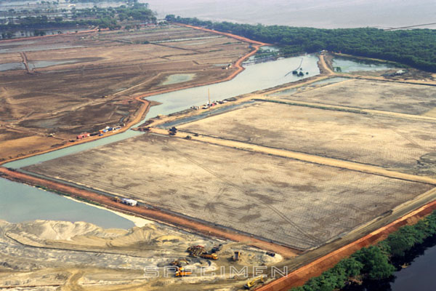
SIGNIFICANT REDUCTION
OF GREEN OYSTER CULTIVATION
Domination of green oyster cultivation &main source of income
Serious problems facing for sustainable cultivation :
Coastal reclamation
  A half of cultivation area (around 13,000 units or 360 ha) has been closed, reimbursed & converted to reclamation purposes
  Limited suitable area for oyster cultivation

Slide 15
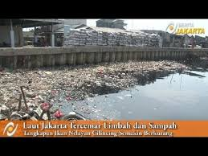
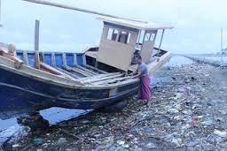
REDUCTION OF GREEN OYSTER CULTIVATION
Unmanaged water pollution
  Liquid waste from nearby factories and industries (textile, metal and plastic)
  domestic /solid waste. About 1100m³ of waste fows directly to the bay
  Green oyster cultivation waste
Impacts of climate change on the cultivation

Slide 16
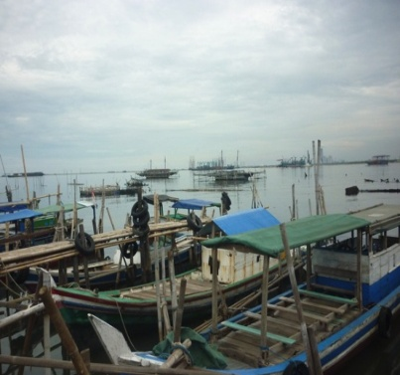
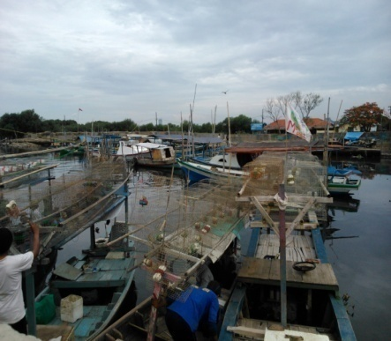
THREAT TO FISHING ACTIVITIES
Coastal reclamation:
  Significant reduction of fish catching areas: Sero (like fish traps), bagan, fishing nets and hook&lines
Water pollution from inland and sea activities
Mangrove & environmental degradation
Climate change Impacts: changes in fishing seasons &time, catching areas & gears
Limited access for fishing boats & technology, whereas fishermen must go for fishing far away

Slide 17
FISHERMEN’S PERCEPTION TOWARD IMPACTS OF CLIMATE CHANGE ON THEIR FISHING ACTIVITIES
Impacts | Percentage
Disturbed green oyster cultivation | 63.3
Disturbed fishing time | 100.0
Disturbed fishing area | 100.0
Affected to types of fishing gears | 83.3
Reduce fish production | 70.0
N | 30
Source: LIPI and MKG-ICCTF, 2010

Slide 18
FISHERMEN’S EFFORTS
TO ADAPT TO CLIMATE CHANGES, KAMAL MUARA, 2010
Efforts | Percentage
Change in fishing cultivation type/aqua culture | 16.7
Changes in fishing gears/technology | 40.0
Changes in fishing boats | 33.3
Changes in fish catching area | 66.7
Changes in fishing time | 86.7
Changes in types of fish catching | 70.0
N | 30
Source: LIPI and BMKG-ICCTF, 2010

Slide 19
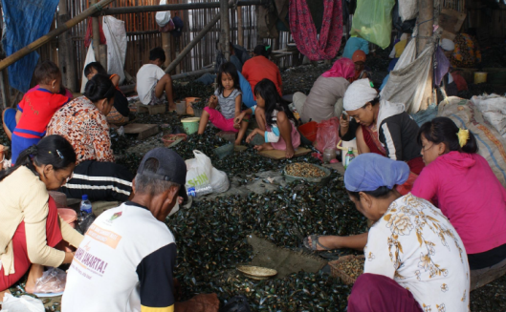

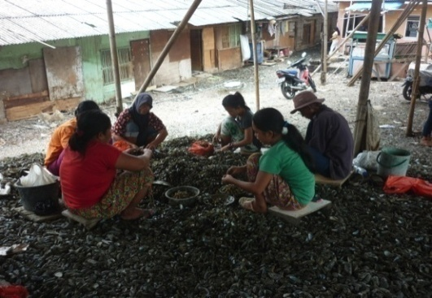
COMMUNITY LIVELIHOOD AT RISK
Substantial decrease in oyster production
  Production in 2013 about 1/3 compared with production in the late 1990s
High impact to Kamal Muara Community Livelihood
  80 % of people in RW 1 & RW 4 are fishermen
  Most fishermen are green oyster cultivators
  Most women work in oyster & fishing related activities

Slide 20

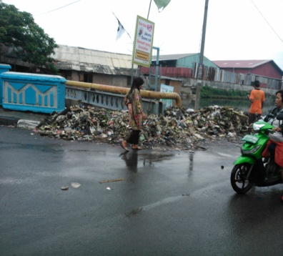
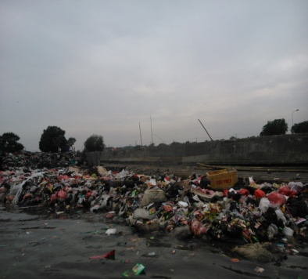
PROBLEM RELATED TO WATER QUALITY
Water fresh during rainy season and become salty during dry season
Water from bored well still unhealthy for drinking
Salt water intrusion to well
Water contamination due to unmanaged waste disposal

Slide 21
SUMMARY
Jakarta poor communities are physically and socio-economically vulnerable to climate and environmental changes - related disasters
The poor communities have limited awareness and lack choices of response
They have low of adaptive capacity: lack of awareness, lack of information and lack of access to basic services
The poor communities therefore face the greatest risk to climate and environmental changes - related disasters
The crucial need to increase community awareness, poverty alleviation and disaster risk reduction.

Slide 22

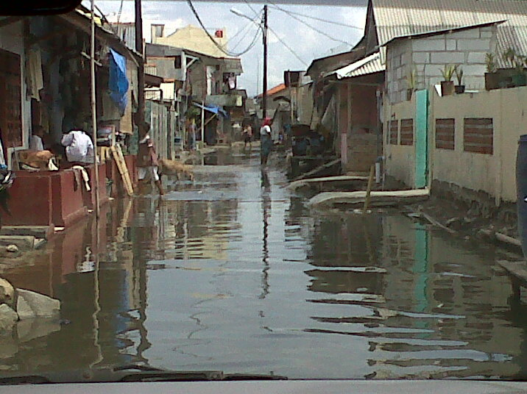

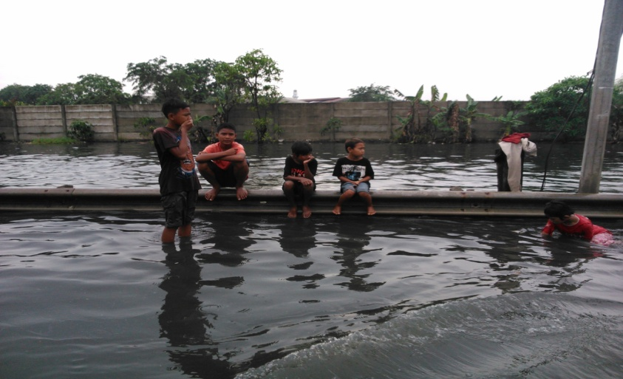
Thank You

