Slide 1
The importance of higher education research networks to investigate aggravating effects of Climate Change on species invasion into Indonesian marine ecosystems
Research / Integration & Internationalization
1st International TWIN-SEA Workshop
Feb 19-22, 2014
Dr. Carsten Thoms
DAAD Longterm Lecturer
Marine Sciences
Bogor Agricultural University (IPB)

Slide 2
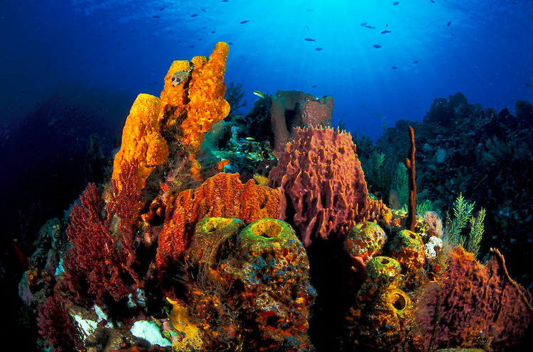
http://stevejones.photoshelter.com
Sponges in a coral reef
Carsten Thoms – slide 2/21

Slide 3
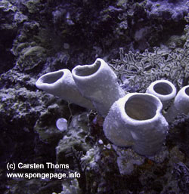
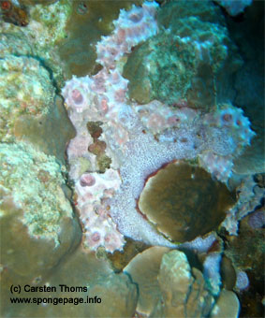
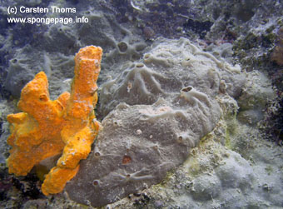
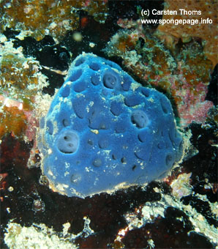
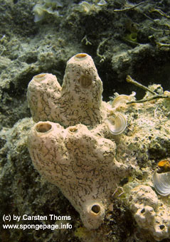
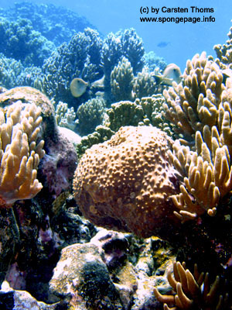
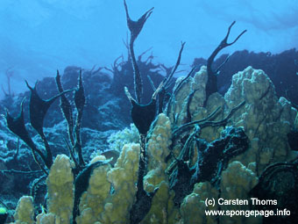
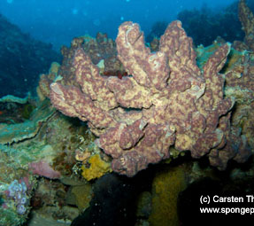
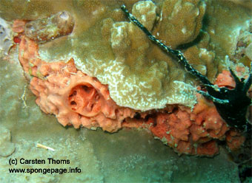
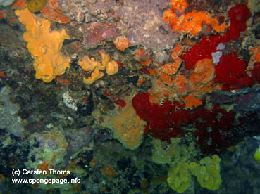
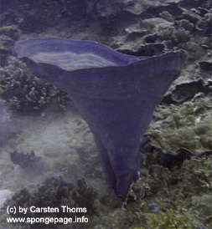
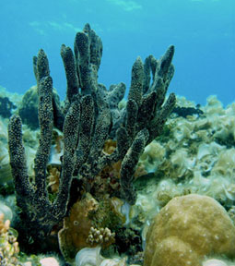
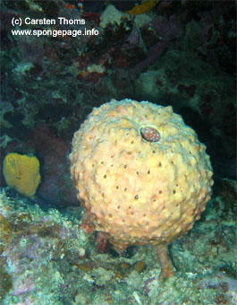
Marine sponges
> 12,000 species world-wide
Many sponges produce chemicals with pharmaceutical activity
(new “drugs from the seas” against cancer, malaria, inflammation, HIV…)
Sponges provide important ecosystem functions in intact coral reefs
Carsten Thoms – slide 2/21

Slide 4
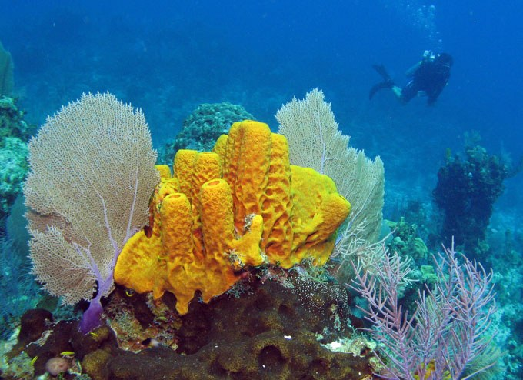
http://stevejones.photoshelter.com
Healthy co-existence between sponges and corals
Carsten Thoms – slide 4/21

Slide 5
Published in Global Change Biology (September 2013):
Research / Integration & Internationalization
Authors’ hypotheses:
sponges profit from the climate change-induced weakness of corals
this may result in sponge proliferation in coral reefs
Carsten Thoms – slide 5/21

Slide 6
Published in Global Change Biology (September 2013):
has repeatedly happened in the past (e.g. at transition from Triassic to Jurassic period (200 MYA))
was accompanied by ocean acidification
resulted in sponge dominance that persisted over several million years and had severe impacts on reef ecosystem functions
Carsten Thoms – slide 6/21

Slide 7
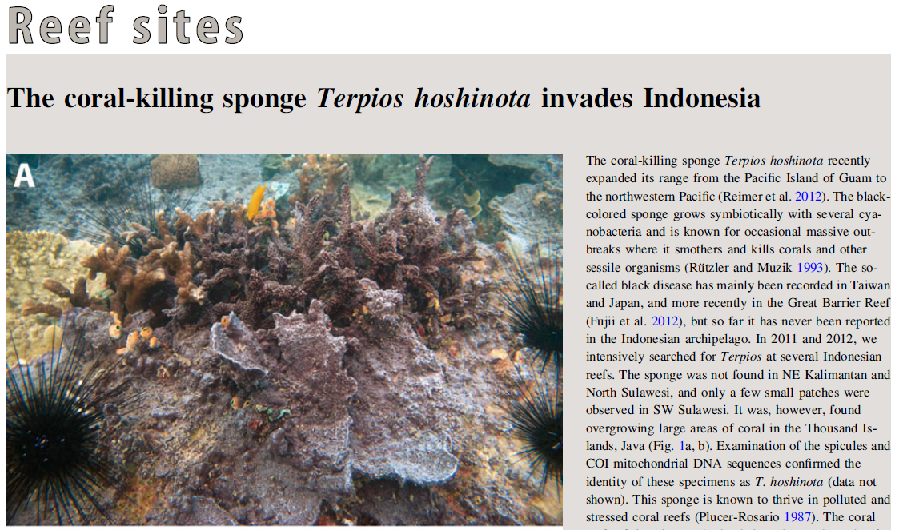
Recent observation:
DeVoogd et al. Coral Reefs (2013)
Carsten Thoms – slide 7/21

Slide 8
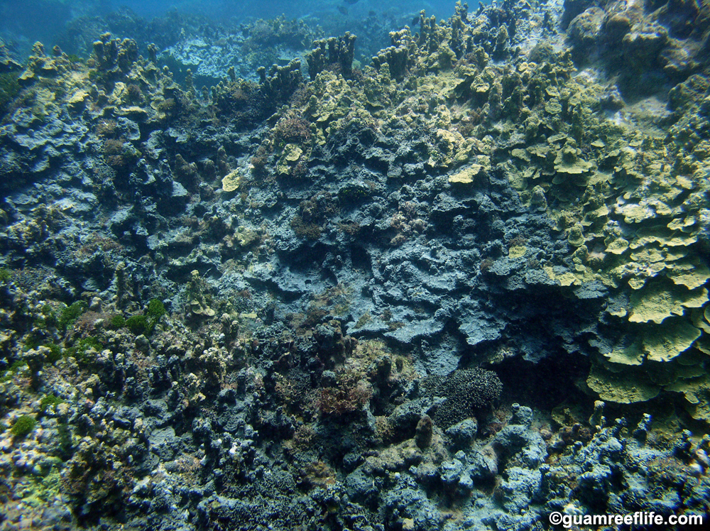
T. hoshinota overgrows large patches of coral reefs and occupies reef substrata for many months or years
Carsten Thoms – slide 8/21

Slide 9
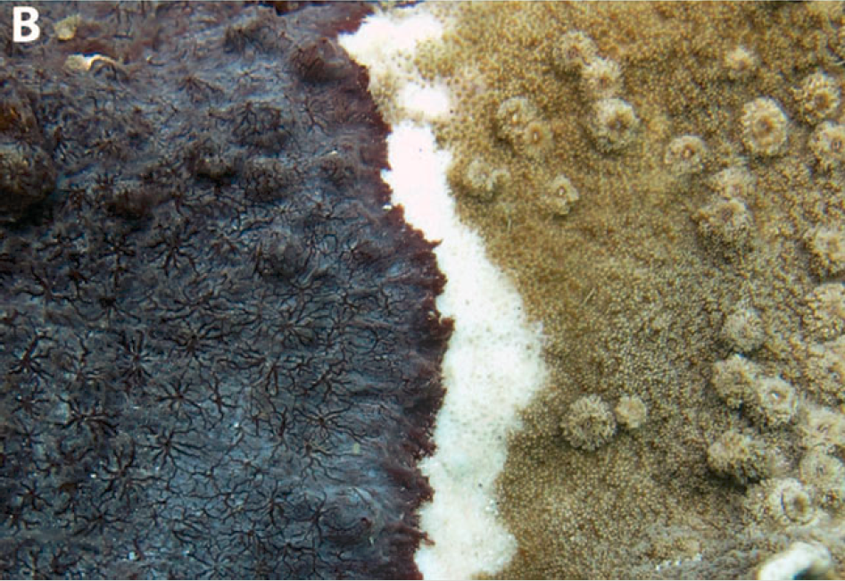
Overgrowth results in coral death; juvenile corals do not resettle on the original reef
sponge T. hoshinota
bleached coral
coral
DeVoogd et al. Coral Reefs (2013)
Carsten Thoms – slide 9/21

Slide 10
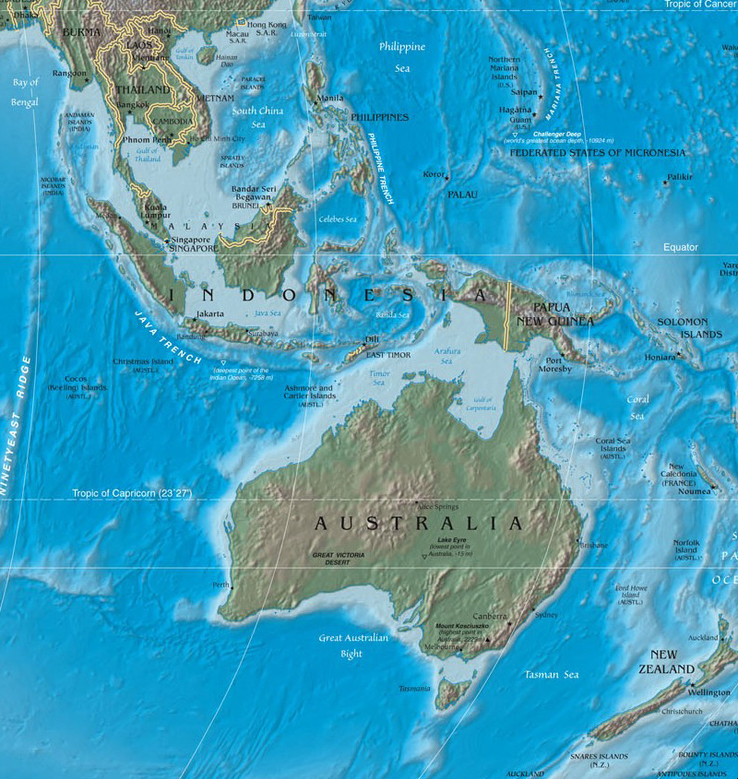
Invasion of Terpios hoshinota into SEA coral reefs
Japan 1993
·
Taiwan 2007
·
Thailand 1987
Philippines 1987
Guam & Marianas 1973
·
·
·
·
Indonesia 2013
·
·
·
Great Barrier Reef 2012
·
Carsten Thoms – slide 10/21

Slide 11
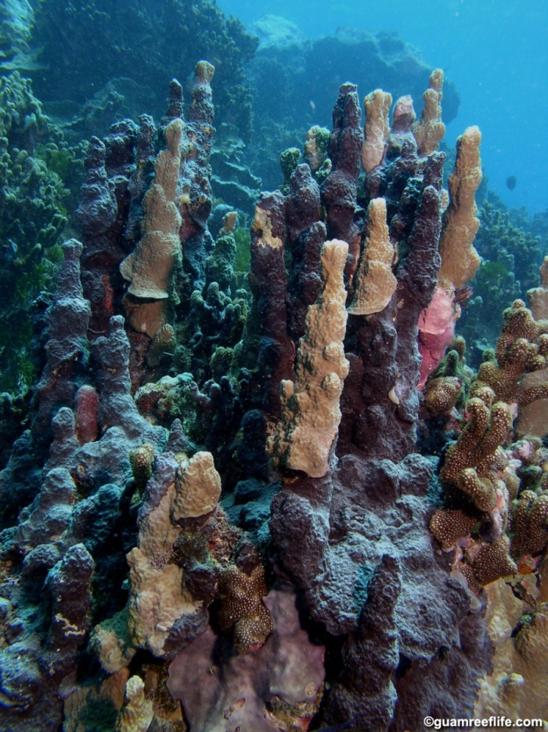
Terpios hoshinota invading Indonesia
T. hoshinota probably underreported in SEA
Kalimantan
·
SW Sulawesi
→ especially successful in stressed reefs!
Kepulauan Seribu
·
·
Bali
·
IS THERE A LINK BETWEEN THE TWO FINDINGS ???
Carsten Thoms – slide 11/21

Slide 12
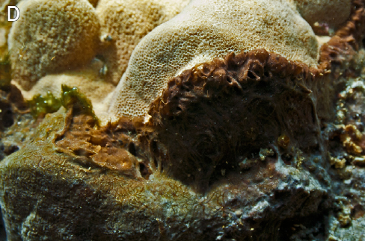
New observation (Schils 2012, PLoS One):
T. hoshinota in association with filamentous cyanobacteria
coral
Observation by Schils 2012:
Sponge becomes more successful and quicker in killing corals when in association with filamentous cyanobacteria
filamentous cyanobacteria
Corroborated by other studies (e.g. Diaz et al. 2007; Thacker et al. 2007)
But: Increased water temperature may stimulate rapid cyano-bacterial symbiont growth that may also be deleterious to the
host sponge (e.g. Rützler 1988)
T. hoshinota
Carsten Thoms – slide 12/21

Slide 13
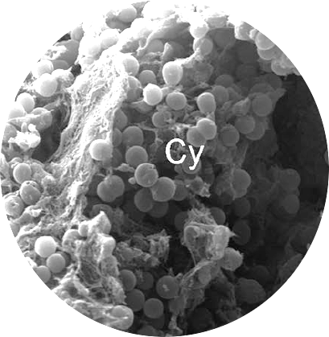
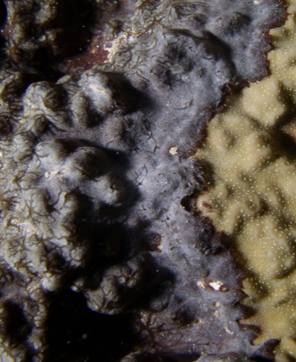
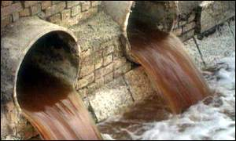
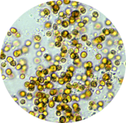
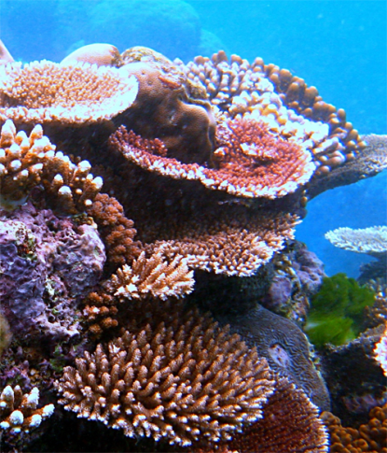
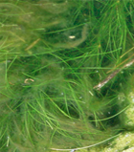
Is there a link between the SPONGE INVASION and CLIMATE CHANGE EFFECTS ?
CLIMATE CHANGE
OTHER ANTHROPOGENIC IMPACTS
sponge
complex ecological interactions
beneficial ?
beneficial ?
detrimental ?
detrimental ?
coral
cyanobacteria
Carsten Thoms – slide 13/21

Slide 14
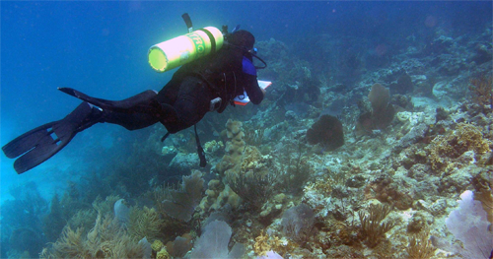
How to unravel this immense COMPLEXITY?
Carsten Thoms – slide 14/21

Slide 15
Understanding patterns of species invasions and environmental parameters (potential invasion-drivers)
Coordinated monitoring of invasions (status quo + development / pathways)
across the Indonesian archipelago
Simultaneous “open eye/mind” observations of environmental parameters in a concerted approach
Central integration of data
Comparative data analysis (national + international) to recognize patterns
Development and experimental testing of hypotheses for links between invasions and environmental parameters (patterns)
Carsten Thoms – slide 15/21

Slide 16
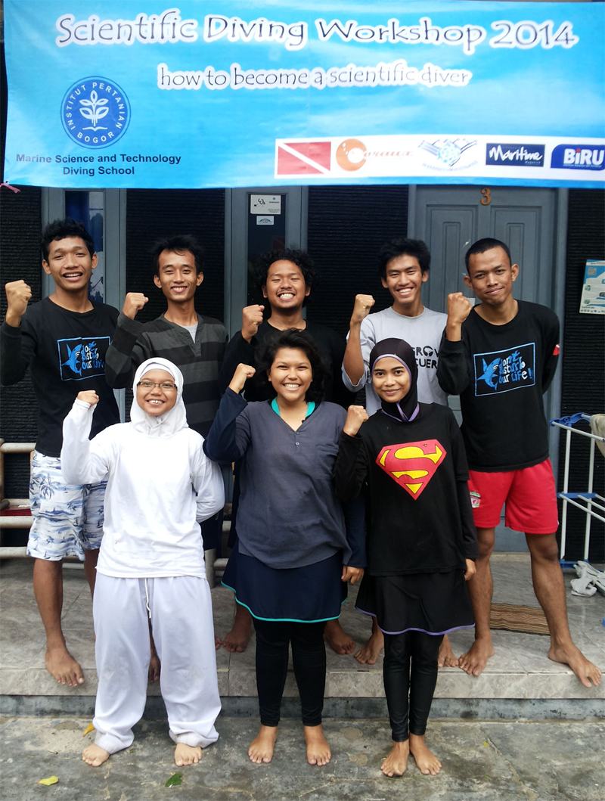
The importance of higher education networks…
Plethora of marine field experience / knowledge at Indonesian universities
(through numerous student practical trainings and field-based studies)
Many links to international research partners
Extensive “human resources” at early research career levels
the young researchers are the ones to do the actual lab + field work
have mobility for national + international collaborative projects
capacity-building and research networks have highest sustainability if built on young researchers
Carsten Thoms – slide 16/21

Slide 17
The importance of higher education networks…
BUT:
So far very scattered approaches (little coordination among universities or even between research groups in departments)
Local capacity-building and resources needed:
to raise research methodologies to an international quality level
for concerted research approaches and data integration
to build skills for data publication & presentation
to facilitate access to international scientific knowledge
Carsten Thoms – slide 17/21

Slide 18
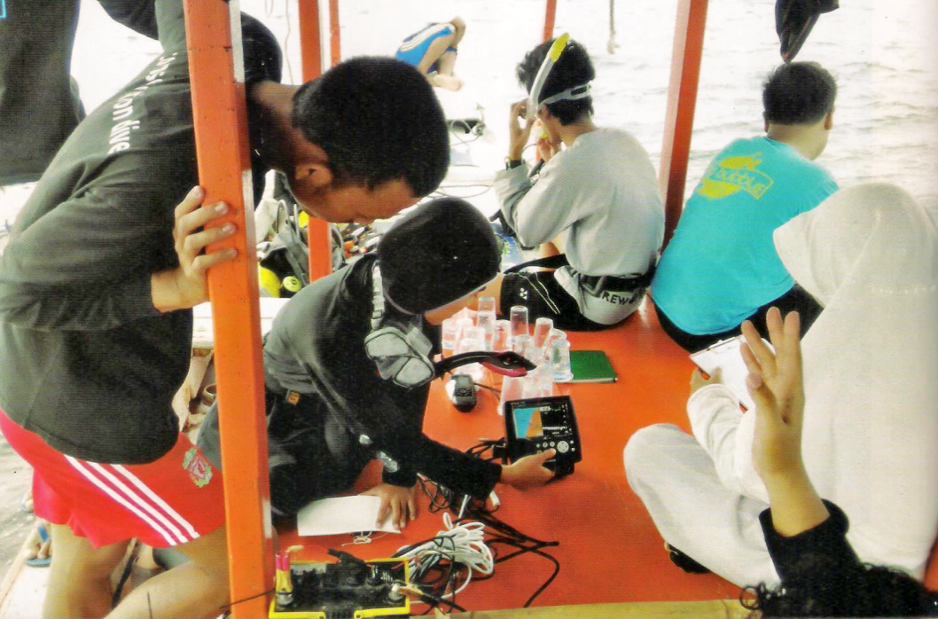
Marine Science Education Network (MarEduNet)
network of Marine Science Faculties at Indonesian Universities
coordinated by the Bogor Agricultural University (IPB)
aim: concerted research projects by young researchers from universities across Indonesia (centrally coordinated at IPB)
Joint methodology development and research preparation/training at IPB
Student tandem teams conduct field studies at locations all over Indonesia
Joint data analysis centrally at IPB
Joint publication of data
Career training for participants (e.g. presentation & writing skills)
Carsten Thoms – slide 18/21

Slide 19
EMBRIO
Enhancing Marine Biodiversity Research in IndOnesia
a program very recently initiated by the IPB Rectorate to:
increase (international) visibility of Indonesian Marine Biodiversity Research
promote dialogue in Marine Biodiversity Research on a national and international level
instigate coordinated / concerted research projects targeted on “Understanding, Protecting/Rehabilitating & Sustainable Use of Indonesian Marine Biodiversity”
Carsten Thoms – slide 19/21

Slide 20
Proposed strategy to tackle the complexity of possible links between climate change effects and species invasions:
make use of existing university networks
conduct centrally coordinated studies concerted across the Indonesian archipelago
draw on the vast “young human resources” capacities of Indonesian universities
Carsten Thoms – slide 20/21

Slide 21
Acknowledgements
Bogor Agricultural University (IPB)

