Slide 1
Impact chains of climate change in coastal regions for ecosystem-based adaptation
Coastal hazards and climate change impacts on coastal ecosystem services , Febraury 19th 2014, Jakarta, Indonesia
Presented by Giacomo Fedele, Study by Emilia Pramova, Florie Chazarin, Fitri Hasibuan and Bruno Locatelli
Notes:
Layout: Title Slide
Variation: none

Slide 2
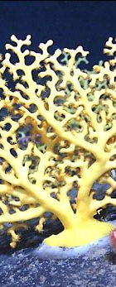
Background
Climate change already evident in coastal areas
  - will continue to have drastic effects in these regions
Coastal ecosystems are very vulnerable, as well as coastal communities
Notes:
(Deep-sea coral photos courtesy "Mountains in the Sea" scientific party, NOAA, and the Institute for Exploration - http://www.whoi.edu/oceanus)

Slide 3
Impact Chains
How a given climate stimulus spreads through a system via direct and indirect impacts.
Stressors
Services
Humans
Ecosystems
AFFECT
MANAGE
BENEFIT
PRODUCE
Notes:
Layout: Content with Portrait Picture
Variation: none

Slide 4
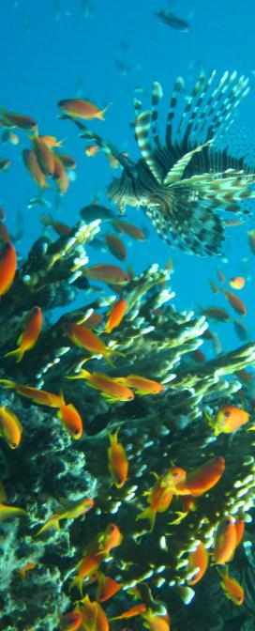
What do we know about climate change impact chains in coastal areas?
Notes:
Layout: Title and Content 2
Variation: none

Slide 5
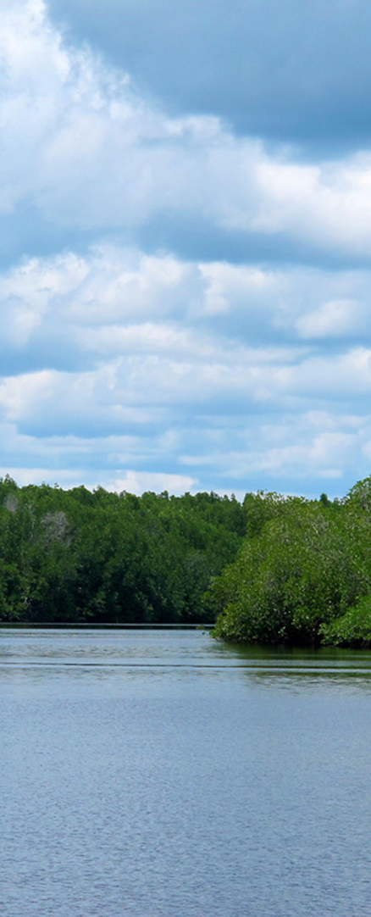
ICCA – Impact Chains in Coastal Areas
Purpose of the study:
global literature review – 289 articles
Main Objective:
Understand and delineate the current and potential impacts and related feedback loops from climate variability, extreme, and change in mangrove and coral socio-ecological systems.

Slide 6
Stressors
Services
Humans
Ecosystems

Slide 7
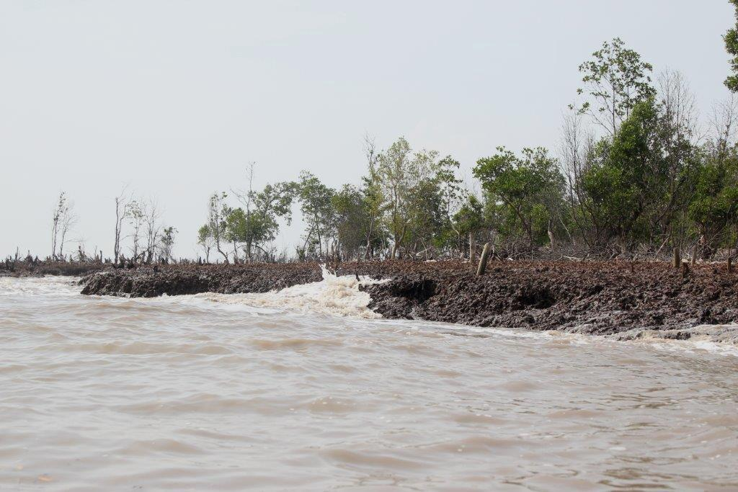
Tropical Storms
Notes:
Photo credit: Vien Ngoc Nam/Nong Lam Univerity

Slide 8
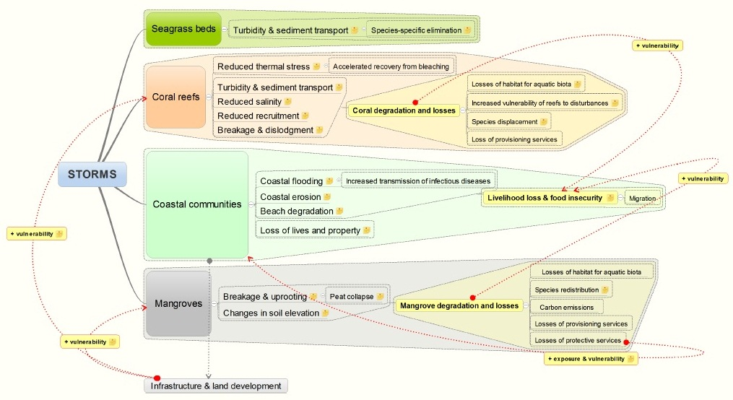
Notes:
Layout: Title and Content 2 Columns All Bullet
Variation: none

Slide 9
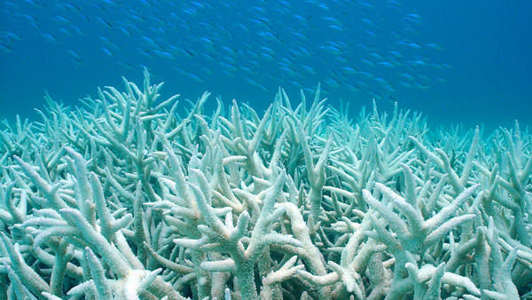
Sea-Level Rise
Notes:
Photo credit: Consortium for Ocean Leadership (http://www.oceanleadership.org/2010)

Slide 10
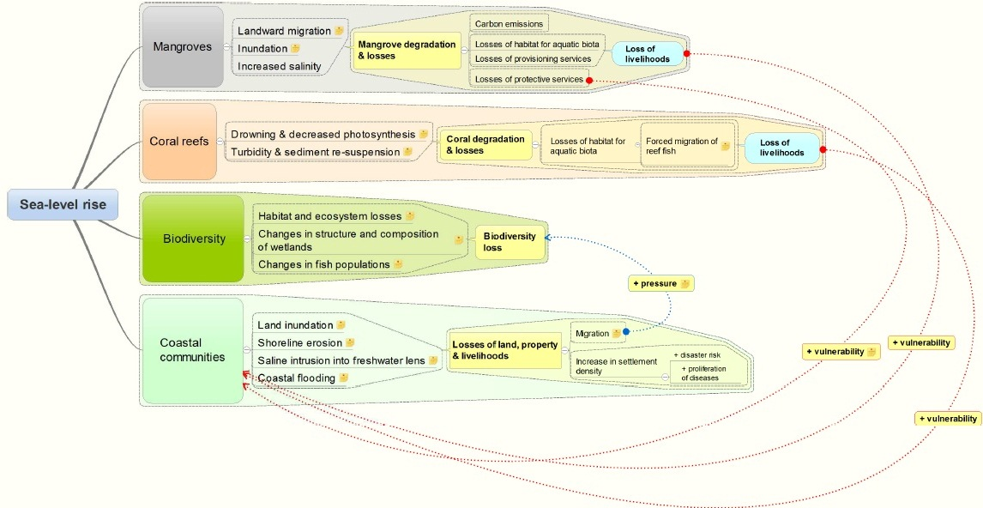
Notes:
Layout: Title and Content 2 Columns All Bullet
Variation: none

Slide 11


Global regulating service (carbon)
Global CC mitigation
More evidence
Forests and trees
Provisioning services
Local and regional regulating services
1. Products
Local adaptation to CC
2. Agriculture
3. Watersheds
Meso-level adaptation to CC
4. Coasts
5. Cities
(see Pramova et al., 2012. Forests and trees for social adaptation to climate variability and change. WIREs Climate Change 3:581–596)
More knowledge gaps and controversies
6. Regional climate
Regional adaptation to CC
Notes:
(Note: the WIREs CC paper does not include the 6th story, as there was no paper on the effects of forests on regional climate with a CC adaptation perspective)

Slide 12
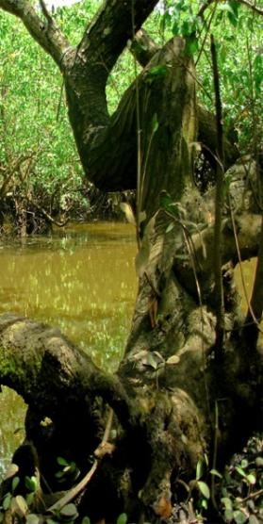
4. Coasts
Coastal forests
  Absorb and dissipate wave energy and stabilize coastal land
  Protection from tropical storms, sea level rise, floods and coastal erosion
Examples:
  India (Orissa): Cyclone protection. Villages behind mangroves suffered less losses of life, property and crops during 1999 cyclone (Badola & Hussain, 2005)
  Vietnam: Reducing dyke maintenance costs. Benefits of $70–130 per ha/year (Das & Vincent, 2009; Tri et al., 1998)
Issues
  What level of protection from extremes?
Notes:
In Vietnam, economic valuations showed that planting mangroves on the seaward side of sea dykes reduced the costs of maintaining these defenses, as mangroves dissipate
destructive wave energy, stabilise the sea floor and its slope, and trap sediment.The annual benefits of mangrove restoration for dyke protection were estimated to be $70–130 per ha/year

Slide 13
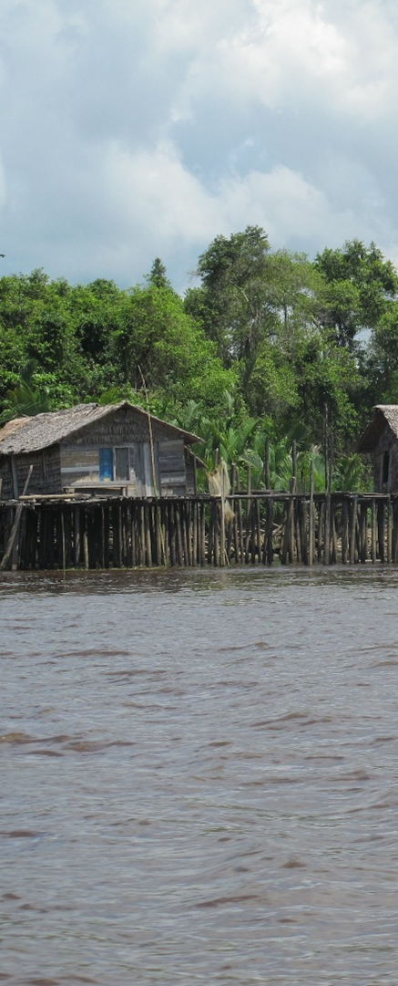
Key Messages and Further Research
Knowledge gaps on human/socio-ecological systems
Need to understand better the combined effects between systems.
Need for usable/accessible knowledge at all levels
Need to link disciplines together for a broader understanding
Need to explore ecosystem-based adaptation potential.
Notes:
Layout: Title and Content 2 Columns All Bullet
Variation: none

Slide 14
Thank you!
Notes:
Layout: Closing Slide
Variation: none

